Slide 1
O.C.G.A. Title 12 Chapter 7
The Georgia erosion & Sedimentation Act of 1975
Level II: Introduction to Design
Effective August 2018
Notes:
O.C.G.A. – Official Code of Georgia Annotated
Title 12 – Conservation & Natural Resources
Chapter 7 – Control of Soil Erosion & Sedimentation

Slide 2
Overview
Key Definitions – Slide 7
LIA Requirements – Slide 13
Permitting Process – Slide 19
Enforcement – Slide 25
Exemptions – Slide 33
Education & Training – Slide 46

Slide 3
Key Points
Erosion in Georgia is the result of several activities including construction, agriculture, forestry, etc.… that convert land from one use to another
Land disturbing activities are governed on the federal, state, and local level
GESA is the State Law that may be incorporated into a local ordinance and enforced by a county or municipality
Sometimes referred to as the “E&S Act”

Slide 4
History of GESA
On April 24th, 1975, the Honorable George Busbee, Governor of the State of Georgia, signed into law as Act 599, the Erosion & Sedimentation Act of 1975 (O.C.G.A. 12-7-1 et. seq.)
With the passage of the E&S Act, Georgia joined very few states that had adopted legislation specifically designed to protect soil and water resources

Slide 5
Intent of GESA
To strengthen and extend the present erosion and sediment control activities and programs of this state
To provide for the establishment and implementation of a state-wide comprehensive soil erosion and sediment control program
To conserve and protect the land, water, air, and other resources of the state
O.C.G.A 12-7-2

Slide 6
Participating Agencies
Local Issuing Authorities (LIA)
Soil & Water Conservation Districts (SWCD)
Georgia Soil & Water Conservation Commission (GSWCC)
Georgia Environment Protection Division (GA EPD)
Natural Resources Conservation Service (NRCS)
Contact information for each agency can be found in the
“Resource Information” section

Slide 7
Key Definitions
O.C.G.A. 12-7-3
*A complete listing of all Definitions can be found in the
“Resource Information” section

Slide 8
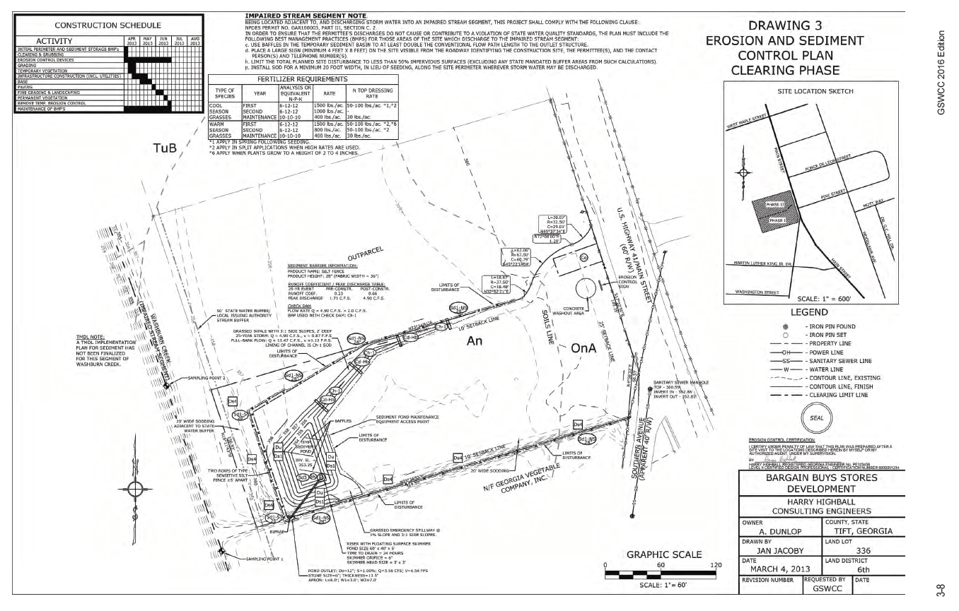
“Plan”
An “Erosion & Sediment Control Plan” is a plan for the control of soil erosion and sediment resulting from a land-disturbing activity
O.C.G.A. 12-7-3(8)

Slide 9
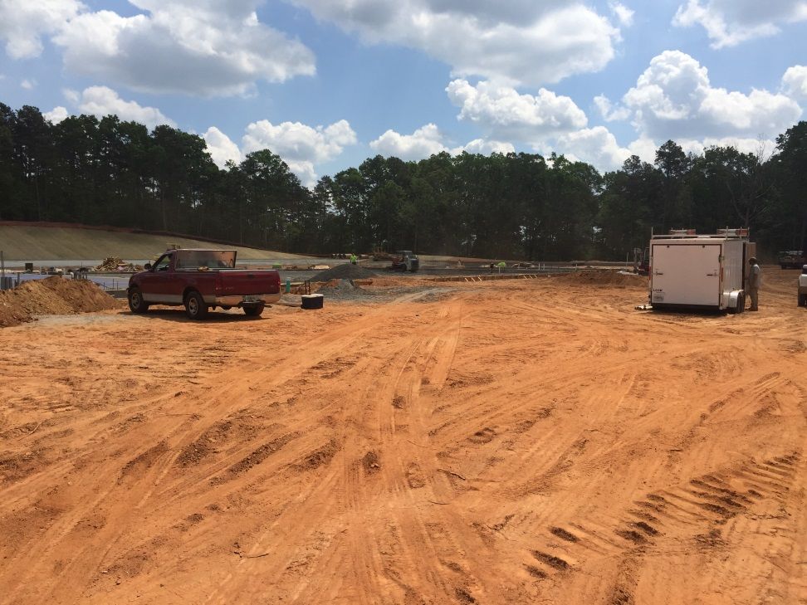
“Land-Disturbing Activity”
Any activity which may result in soil erosion from water or wind and the movement of sediments into state water or onto lands within the state, including, but not limited to:
Clearing
Dredging
Grading
Excavating
Transporting
Filling of land
O.C.G.A. 12-7-3(9)

Slide 10
“Local Issuing Authority”
The governing authority of any county or municipality which is certified pursuant to subsection (a) of Code Section 12-7-8 (Certified by GA EPD)
Please refer to the “Resource Information” in the back of this section for a complete listing of all Local Issuing Authorities in the State of Georgia
O.C.G.A. 12-7-3(10)

Slide 11
“Manual”
The “Manual for Erosion & Sediment Control in Georgia” is the published guidance of the GSWCC governing the design and practices to be utilized in the protection of this state’s natural resources from erosion and sedimentation which shall be based upon sound engineering principles and repeatable bench and field testing of structural and vegetative best management practices
O.C.G.A. 12-7-3(10.2)

Slide 12
Overview Council
Purpose
Approve the Manual for Erosion & Sediment Control in Georgia prior to publication by GSWCC
Provide guidance on the installation and maintenance of best management practices for the preparation of plans
Composed of 9 members
House of Representatives
Senate
GA DOT
GA EPD
State & Road Tollway Authority
Environmental Engineer
Highway Contracting Industry
Electric Utility Industry
Chairperson
O.C.G.A. 12-7-7.1(f)(1-2)

Slide 13
LIA Requirements & Responsibilities
O.C.G.A. 12-7-4
O.C.G.A. 12-7-7
O.C.G.A. 12-7-8

Slide 14
Local Ordinance
The EPD may certify a county or municipality as a Local Issuing Authority if the county or municipality enacts an ordinance which meets or exceeds the standards, requirements, and provisions of GESA and the State General Permit
Any land-disturbing activities by a Local Issuing Authority shall be subject to the same requirements of the ordinances such Local Issuing Authority adopted pursuant to this chapter as are applied to private persons, and the division shall enforce such requirements upon the Local Issuing Authority
O.C.G.A. 12-7-8(a)(3)

Slide 15
Local Ordinance
Cannot be more stringent for:
Monitoring
Reporting
Inspections
Design standards
Turbidity standards
Education & Training requirements
May be more stringent for:
Additional Buffers
Project size*
Other related ordinances such as:
Tree protection
Flood plain protection
Stormwater management
*Project size thresholds with regard to education and training requirements cannot exceed the state general permit
O.C.G.A. 12-7-4(a)
O.C.G.A. 12-7-8(a)(1)

Slide 16
Responsibilities of Certified LIA
Process applications
Forward ES&PC plans to SWCD for review
Issue permits
Maintain list of active permits
Conduct inspections
Enforce ordinance
Collect fees
Handle complaints
O.C.G.A. 12-7-7

Slide 17
Memorandum of Agreement (MOA)
When a certified LIA demonstrates the capability to review and approve ES&PC plans AND requests an agreement with the SWCD to conduct such review and approval,
The LIA enters into an agreement with the SWCD & GSWCC to conduct plan review “in-house”
Can result in a quicker turn around time
Please refer to the “Resource Information” for a complete listing of all LIA’s with a Memorandum of Agreement
O.C.G.A. 12-7-7(2)(e)
Notes:
Responsibilities of a LIA with MOA are the exact same

Slide 18
LIA Oversight
The SWCD and/or GSWCC shall review semi-annually the actions of certified LIA’s
LIA w/MOA are required to submit additional quarterly reports
The SWCD and/or GSWCC may provide technical assistance to any county or municipality to improve the effectiveness of their erosion and sedimentation control program
The GA EPD may periodically review the actions of certified LIA’s
O.C.G.A. 12-7-8(b)
Notes:
Quarterly reports are required per the MOA agreement

Slide 19
Permitting Process
O.C.G.A. 12-7-9

Slide 20
LDA Permit
All land disturbing activities, not exempt from GESA, must first secure a Land Disturbing Activity (LDA) Permit from the LIA (if applicable)
It is the responsibility of the property owner/operator to obtain the LDA Permit
*Local requirements can be more stringent
Notes:
*For example, a boat ramp on the Chattahoochee River in Fulton County that disturbs 0.25 acres – a stand alone project – is exempt from NPDES permits, but a LDA Permit from the County is required and a buffer variance from EPD is required

Slide 21
Plan Submittal
An application for a LDA permit shall be accompanied by an Erosion & Sedimentation Control Plan
The Plan shall contain a certification stating that the plan preparer or the designee thereof visited the site prior to the creation of the plan
In any event, permits shall be issued no later than 45 days after the application has been filed with the LIA
O.C.G.A. 12-7-9(a-c)

Slide 22
Plan Submittal
LIA w/o MOA
LIA w/ MOA
Owner/Operator
Submits application with Plan
LIA
Receives application with Plan
Forwards Plan for review within 10 days
SWCD
Technical review conducted by GSWCC or NRCS
Ratifies the Plan
35 days upon receipt per submittal to approve or deny
Owner/Operator
Submits application with Plan
LIA
Receives application with Plan
Approves or denies the Plan
45 days upon receipt to issue or deny permit application
Failure to act within timeframe constitutes an automatic approval
O.C.G.A. 12-7-10

Slide 23
Plan Submittal
No LIA
Owner/Operator
Submits single copy of the Plan to the GA EPD Watershed Protection Branch
Submits second copy to the corresponding GA EPD District office
GA EPD
GA EPD Watershed Protection Branch reviews the Plan for deficiencies and may provide comments
Enforcement conducted by GA EPD District office
EPD does not issue a LDA Permit

Slide 24
Plan Submittal
Project not regulated by a Local Issuing Authority
(GA DOT, GA Power, Poultry House, Public Drinking Reservoir)
Owner/Operator
Submits single copy of the Plan to the GA EPD Watershed Protection Branch
Submits second copy to the corresponding GA EPD District office
GA EPD
GA EPD Watershed Protection Branch reviews the Plan for deficiencies and may provide comments
Enforcement conducted by GA EPD District office
EPD does not issue a LDA Permit

Slide 25
Enforcement Options
O.C.G.A. 12-7-7
O.C.G.A. 12-7-11
O.C.G.A. 12-7-12
O.C.G.A. 12-7-15

Slide 26
Possible Actions
Notice of Violation
Issuance of Stop Work Order
Suspension of LDA Permit
Denial of future LDA Permit applications
Imposition of civil penalties
Forfeiture of bonding

Slide 27
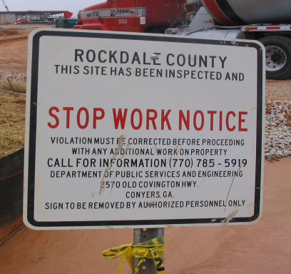
Notice of Violation
First & Second Violation
A written warning is issued to the permittee
The permittee shall have five (5) days to correct the violation
If the violation is not corrected within five (5) days, an immediate stop work shall be issued
Third Violation
An immediate stop work order shall be issued
O.C.G.A. 12-7-12(c)

Slide 28
Stop Work Order
Immediate Issuance
3rd violation
Imminent threat to public health
Land disturbance without a permit
Failure to maintain stream buffer
Significant amounts of sediment discharged into state waters
Where BMPs have not been properly designed, installed, and maintained
All Stop Work Orders
Effective immediately upon issuance
In effect until corrective action or mitigation has occurred
Apply to all land-disturbing activity on the site with the exception of the installation and maintenance of all erosion and sediment controls
Can be issued with a NOV
O.C.G.A. 12-7-12(d)

Slide 29
Suspension of LDA Permit
The LDA Permit may be suspended, revoked, or modified by the LIA if the permit holder is not in compliance with the approved Erosion & Sediment Control Plan or if there is any violation
O.C.G.A. 12-7-11(b)

Slide 30
Denial of Future LDA Permits
If a permit applicant has had two (2) or more violations of previous permits within three (3) years prior to the date of filing of the application under consideration, the Local Issuing Authority may deny the permit application.
O.C.G.A. 12-7-7(f)(1)

Slide 31
Civil Penalties
A maximum penalty of $2500 for each violation shall be imposed by the municipal or magistrate courts
Each day during which the violation or failure or refusal to comply continues shall be a separate violation
O.C.G.A. 12-7-15

Slide 32
Forfeiture of Bonding
The LIA may require the permit applicant to post a bond in the form of:
Government security
Cash
Irrevocable letter of credit
Combination thereof
Up to $3000/acre of the proposed land-disturbing activity
If the applicant doesn’t comply with permit, the bond may be forfeited and the proceeds may be used to hire a contractor to stabilize the site and bring it into compliance
O.C.G.A. 12-7-7(f)(2)
Notes:
Bonding is not a common enforcement tool, but it is very effective. It should be used more often by Local Issuing Authorites. This option prevents sites from being out of compliance for months to even years

Slide 33
Exemptions
O.C.G.A. 12-7-17

Slide 34
Surface Mining
"Surface mining" means any activity constituting all or part of a process for the removal of minerals, ores, and other solid matter for sale or for processing or for consumption in the regular operation of a business. Tunnels, shafts, borrow pits of less than 1.1 disturbed acres, and dimension stone quarries shall not be considered to be surface mining.
O.C.G.A. 12-7-17(1)
O.C.G.A. 12-4-72(15)
Notes:
Surface mining is defined in O.C.G.A. 12-4-72(15)

Slide 35
Granite Quarrying
Granite quarrying and the land clearing for such quarrying
O.C.G.A. 12-7-17(2)

Slide 36
Minor Land Disturbing Activities
Home gardens
Home landscaping
Repairs
Maintenance
Fences
Other related activities which result in minor soil erosion
N/A for activities that are located within the State-mandated Buffer on sites covered by the State General Permits
O.C.G.A. 12-7-17(3)

Slide 37
Single-Family Residences
When
Construction disturbs < one (1) acre
Not part of a larger common plan of development
ES&PC Plan & Buffer requirements still apply
Exempt from LDA Permit only
O.C.G.A. 12-7-17(4)

Slide 38
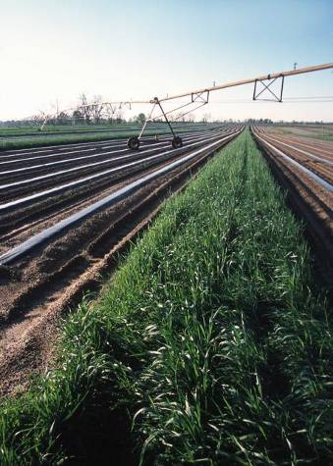
Agricultural Operations
Practices involving the establishment, cultivation, or harvesting of products of the field or orchard
Preparation and planting of pasture land
Farm ponds
Dairy operations
Livestock & Poultry management practices
Construction of farm buildings (Not exempt from NPDES)
O.C.G.A. 1-3-3
O.C.G.A. 12-7-17(5)
Notes:
Agriculture is defined in O.C.G.A. 1-3-3
Farm Buildings (i.e. Chicken Houses, etc..) are NOT exempt from NPDES permitting

Slide 39
Forestry Practices
Forestry land management practices, including harvesting
When such activities result in a buffer encroachment, a 3 year moratorium is placed on the entire property
Forestry Land Management Practices/Silvicultural Practices Exemption Guidelines – March 2010 (epd.georgia.gov)
O.C.G.A. 12-7-17(6)

Slide 40
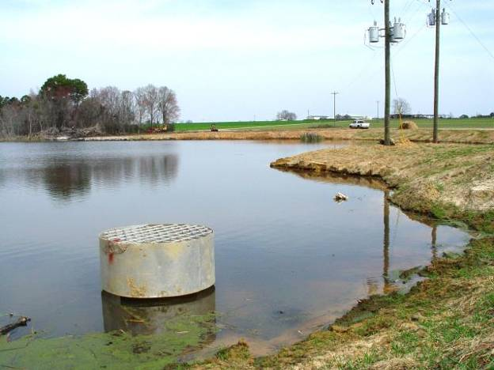
NRCS Projects
Projects carried out under the technical supervision of the USDA-NRCS
O.C.G.A. 12-7-17(7)

Slide 41
Projects < 1.0 Acre
Any project involving less than one (1) acre of disturbed area unless the land-disturbing activity is:
Within a larger common plan of development with a planned disturbance equal to or greater than 1.0 acre
Or within 200 ft. of the bank of any perennial stream
If a project, located in a area with no Certified LIA, is less than one (1) acre AND within 200 ft. of a perennial stream, no plan submittal is required but the buffer requirements would still be applicable
Check local requirements
O.C.G.A. 12-7-17(8)

Slide 42
Road Projects
Not exempt from NPDES
Any projects undertaken or financed by:
Department of Transportation
GA Highway Authority
State Road & Tollway Authority
Any road construction or maintenance project, or both, undertaken by any county or municipality
Not exempt if located within a larger common plan of development
Becomes secondary permittee; Enforced by LIA
O.C.G.A. 12-7-17(9)

Slide 43
Utility Projects
Not exempt from NPDES
Any land-disturbing activities conducted by:
Electric Membership Corporation
Municipal Electrical System
Public Utility under PSC jurisdiction (i.e. Solar Farms & Railroads)
Any utility under FERC jurisdiction
Cable television systems
Not exempt if located within a larger common plan of development
Becomes secondary permittee; Enforced by LIA
O.C.G.A. 12-7-17(9)
Notes:
PSC – Public Service Commission
FERC – Federal Energy Regulatory Commission

Slide 44
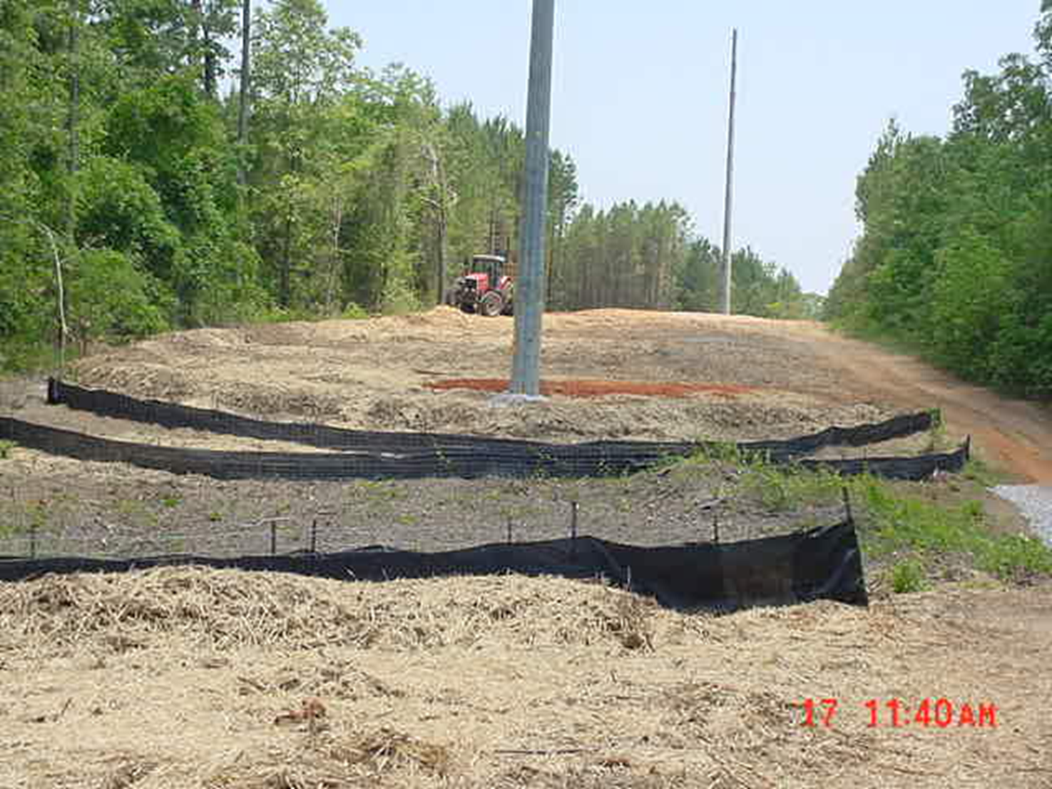
Utility Projects
Not exempt from NPDES

Slide 45
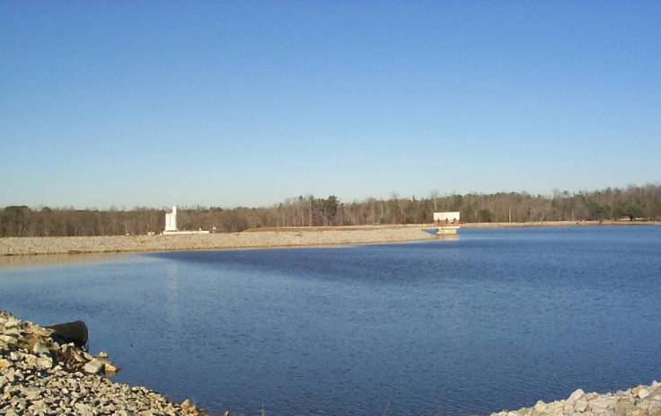
Public Water System Reservoirs
Not exempt from NPDES
O.C.G.A. 12-7-17(11)

Slide 46
Education & Training Requirements
O.C.G.A. 12-7-19

Slide 47
Who Must Be Certified?
Persons involved in land development design, review, permitting, construction, monitoring, or inspection or any land-disturbing activity shall meet the education and training certification requirements, dependent on his or her level of involvement with the process as developed by the Commission in consultation with the GA EPD and the Stakeholder Advisory Board
O.C.G.A. 12-7-19(a)(1)
Notes:
Regulatory authorities have to meet certification requirements as well as enforce certification requirements on site

Slide 48
Who Must Be Certified On Site?
Whenever land-disturbing activities are being conducted on site, each entity or person acting as either a primary, secondary, or tertiary permittee shall have as a minimum one (1) person who is responsible charge of erosion and sedimentation control activities
Persons or entities involved in projects not requiring a state general permit but otherwise requiring certified personnel on site may contract with certified persons
O.C.G.A. 12-7-19(a)(2-3)

Slide 49
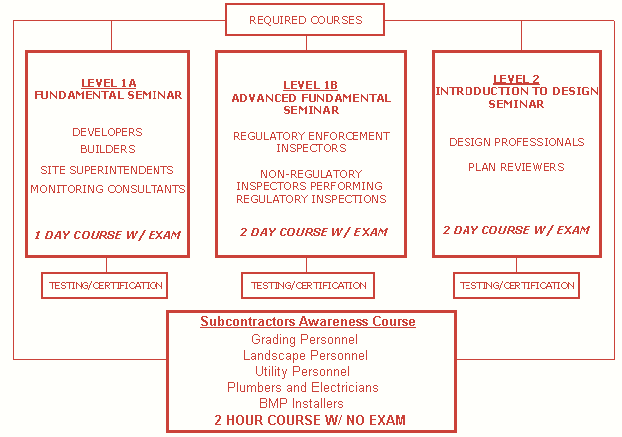
Courses
Notes:
Although not required, it is a good idea for elected officials to become aware of the minimum requirements

Slide 50
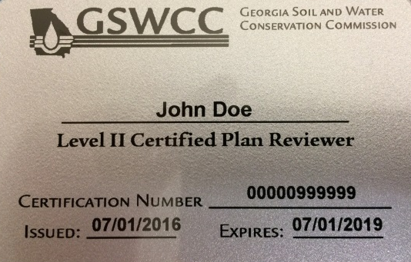
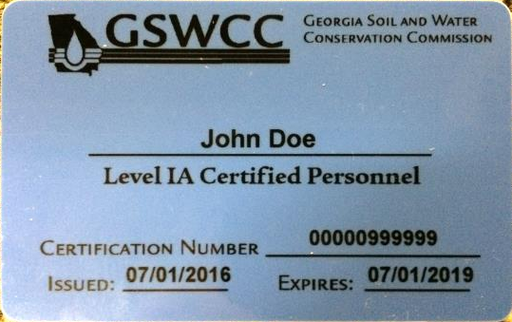
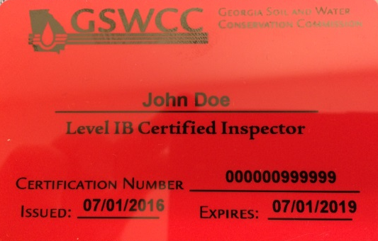
Certification Card Substitution

Slide 51
Subcontractor Awareness Seminar
Required for individuals involved in land disturbing activities that are working in a subcontractor capacity for a primary, secondary or tertiary permittee
Individuals working in a subcontractor capacity cannot be required to meet any educational requirements that exceed those of a Certified Subcontractor
Certified Subcontractor status DOES NOT certify an individual to perform the duties of a “certified” person/personnel
If an individual is performing “certified” duties, a Level 1A certification is required

Slide 52
Subcontractor Awareness Seminar
If an individual is working in a subcontractor capacity and possesses a Level 1A certification they are not required to take the Subcontractor Awareness Seminar
If an individual is working in a subcontractor capacity and has attended a Level 1A course, they are not required to take the Subcontractor Awareness Seminar. They can:
Complete a Subcontractor Awareness Application
Submit a Proof of Attendance form from the Level 1A course

Slide 53
Certification Cards
Cards are color coded by level of certification for quick reference in the field
Level 1A – Blue
Level 1B – Red
Level II Plan Reviewer – Gray
Level II Design Professional – Tan
Subcontractor Awareness – White
Regulatory inspectors should ask to see certification cards on-site

Slide 54
Certification Cards
Level 1A Blue Card
Name
Certification # is the same for all levels
All certifications are valid for 3 years

Slide 55
Re-Certification Requirements
A certification provided by achieving the requirements established by GSWCC shall expire no later than three (3) years after its issuance
A certified individual shall be required to attend and participate in at least four (4) hours of approved continuing education courses, as established by GSWCC, every three (3) years
Individuals may begin taking re-certification courses one (1) year before their initial certification expires
Courses taken before the 1 year mark will not count as credit
O.C.G.A. 12-7-19(e)(1-2)

Slide 56
Re-Certification Requirements
An individual who wishes to renew their certification shall attend four (4) hours of continuing education (CE) for each certification they wish to renew
Example
John Doe is a Certified Inspector & Certified Plan Reviewer
He must attend 4 hours of CE for Level 1B & 4 hours of CE for Level II
There is no exam for any re-certification course
Re-certification cards are mailed out two (2) weeks before expiration

Slide 57
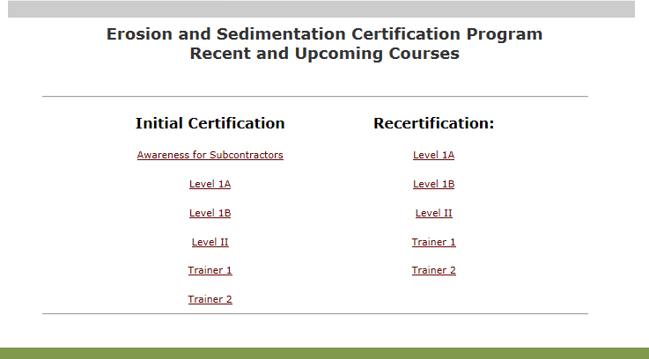
Course Listings
For additional information and a complete list of upcoming courses
http://www.gaswcc.org/esc-courses.php

Slide 58
Summary
GESA is the State Law that governs land-disturbing activities
All eligible activities must first secure a LDA permit
Counties and municipalities can become a LIA when certified by the GA EPD
One person from each entity shall meet the education and certification requirements dependent on their level of involvement

Slide 59
Questions?
GSWCC
Urban Program
4310 Lexington Road
Athens, GA 30605
(706) 552-4474

