Slide 1
Principles & Processes
Local Programs
Level 1B: Advanced Fundamentals
Effective August 2018

Slide 2
Overview
Purpose of the Local Program
Principles of the Local Program
Five key standards of an effective program
Processes of the Local Program
Ordinance Adoption & Implementation
Program Administration
Plan Preparation & Review
Inspection & Enforcement
Education & Training
Program Oversight

Slide 3
Purpose of the Local Program
The E&S Act of 1975 states that the governing authority of each county and municipality shall adopt a comprehensive ordinance establishing procedures governing land disturbing activities conducted within their boundaries
If counties and municipalities fail to adopt such an ordinance, then the State Board of Natural Resources will adopt rules governing land disturbing activities within those areas

Slide 4
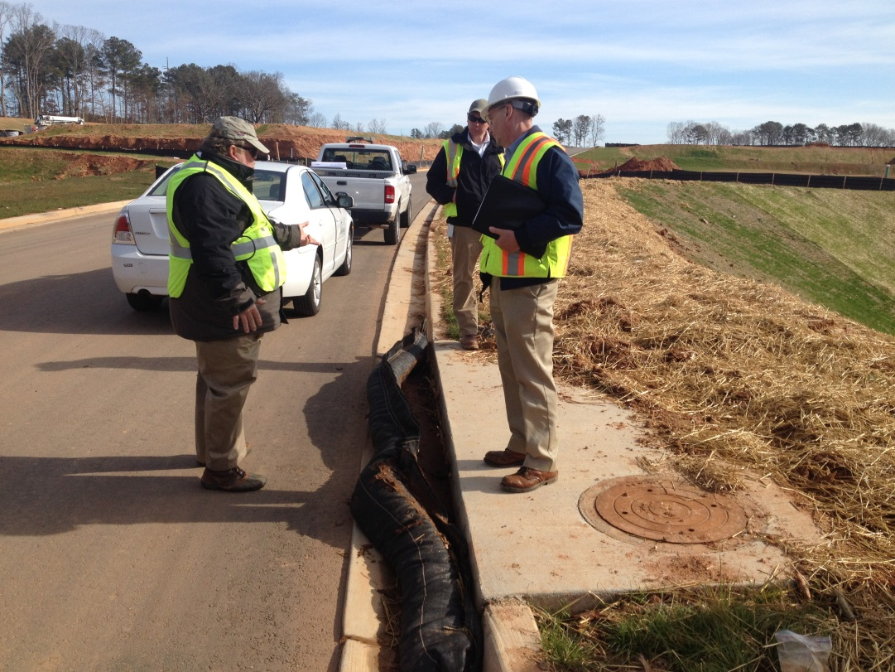
Intent of the Law
The emphasis of the law is truly on implementation of a Local erosion and sediment control programs
Local officials/employees have Local
Knowledge
Authority
Responsibility

Slide 5
5 Key Principles of an Effective Program
Stay Informed
Appropriate Certification
Be Knowledgeable
Plan Ahead
Evaluations
2016 Manual for Erosion & Sediment Control in Georgia
Chapter 4

Slide 6
#1 Stay Informed
Erosion & Sediment control should become a stated policy of all concerned, including:
Public agencies
Developers
Landowners
Consultants
Design Professional
Notes:
First, erosion and sediment control policy and procedures can not come from the top down and be effective. It should be the policy of the local government to control erosion and sedimentation within its boundaries. It should also be an accepted public policy by public and private agencies operating in and/ or having jurisdiction within the boundaries of the city or county. Developers, land owners, consultants, plan designers should also be aware of the necessity for sound erosion and sediment control programs.

Slide 7
#2 Appropriate Certification
The appropriate GSWCC certification of persons involved in land development design, review, permitting, construction, monitoring, or inspection of land-disturbing activity

Slide 8
#3 Be Knowledgeable
Competent technical personnel knowledgeable in local soil and climatic conditions, workable procedures, and inspections are necessary for successful erosion and sediment control
Notes:
A city or county cannot have an effective local program without competent personnel. The program must be staffed with individuals who have not only a technical knowledge of the issues but are also knowledgeable about local soil and climate conditions (and sometimes political!) and who understand the set procedures for exacting compliance with erosion and sediment control ordinances.

Slide 9
#4 Plan Ahead
To be effective, provisions for erosion and sediment control must be made in the planning stage. Practical combinations of the basic design principals contained in Chapter 2 of the Manual should be skillfully planned and applied in a timely manner
Notes:
To be effective, erosion and sediment control must be provided for in the planning phase of a development – early in the planning phase. Designers must use proper design principles when developing plans, and plan reviewers must accurately and fairly review the plan to ensure it meets standards.

Slide 10
#5 Evaluations
Research, observations, and evaluations should be conducted to provide needed information for improvement of the erosion and sediment control program
The SWCD and/or GSWCC are required by GESA to semi-annually review the erosion and sediment control programs for effectiveness of the cities and counties that have been certified as a LIA
Notes:
Finally to be effective, a local program must be periodically reviewed for effectiveness. This includes an internal review by program personnel as well as outside evaluation by agencies such a the GSWCC and EPD.

Slide 11
Processes of the Local Program
Ordinance Development and Implementation
Program Administration
Plan Preparation and Review
Inspection and Enforcement
Information, Education, and Training

Slide 12
Ordinance Development/Implementation
A model ordinance has been developed by the GSWCC and the GA EPD for use by officials in municipalities and counties
The model is intended primarily to provide guidelines for control of urban soil erosion and sediment pollution
It is designed to meet state requirements and comply with the NPDES permits
A copy is contained within Appendix D of the Manual and at www.gaswcc.georgia.gov

Slide 13
Ordinance Development/Implementation
A review of the final draft by the county or city attorney should be mandatory
A LIA must review and amend its ordinance within 12 months of any amendment to the E&S Act
The adoption of an ordinance should be considered as only the 1st step toward a sound soil erosion and sedimentation control program
It is essential that sufficient lead time be provided for education of the public and technical training of those involved directly

Slide 14
Written Procedures
Organizations need a set of written instructions that document an “organizational culture”
Why is this important?
Demonstrates that the program is being operated in an efficient manner
Provides program credibility
Allows the staff to understand their expectations
Provides quicker recovery in times of staff turnover
Helps to identify workplace inefficiencies

Slide 15
Record Keeping System
The record system should contain a detailed filing system for all land-disturbing activities
The file should contain
Permit application
Approved Plan
Inspection reports
Photographic evidence
Correspondence
Complaint info
Record of enforcement action

Slide 16
Trained Personnel
Regulatory Inspectors
Local program inspectors must be certified inspectors (Level 1B) within 6 months of their hire date
Should participate in continuing education courses and stay up to date on current regulations
Plan Reviewers (MOA)
Must possess a Level II certification to review plans on behalf of the Local Issuing Authority
Requires a minimum of 6 months work experience

Slide 17
Program Administration
Commonly seen problems
Staffing
If we had more people/time/support/resources
Policies & Procedures
This is the way we’ve always done it
This is how I think we do it
This is how my boss says to do it but I think…
Program Growth
We have a proactive program with excellent personnel, why would we need to change?

Slide 18
Plan Preparation and Review
All parties involved in the plan development and review process must realize without exception that there is more than one approach to minimizing erosion and sedimentation damages
Flexibility without compromising the primary objective must be encouraged to arrive at a common solution to the problem
Local officials should provide assistance to the developer and engineer prior to plan submission so that processing time can be more effective

Slide 19
Inter-departmental Cooperation
Many departments are either directly or indirectly involved with E&S activities
These include
Planning & Zoning
Engineering
Public Works
Code Enforcement
Different departments must be able to communicate and have clear responsibilities

Slide 20
Plan Processing
The owner, developer, or authorized agent submits the plan to the Local permit-Issuing Authority after completing an application for a permit
It is suggested that a minimum of 3 copies of the plan be submitted
A letter of transmittal containing the following should accompanying the plan:
Name, address, phone number of applicant, land owner, contractor, design professional
Location of the proposed activity
Any other relevant info

Slide 21
Plan Processing
It is suggested that the Local Issuing Authority delegate authority for receiving applications and processing permits to a qualified individual who is knowledgeable in the processing of site development plans
A minimum of 2 copies of the ES&PC Plan shall be forwarded as soon as possible to the local SWCD for review (see Local Ordinance for specifications on # of copies required)
Technical review is conducted by GSWCC or NRCS
The Local Issuing Authority issues or denies a permit
Any necessary modifications should be specified in writing

Slide 22
MOA Concurrence Process
A Memorandum of Agreement (MOA) is an agreement between the Local SWCD and a LIA, with concurrence from the GSWCC, to allow the LIA to conduct its own technical review and approval of ES&PC Plans
The initial request should be made by the LIA to their Local SWCD

Slide 23
MOA Concurrence Process
Overviews
The LIA will need to pass at least 2 consecutive overviews that occur at least 6 months apart
Co-Plan Review Period
During the 6 month Co-Plan Review Period, the LIA will receives the ES&PC Plan, review the Plan, and submit the Plan to the SWCD with their recommendation to approve or deny
GSWCC staff will conduct technical review and recommend the plan be approved/denied by the SWCD

Slide 24
MOA Concurrence Process
Once the process is completed, GSWCC Urban Program will determine, based on all documentation, whether the LIA has demonstrated their ability to conduct quality Plan review
Technical staff will forward their recommendation to the GSWCC Board to approve, deny, extend, or add restrictive language to the MOA
Copies of the agreement have to be signed and notarized by all parties

Slide 25
Inspection and Enforcement
These responsibilities begin after the issuance of a permit
A crucial element in any program is adequate field inspection for evaluating compliance to the approved E&S Plan
The inspector, regardless of background, should have some knowledge in the field of soil and water conservation and GSWCC Level 1B Certification
An inspection checklist should be used by the inspector to assist him or her in fulfilling his responsibilities

Slide 26
Inspection Process Issues
Commonly seen problems
Inspection frequency
Inconsistent approach to an inspection
“Drive-by” Inspection
Lack of documentation
Follow-up inspections
Reasonable ratio of sites to inspectors

Slide 27
Pre-construction Meeting
To assure that the enforcing agency and the permit applicant are in agreement about the control procedures, a pre-construction conference would be desirable
All facets of the proposed work should be discussed at this meeting and anticipated problems addressed
The need for installing initial sediment storage requirements and perimeter control BMPs prior to any actual clearing shall be emphasized
The contractor should be informed of the local inspection policies and schedules

Slide 28
Inspection Schedule
The institution of both random and scheduled inspections would be appropriate
A scheduled (once every 7 calendar days) inspection would be a routine inspection related directly to construction operations and carried out in a rigid format
Random or impromptu site inspections would assume continuing compliance and the proper maintenance of BMPs

Slide 29
Notice to Comply
In the event that an inspection indicates a violation, some type of system for notifying the permittee would be necessary
An effective system often utilized by authorities involves a written “Notice to Comply”
Enforcement orders should contain specific measures or corrections which need to be addressed and specify a timely deadline for completion

Slide 30
Complaint Investigation
A Local Issuing Authority must follow a Complaint Investigation Process
Investigation of the complaint by the Local Issuing Authority within 5 business days
Mechanism for referral of unresolved complaints to the EPD
Monthly log of complaints and inquiries including actions taken

Slide 31
Complaint Investigation
LIAs receive complaints from many sources including citizens,
EPD and the GSWCC
Local Issuing Authority
EPD Complaint Referral
Citizen Complaints
GSWCC Complaint Referral
Inter-Department Complaint Referral

Slide 32
Education & Training
One of the most important processes in any erosion and sediment control program is an effective information and education effort
A local program must have the support of the persons most affected…. the developers, engineers, planners, as well as the general public
Consideration should be given to training seminars, conferences, and educational material for the developer and his or her consultants or planners

Slide 33
Education & Training
Initial training programs for new employees is mandatory
Training seminars for Local Issuing Authority personnel who are authorized to perform inspections, enforcement, and administrative duties should be planned
Assistance in planning and conducting local training programs may be obtained through the local Soil & Water Conservation District

Slide 34
Program Oversight
Internal Evaluation
State Oversight

Slide 35
Internal Program Evaluation
Overall program should be systematically reviewed on periodic basis
Are policies current and reflective of current regulations?
Do written procedures need to be changed?
Are inspections being done regularly and consistently?
Where is there room for improvement?

Slide 36
Semi-Annual Reports
GSWCC is required by law to conduct overviews semi-annually
LIAs are required to complete and submit the Semi – Annual Report to GSWCC (Jan and July)
GSWCC review of the report will determine if a more in depth overview is required

Slide 37
Local Program Overview
Purpose
To provide administrative and technical assistance in an effort to improve the effectiveness of local programs
Local program overviews are performed by a District Assessment Team (DAT) that includes the:
GA Soil and Water Conservation Commission
Local Soil and Water Conservation District
Natural Resources Conservation Service
May include EPD representatives

Slide 38
Overview
The overview process begins with a letter from the GASWCC and/or Local SWCD scheduling an overview.
The LIA will receive a questionnaire that must be filled out prior to the day of the overview.
The DAT will conduct an office visit that consists of a review of the questionnaire and evaluates the program’s administration and recordkeeping.
Randomly chosen sites are visited to compare the inspection and enforcement record with site conditions.

Slide 39
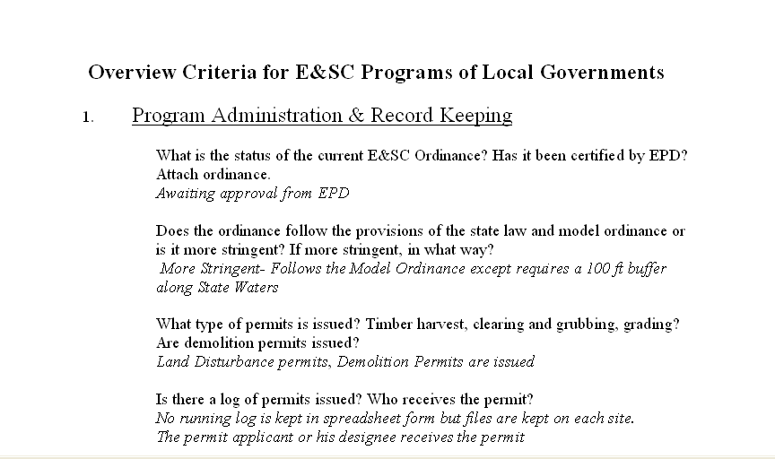
Overview Questionnaire

Slide 40
Overview Report
Outline of findings
Notes strong points and deficiencies
Recommendations for improvement
Rating
Exceptional
Passing
Needs Plan for Improvement
Failed-Notify EPD

Slide 41
EPD Oversight
Purpose
Ensure LIAs are properly implementing the requirements of the E&S Act
Review of Certification Status
May be done in response to notification by SWCD and/or GSWWC to investigate an ineffective local program
LIA must submit documentation showing continued compliance and a plan for improvement

Slide 42
De-certification Process
The EPD may initiate the de-certification process based on a request by the local SWCD, GSWCC, or EPD if:
LIA’s ordinance is not up to date
Inadequate inspection personnel
Inadequate recordkeeping
Failure to utilize the Complaint Investigation Process
The EPD investigates and notifies the LIA within 60 days of perceived deficiencies
Notes:
EPD decertification is a lengthy process. The process may start due to EPD observations or on a recommendation by the local Soil and Water Conservation District or the Conservation Commission.

Slide 43
De-certification Process
The LIA must respond within 30 days in one of the following ways:
Acknowledge the deficiencies and agree to comply
Offer explanation and solution with deadline for compliance within 90 days
Disagree with the deficiencies and request mediation
If the LIA does not take corrective action within 90 days, the EPD shall revoke the certification of the Local Issuing Authority

Slide 44
Summary
Effectiveness of a local program depends on the adoption of credible procedures and implementation of those procedures
Inspections should be conducted by individuals with proven experience
Recordkeeping is vital to a program’s success
A periodic internal review is necessary for a program’s success
SWCD, GSWCC, EPD may perform periodic overviews of the local program

Slide 45
Questions?
GSWCC
Urban Program
4310 Lexington Road
Athens, GA 30605
(706) 552-4474

