Slide 1
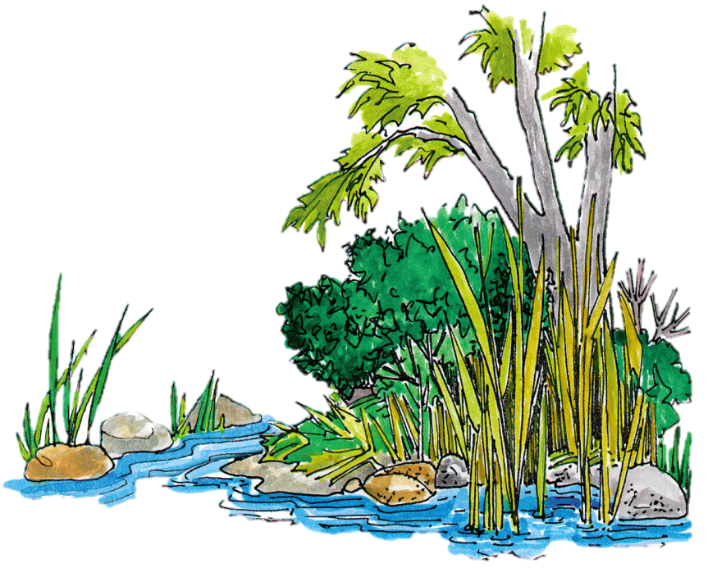

Buffers, Permits, Variances
STATE WATERS
Level 1B Recertification
Effective August 2018

Slide 2
Overview
State Waters – Slide 3
Definition – Slide 4
Steps to Determine State Waters – Slide 29
Buffer Variances & Exemptions – Slide 36
Coastal Marshlands – Slide 49
Definition – Slide 50
Steps to Determine Coastal Marshlands – Slide 51
Waters of the U.S. – Slide 60
Definition – Slide 61
Wetlands – Slide 76

Slide 3
State Waters
State Level

Slide 4
Definition
Per O.C.G.A. 12-7-3(16)
  “State waters” includes any and all rivers, streams, creeks, branches, lakes, reservoirs, ponds, drainage systems, springs, wells, and other bodies of surface or subsurface water, natural or artificial, lying within or forming a part of the boundaries of the state, which are not entirely confined and retained completely upon the property of a single individual, partnership, or corporation.

Slide 5

Agency Roles
GA Environmental Protection Division
  Reviews buffer variance applications
  Issues buffer variances for state-mandated buffers
  State waters determinations (where there is no certified LIA)
Local Issuing Authority
  Can incorporate additional stream buffers (more stringent than state buffers)
  Can issue variances for their own buffers
  State water determinations

Slide 6
Who Determines State Waters?
For projects regulated by a certified Local Issuing Authority (LIA), the LIA is responsible for determining State Waters
For projects that are exempt from local Erosion & Sediment Control Ordinances and not regulated by a LIA, the GA EPD is responsible for determining State Waters
The Buffer Variance application must include a letter from the LIA, stating that the LIA has visited the site and determined the presence of State Waters that require a buffer

Slide 7
Important Terms - Buffer
The State-mandated buffer requirements apply to State Waters that have wrested vegetation by normal stream flow
Buffer (Per O.C.G.A. 12-7-3(2))
  “The area of land immediately adjacent to the banks of State Waters in its natural state of vegetation, which facilitates, when properly vegetated, the protection of water quality and aquatic habitat.”
The State-mandated stream buffers are measured horizontally from the point where vegetation has been wrested by “normal stream flow” or “wave action”

Slide 8
Important Terms – Wrested Vegetation
The State mandated buffer requirements apply to State Waters that have wrested vegetation by normal stream flow
Wrested vegetation = movement of water that removes soil, debris, and vegetation, creating a clear demarcation between water flow and vegetative growth

Slide 9
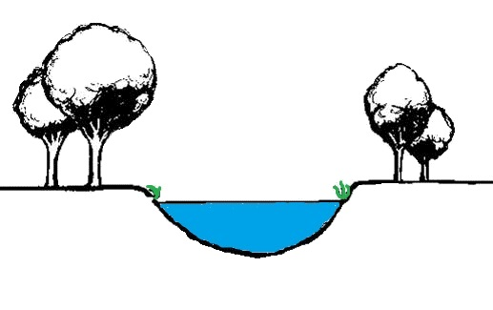
Wrested Vegetation
Buffer
Buffer
Wrested Vegetation
Wrested Vegetation

Slide 10
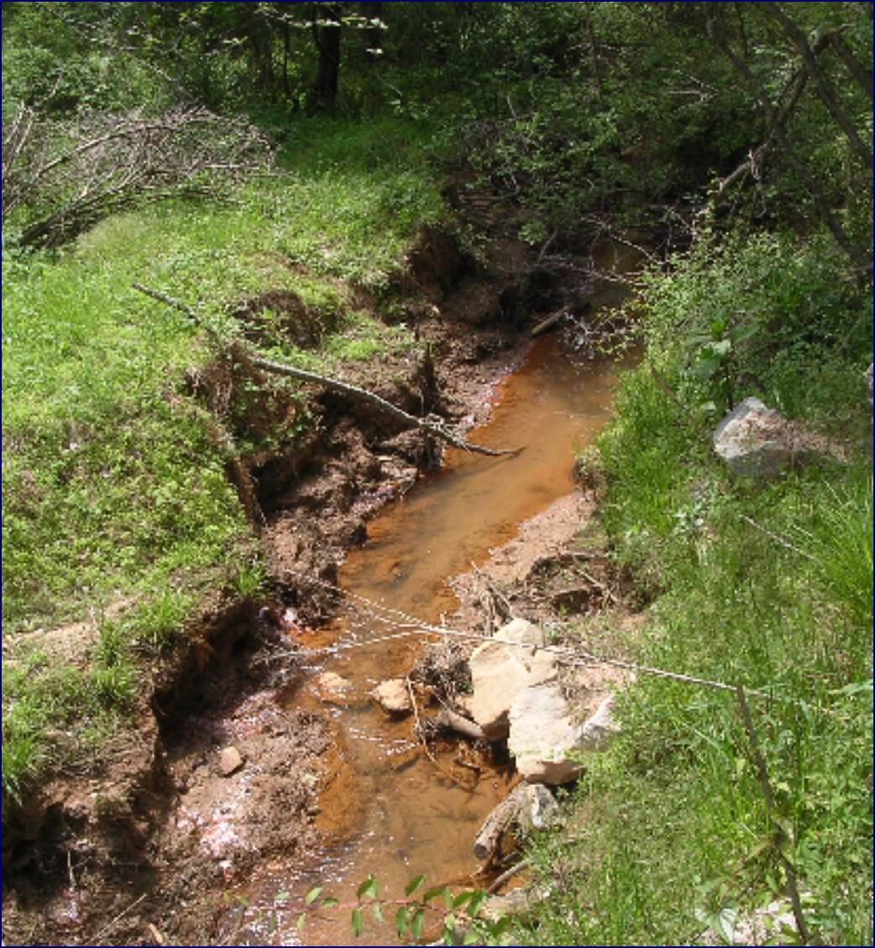
Wrested Vegetation
Wrested
Vegetation

Slide 11
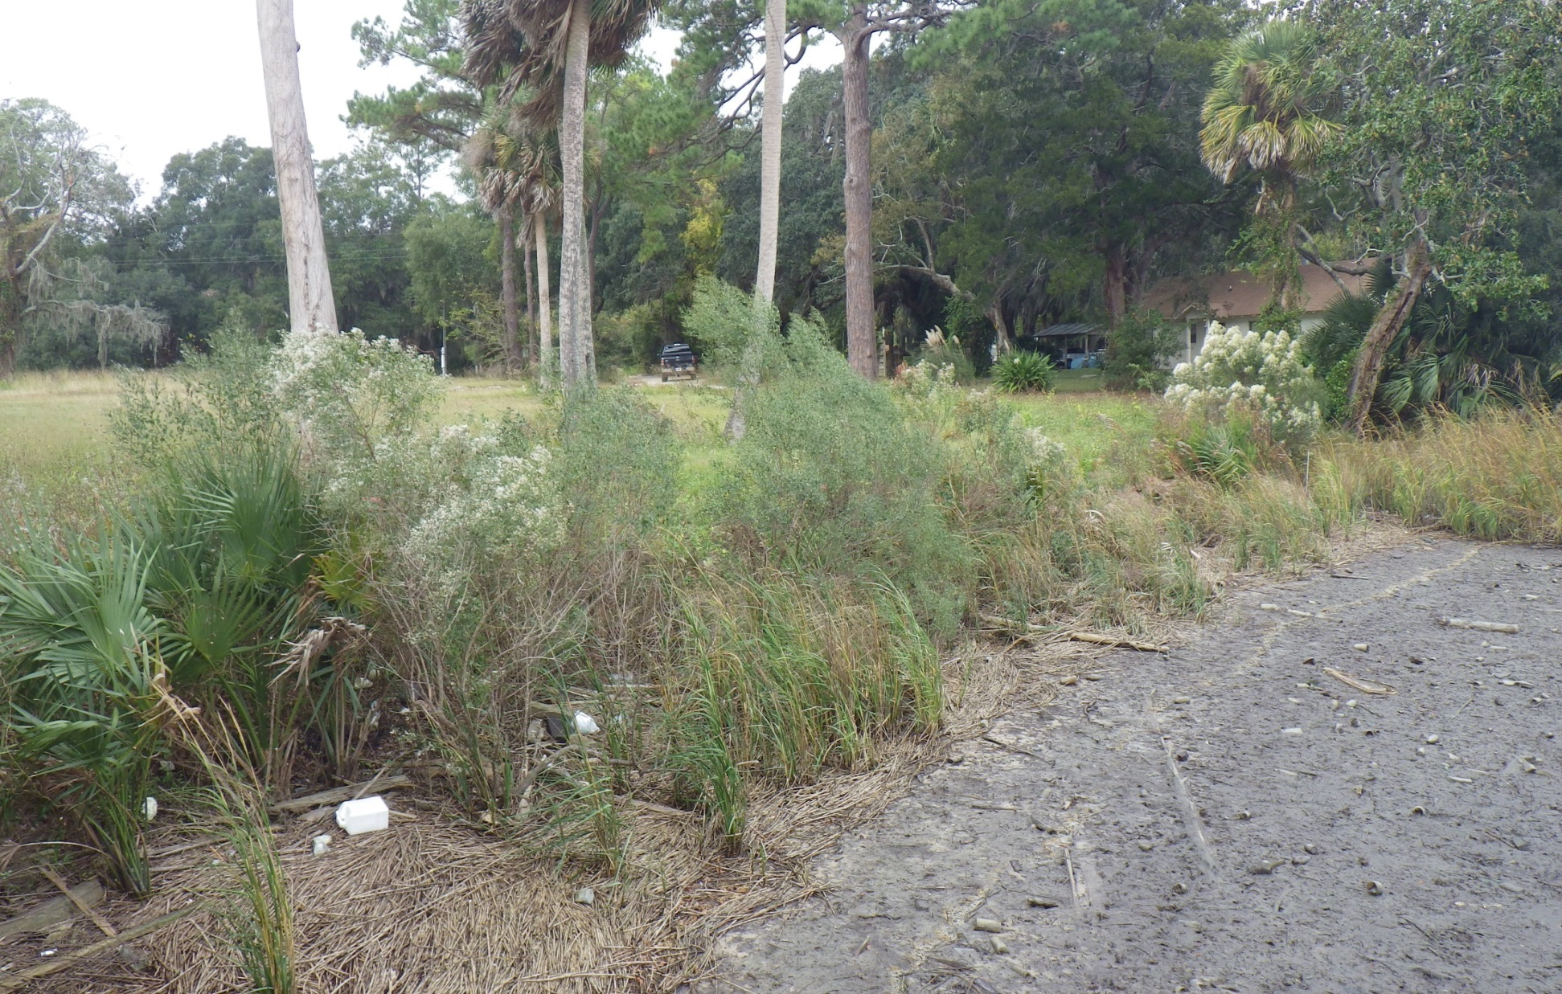
Wrested or Not Wrested Vegetation?
…movement of water by normal stream flow or wave action that removes soil, debris, and vegetation, creating a clear demarcation between water flow and vegetative growth…
Wrested
Notes:
“Enter/Advance” to reveal answer

Slide 12
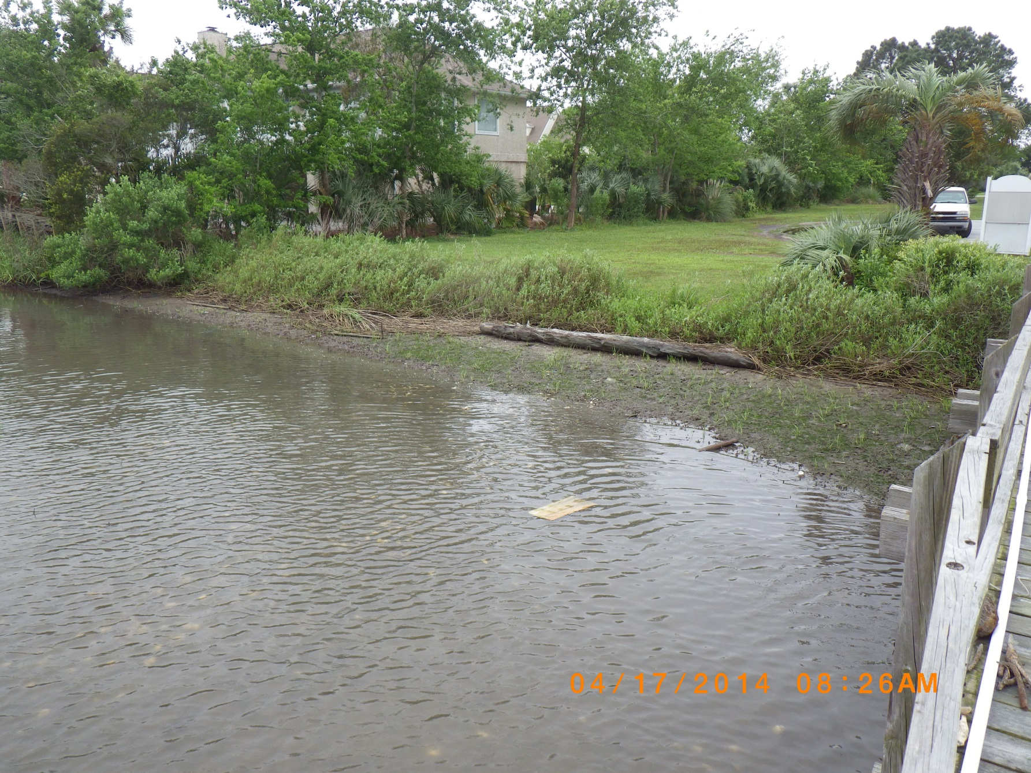
Wrested or Not Wrested Vegetation?
…movement of water by normal stream flow or wave action that removes soil, debris, and vegetation, creating a clear demarcation between water flow and vegetative growth…
Wrested
Notes:
“Enter/Advance” to reveal answer

Slide 13
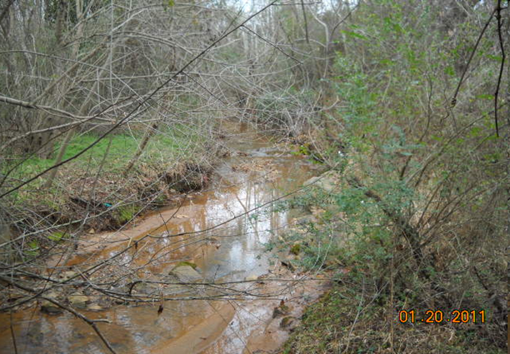
Wrested or Not Wrested Vegetation?
…movement of water by normal stream flow or wave action that removes soil, debris, and vegetation, creating a clear demarcation between water flow and vegetative growth…
Wrested
Notes:
“Enter/Advance” to reveal answer

Slide 14
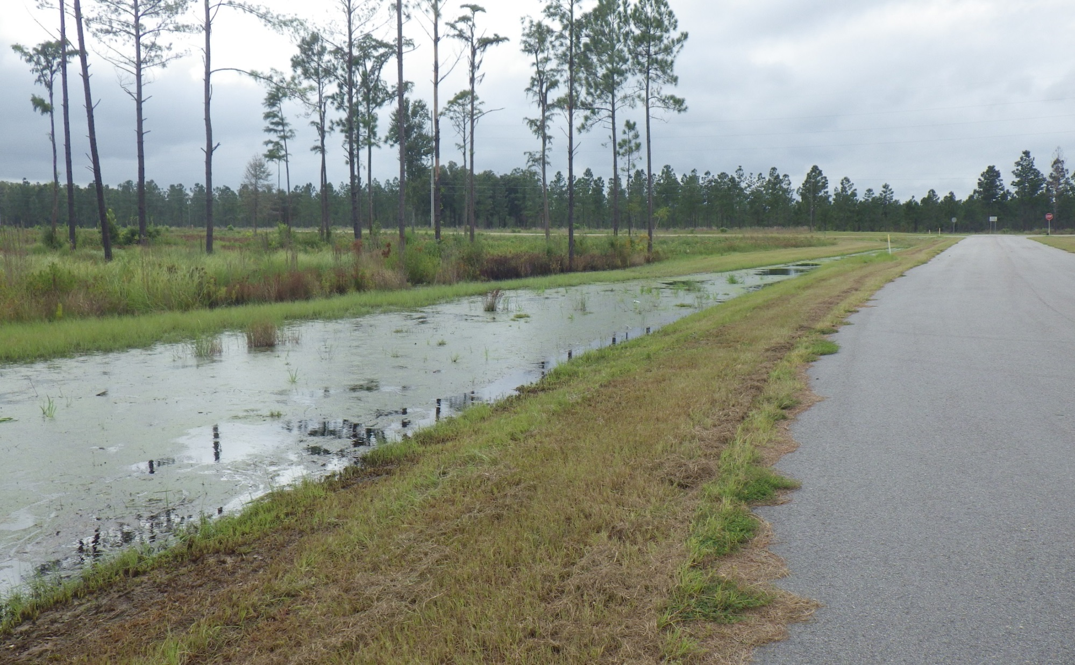
Wrested or Not Wrested Vegetation?
…movement of water by normal stream flow or wave action that removes soil, debris, and vegetation, creating a clear demarcation between water flow and vegetative growth…
Not Wrested
The absence of wrested vegetation can be due to completely vegetated banks and/or
bottoms (excluding aquatic vegetation), rip rap or a solid bulkhead, seawall, or retaining wall.
Notes:
“Enter/Advance” to reveal answer

Slide 15
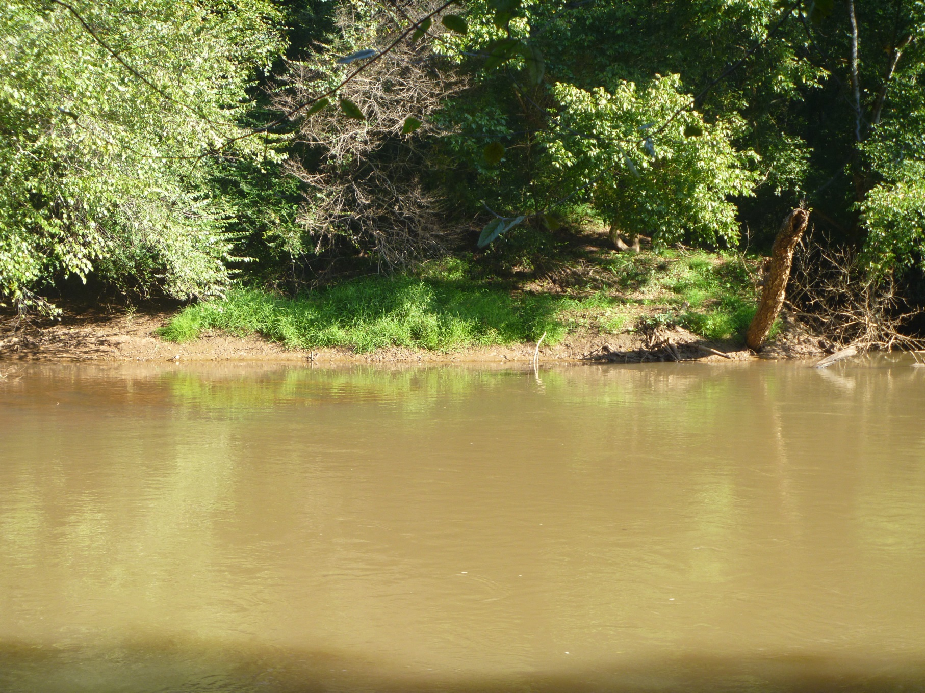
Wrested or Not Wrested Vegetation?
…movement of water by normal stream flow or wave action that removes soil, debris, and vegetation, creating a clear demarcation between water flow and vegetative growth…
Wrested
Notes:
“Enter/Advance” to reveal answer

Slide 16
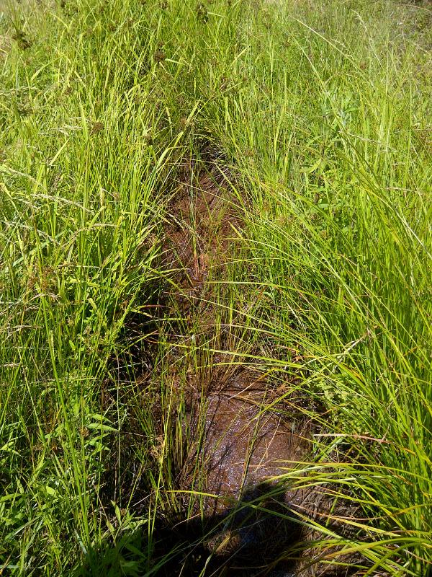
Wrested or Not Wrested Vegetation?
…movement of water by normal stream flow or wave action that removes soil, debris, and vegetation, creating a clear demarcation between water flow and vegetative growth…
The absence of wrested vegetation can be due to completely vegetated banks and/or
bottoms (excluding aquatic vegetation), rip rap or a solid bulkhead, seawall, or retaining wall.
Not Wrested
Notes:
“Enter/Advance” to reveal answer

Slide 17
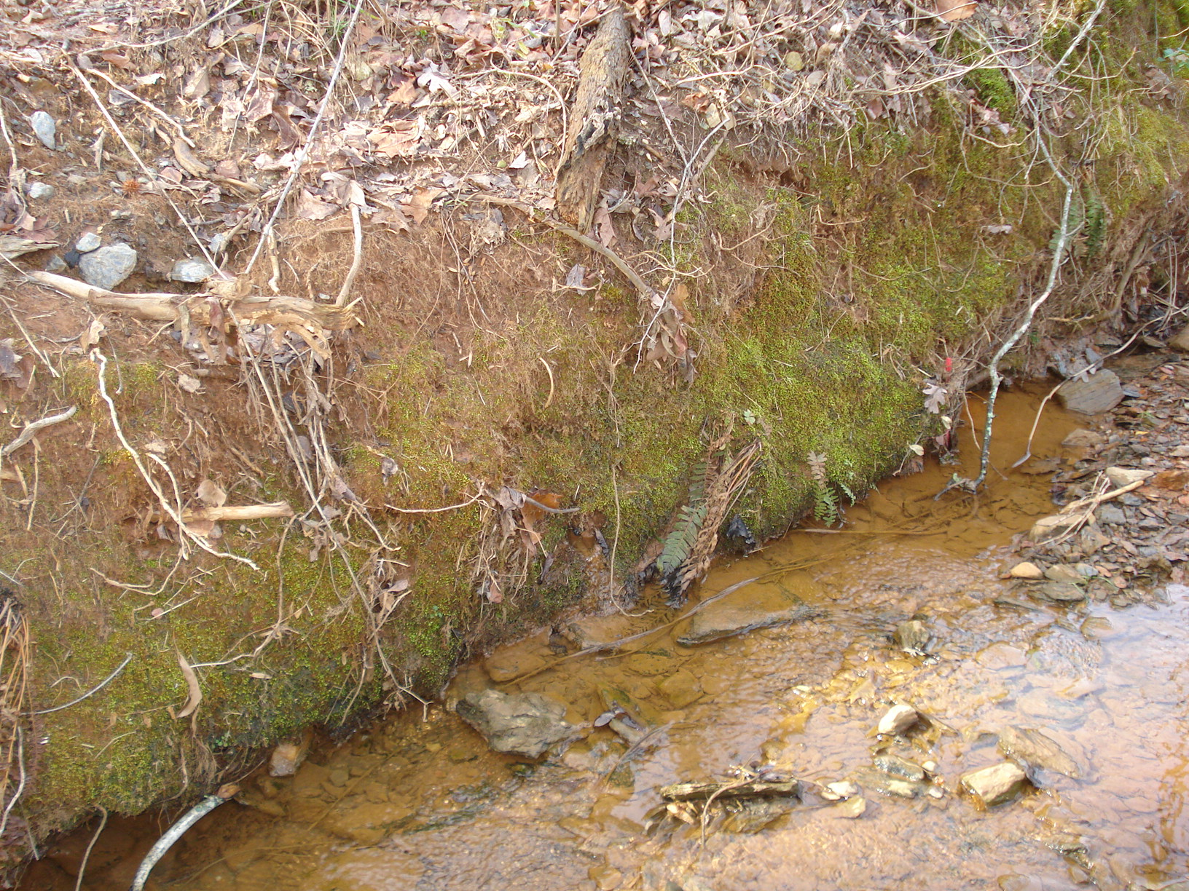
Wrested or Not Wrested Vegetation?
…movement of water by normal stream flow or wave action that removes soil, debris, and vegetation, creating a clear demarcation between water flow and vegetative growth…
Wrested
Notes:
“Enter/Advance” to reveal answer

Slide 18
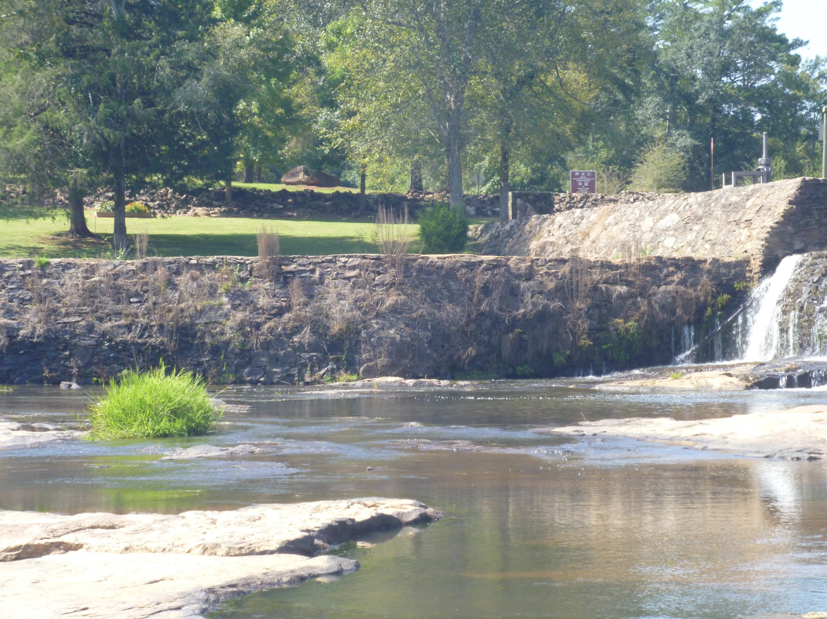
Wrested or Not Wrested Vegetation?
…movement of water by normal stream flow or wave action that removes soil, debris, and vegetation, creating a clear demarcation between water flow and vegetative growth…
Not Wrested
The absence of wrested vegetation can be due to completely vegetated banks and/or
bottoms (excluding aquatic vegetation), rip rap or a solid bulkhead, seawall, or retaining wall.
Notes:
“Enter/Advance” to reveal answer

Slide 19
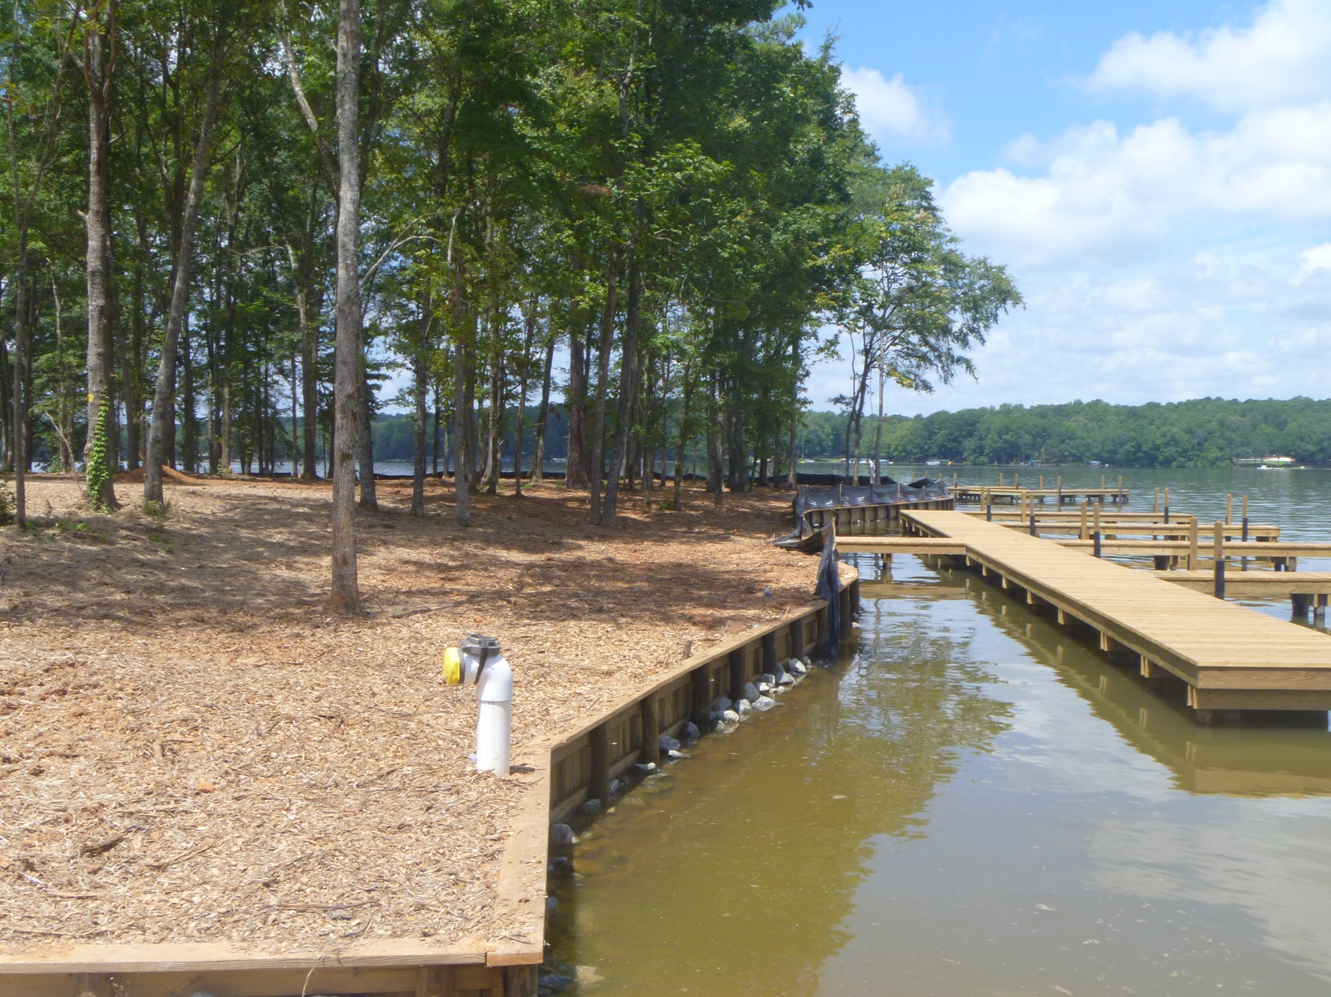
Wrested or Not Wrested Vegetation?
…movement of water by normal stream flow or wave action that removes soil, debris, and vegetation, creating a clear demarcation between water flow and vegetative growth…
Not Wrested
The absence of wrested vegetation can be due to completely vegetated banks and/or
bottoms (excluding aquatic vegetation), rip rap or a solid bulkhead, seawall, or retaining wall.
Notes:
“Enter/Advance” to reveal answer

Slide 20
Important Terms - Normal Stream Flow
The State mandated buffer requirements apply to State Waters that have wrested vegetation by normal stream flow
Normal Stream Flow (Per Rule 391-3-7-.01(w))
  For non-trout waters only, any stream flow that consists solely of base flow or consists of both base flow and direct runoff during any period of the year
    Base Flow – the discharge that enters the stream channel through the soil. This includes spring flow into streams.
    Direct runoff – the water entering stream channels promptly after rainfalls or snow melts

Slide 21
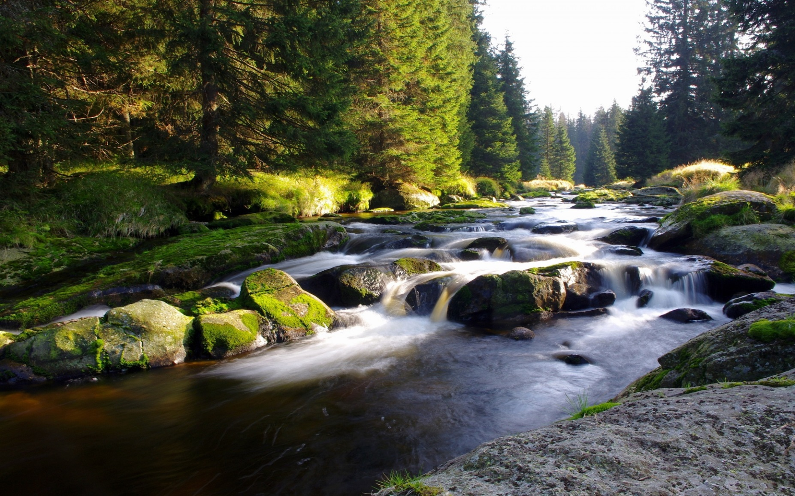
What Type of Stream is Present?
Notes:
Perennial, Intermittent, or Ephemeral

Slide 22
Perennial Stream Characteristics
Base flow that maintains stream flow throughout the year under normal circumstances
Well-developed stream banks
A channel that is almost always sinuous (winding)
Evidence of fluctuating high water marks
Evidence of soil and debris movement (scour) in the channel
Presence of hydric soils
Presence of wetland vegetation

Slide 23
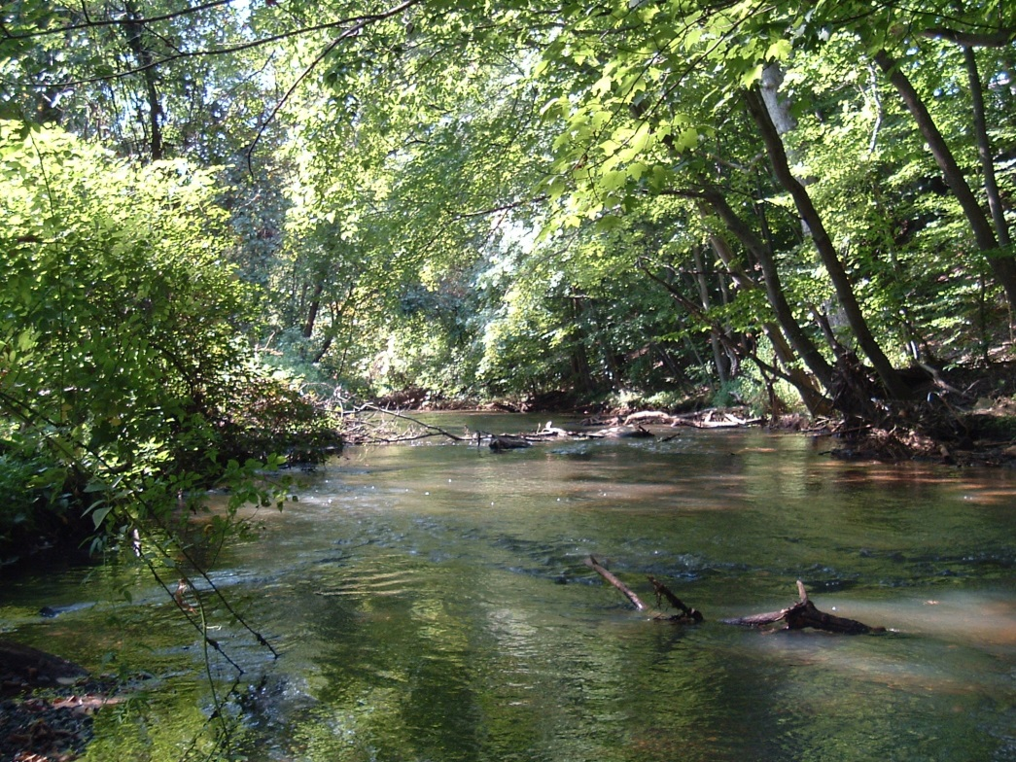
Perennial Stream Characteristics

Slide 24
Intermittent Stream Characteristics
Base flow that is seasonally present
Presence of crayfish burrows and aquatic insects
Well-developed stream banks
Evidence of fluctuating high water marks
Evidence of soil and debris movement (scour) in the channel
Presence of hydric soils
Presence of wetland vegetation
Notes:
Major differences between perennial and intermittent streams

Slide 25
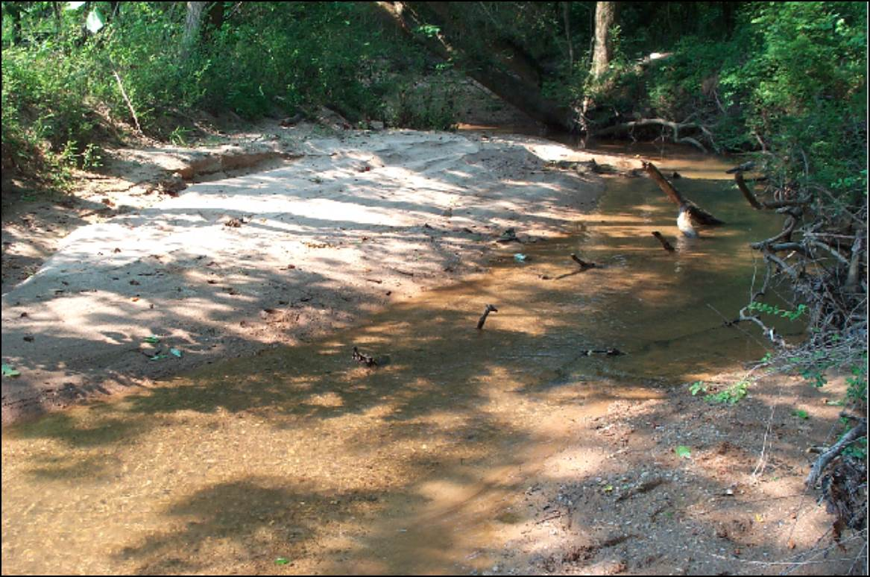
Intermittent Stream Characteristics

Slide 26
Ephemeral Stream Characteristics
Flows only in direct response to precipitation
If there is no flowing water within 48 hours of a rain event, the drainage feature is most probably ephemeral
No well-defined channel
Absence of riffles/pools
A flow area that is almost always straight
Lack of groundwater-induced base flows
Lack of hydric soils that dominate the banks
Lack of wetland vegetation

Slide 27
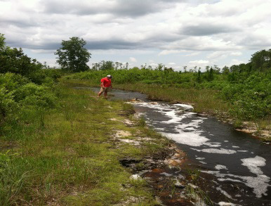
Ephemeral Stream Characteristics

Slide 28
Common Misconceptions
These factors are not to be considered in State Water Determinations:
  Whether a stream appears on a topo map as a solid or dashed blue line
  Whether the stream originates on the property
  Whether a stream that originates on the property flows into another stream before it leaves the property
  The duration of flow in the stream
  The absence of observable aquatic life

Slide 29


Steps for Determining the Presence of State Waters and Buffer Requirements on a Site
Field Guide for Determining the Presence of State Waters That Require a Buffer
WATERSHED PROTECTION BRANCH
NONPOINT SOURCE PROGRAM
The Guidance does not change or modify any requirements in the Erosion and Sedimentation Act of 1975 O.C.G.A. 12-7 or DNR Rules on Buffer Variance Procedures and Criteria 391-3-7-.05, as amended.
This field guide supersedes any previous manuals, memos, or guidance issued by the Georgia Environmental Protection Division on the identification of State Waters that require a buffer. It does not supersede the requirements of any Rule or Law. APRIL 2017
Notes:
This guidance only addresses the identification of rivers, streams, creeks, branches, canals, and impoundments that require a buffer
April 2017 update
Guidance is written to assist LIAs with presence of State Waters and Buffer requirements.
Also a tool to help ES&PC plan preparers and environmental consultants.

Slide 30
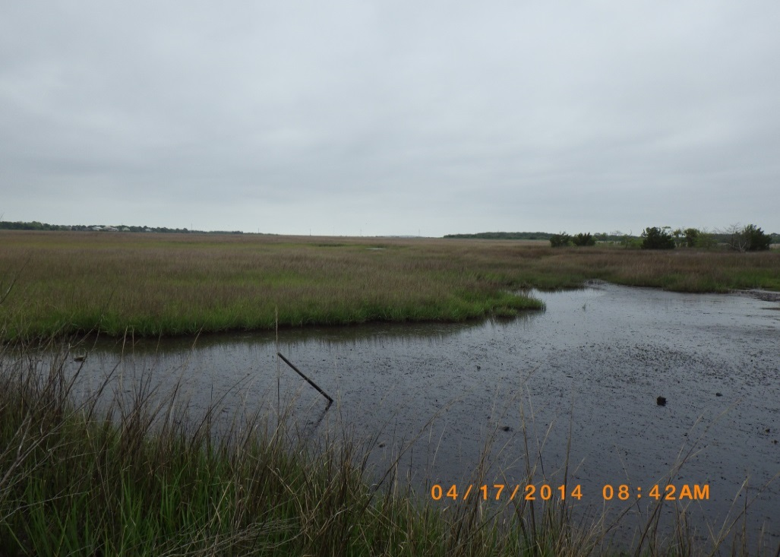
Steps for Determining the Presence of State Waters
Step 1: Review the topography on the ES&PC Plan for natural or artificial features that may indicate the presence of State Waters.
Step 2: Physically visit the site & walk the entire length or perimeter of waterbody to verify the feature is not completely contained on the property. The waterbody
must have an inlet/outlet
outside of the property
in order to be
identified as a
State Water.

Slide 31
Steps for Determining the Presence of State Waters
Step 3: Once a State Water has been determined, the next step is to decide if it should have a buffer.
  The State-mandated buffer requirements apply to State Waters that have wrested vegetation and normal stream flow.
Step 4: Is wrested vegetation present?
  If no point of wrested vegetation, then the waterbody is not required to have a buffer.
  Lack of wrested vegetation can be when there are completely vegetated banks (excluding aquatic vegetation), rip rap, or a solid bulkhead, seawall, or retaining wall.

Slide 32
Steps for Determining the Presence of State Waters
Step 5: Is base flow present?
To accurately identify base flow, a site visit should be made within 48 hours of a rain event.
If evidence of base flow is present during the site inspection, the stream is either perennial or intermittent and will require a buffer.
If the site is visited and base flows are not evident, the feature may be ephemeral or intermittent.
Ephemeral trout streams require a buffer if they have wrested vegetation even without evidence of a base flow.
Ephemeral non-trout streams do not require a buffer.

Slide 33
Steps for Determining the Presence of State Waters
Step 6 & Step 7:
  Further investigation is needed to determine if the stream is ephemeral
  Use professionally trained personnel
  Use the most current version of the “North Carolina Division of Water Quality Stream Identification Method
Step 8: If wrested vegetation and base flows exist, then a buffer is required. The buffer is measured from the point of wrested vegetation.
Step 9: Document the determination (photos recommended)

Slide 34
Stream Buffer Requirements
Non-trout
Trout
Warm water perennial and intermittent streams:
  25-ft buffer
Cold water perennial, intermittent and ephemeral streams:
  50-ft buffer
Measured horizontally from point where vegetation has been wrested by normal stream flow or wave action
Local Issuing Authorities may require additional buffers in the local ordinance!
Notes:
Warm water Ephemeral streams do not have a buffer

Slide 35
Trout Streams
Primary Trout Waters
  Streams supporting a self-sustaining population of Rainbow, Brown, or Brook Trout
Secondary Trout Waters
  Streams with no evidence of natural trout reproduction but capable of supporting trout throughout the year (i.e. water temperatures will support introduced trout, whether or not the fish reproduce)
The list of Primary & Secondary trout waters is maintained by the GA EPD. Designations are listed by individual stream segments or watershed.
Notes:
List of Primary & Secondary Trout Waters is found in the Water Quality Standards document effective 10/22/2015

Slide 36
Stream Buffer Exemptions
Stream crossings for water & sewer lines provided
  It is within 25˚ of perpendicular to the stream
  And the disturbance is not more than 50 ft. within the buffer
Construction of public water system reservoirs
Drainage Structures – warm water streams only
Roadway Drainage Structures
Construction of bulkheads or seawalls only on:
  Lake Sinclair & Lake Oconee
Notes:
Additional Stream Buffer exemptions are covered in NPDES Presentation

Slide 37
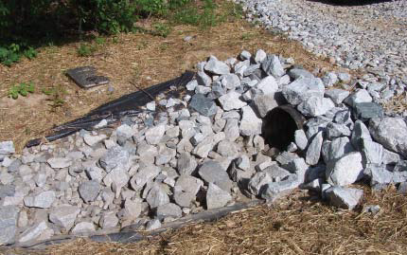
Drainage Structure
A device composed of a virtually non-erodible material such as concrete, steel, plastic or other such material that conveys water from one place to another by intercepting the flow and carrying it to a release point for
storm water
management,
drainage control,
or flood control
purposes.

Slide 38
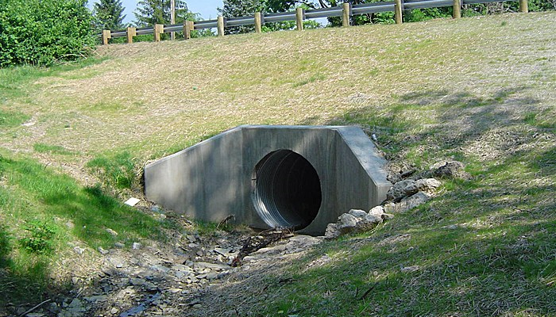
Roadway Drainage Structure
A device such as a bridge, culvert, or ditch, composed of a virtually non-erodible material such as concrete, steel, plastic, or other such material that conveys water under a roadway by intercepting the flow on one side of a traveled roadway consisting of one or more defined lanes, with or without
Shoulder areas, and
carrying water to a
release point on the
other side.

Slide 39
Buffer Variance
The minimum 25-ft or 50-ft undisturbed State-mandated stream buffers shall be maintained, except where the GA EPD Director determines to allow a variance that is at least as protective of natural resources and the environment.
A buffer variance application must be submitted and will only be considered for the applicable criteria (a-k) as delineated in the E&SC Rules & Regulations.
The GA EPD receives ~220 buffer variance applications/year.

Slide 40
Stream Buffer Variance Criteria (a-k)
(a) The project involves the construction or repair of an existing infrastructure project or a structure that, by its nature, must be located within the buffer. Such structures include, include but are not limited to, dams, public water supply intake structures, detention/retention ponds, waste water discharges, docks including access ways, boat launches including access ways, and stabilization of areas of public access to water.

Slide 41
Stream Buffer Variance Criteria (a-k)
(b) The project will result in the restoration or enhancement to improve water quality and/or aquatic habitat quality
(c) Buffer intrusion is necessary to provide reasonable access to a property or properties
(d) The intrusion is for water and sewer lines that cannot reasonably be placed outside the buffer, and stream crossings and vegetative disturbance are minimized

Slide 42
Stream Buffer Variance Criteria (a-k)
(e) Crossing for utility lines, including but not limited to gas, liquid, power, telephone, and other pipelines, provided that the number of crossings and the amount of vegetative disturbance are minimized
(f) Recreational foot trails and viewing areas, providing that impacts to the buffer are minimal

Slide 43
Stream Buffer Variance Criteria (a-k)
(g) The project involves construction of one (1) single family home for residential use by the owner of the subject property and, at the time of adoption of this rule, there is no opportunity to develop the home under any reasonable design configuration unless a buffer variance is granted. Variances will be considered for such single family homes only if construction is initiated or local government approval is obtained prior to January 10, 2005

Slide 44
Stream Buffer Variance Criteria (a-k)
(h) For non-trout waters, the proposed land disturbing activity within the buffer will require a permit from the United States Army Corps of Engineers under Section 404 of the federal Water Pollution Control Act Amendment of 1972, 33 U.S.C. Section 1344, and the Corps of Engineers has approved a mitigation plan to be implemented as a condition of such a permit
(i) For non-trout waters, a plan is provided for buffer intrusion that shows that, even with the proposed land disturbing activity within the buffer, the completed project will result in maintained or improved water quality downstream of the project

Slide 45
Stream Buffer Variance Criteria (a-k)
(j) For non-trout waters, the project with a proposed land disturbing activity within the buffer is located in, or upstream and within ten linear miles of, a stream segment listed as impaired under Section 303(d) of the federal Water Pollution Control Act Amendment of 1972, 33 U.S.C. Section 1313(d),and a plan is provided that shows that the completed project will result in maintained or improved water quality in such listed stream segment and that the project has no adverse impact relative to the pollutants of concern in such stream segment.

Slide 46
Stream Buffer Variance Criteria (a-k)
(k) The proposed land disturbing activity within the buffer is not eligible for a permit from the United States Army Corps of Engineers under Section 404 of the federal Water Pollution Control Act Amendment of 1972, 33 U.S.C. Section 1344, but includes required mitigation in accordance with current EPD "Stream Buffer Variance Mitigation Guidance" document and involves:
    piping, filling, or re-routing of non-trout waters that are not jurisdictional Waters of the U.S.
    stream buffer impacts due to new infrastructure projects adjacent to state waters (jurisdictional and non-jurisdictional Waters of the U.S.). This criterion shall not apply to maintenance and/or modification to existing infrastructure, which are covered under 391-3-7.05(2)(a).

Slide 47
General Variance
A general variance is provided for the piping of trout streams with an average annual flow of 25 GPM or less provided
  The total length of stream that is piped on any one property shall not exceed 200 ft
  The downstream end of the pipe shall terminate at least 25 ft. before the property
  Piping of more than 200 ft. will require an individual variance for the entire project

Slide 48
Public Notice
Within 60 days of receipt of a complete buffer variance application, the GAEPD will either provide written comments to the applicant or propose to issue a variance.
The public shall have 30 days from the date of publication of the public notice to comment on the proposed buffer variance.
The public notice shall describe:
  The proposed buffer encroachment
  The location of the project
  Where the public can view the site plans
  Where comments should be sent

Slide 49
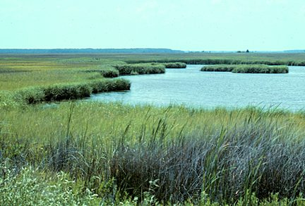
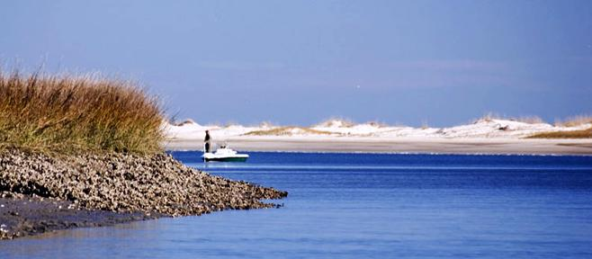
Coastal Marshlands

Slide 50
Coastal Marshlands
Marshlands – any marshland intertidal area, mud flat, tidal water bottom, or salt marsh in the State within the estuarine area of the state, whether or not the tidewaters reach the littoral areas through natural or artificial watercourses (O.C.G.A 12-5-282(3)).
The established 25-foot buffer applies along all coastal marshlands and is measured horizontally from the coastal-marshlands-upland interface as determined in accordance with the Coastal Marshlands Protection Act of 1970

Slide 51

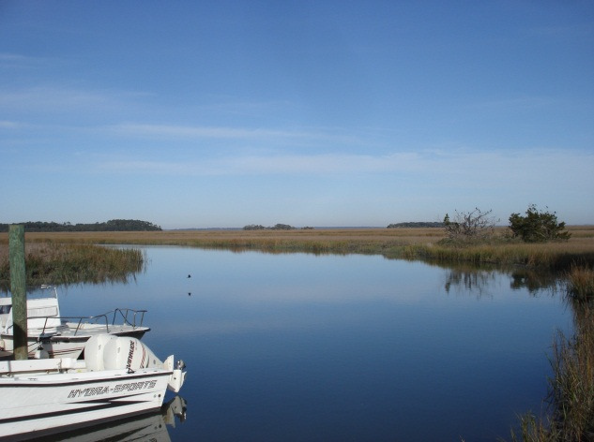
Steps for Determining the Presence of Marshlands and Buffer Requirements on a Site
Field Guide for Identifying and Permitting Coastal Marshlands That Require a Buffer
WATERSHED PROTECTION BRANCH
NONPOINT SOURCE PROGRAM
This guidance addresses the identification and permitting of coastal marshlands (including impoundments) that require a buffer. The State mandated buffer requirements apply to all coastal marshlands as defined in Code Section 12-5-282 (Coastal Marshland Protection Act).
This field guide supersedes any previous manuals, memos, or guidance issued by the Georgia Environmental Protection Division on the identification of coastal marshlands that require a buffer. It does not supersede the requirements of any Rule or Law. APRIL 2017
Notes:
Coastal marshlands may be deemed State Waters based on the definition in OCGA 12-7-3(16)
State waters may also be classified as Waters of the US and may require a USACOE Section 404 Permit

Slide 52
Steps for Determining the Presence of Marshlands & Buffer Requirements on a Site
Step 1: Review topography of the ES&PC Plan for features that indicate the presence of coastal marshland
Step 2: A Jurisdictional Determination (JD) is needed for any land disturbing activity below the 2-meter elevation. The JD line must be documented
Step 3: The LIA or EPD (if no LIA) will determine if the land disturbing activity is exempt. If not exempt, the project will require a buffer variance

Slide 53
Steps for Determining the Presence of Marshlands & Buffer Requirements on a Site
Step 4: All determinations should be documented. Photos are strongly encouraged
Step 5: If needed, buffer variance applications or variance by rule applications are to be submitted to GA EPD

Slide 54
Coastal Marshlands Exemptions
No Buffer Variance Required
For the maintenance of any currently serviceable structure, landscaping, or hardscaping
Construction or maintenance of any drainage or roadway drainage structure
On the landward side of any currently serviceable shoreline stabilization structure
The maintenance of any man-made stormwater detention basin, golf course pond, or impoundment located on the property of a single individual, partnership, or corporation

Slide 55
Coastal Marshlands Exemptions
No Buffer Variance Required
Utility line crossings that cause a width of disturbance less than 50 ft within the buffer
Any land-disturbing activity conducted with a valid LDA permit issued between April 22, 2014 and December 31, 2015
Any lot where the preliminary plat has been approved prior to December 31, 2015 provided
  Roadways, bridges, or water and sewer lines have been extended to such lot prior to the effective date of this Act
  If the requirement to maintain a 25 ft buffer would consume at least 18% of the high ground of the platted lot

Slide 56
Coastal Marshland Variance by Rule
Used for land disturbing activities where the area within the buffer is not more than 500 square feet
Used for land disturbing activities that have a “minor buffer impact” provided that the total area of buffer impacts is less than 5,000 square feet
Bank and shoreline stabilization structures are not eligible for coverage under the variance by rule

Slide 57
Variance by Rule Requirements
Minimize disturbance to existing buffer vegetation
Final stabilization must include a re-vegetation plan recommended using native riparian vegetation
Stabilize soil disturbance on site at the end of each day. Implement temporary vegetative measures after 14 days of soil disturbance
Proper implementation of erosion and sediment control measures
Consideration of post construction stormwater management
Compliance with all other federal, state, and local laws and ordinances

Slide 58
Waters of the U.S.
Federal Level

Slide 59


Agency Roles
U.S. Army Corps of Engineers
  Administers day-to-day program
  Individual and general permit decisions/issuance
  Jurisdictional determinations
  Enforcement
U.S. Environmental Protection Agency
  Develops and interprets policy, guidance, and environmental criteria used in permit applications
  Determines scope of geographic jurisdiction and applicability of exemptions
  Has authority to prohibit, deny, or restrict the use of any defined area

Slide 60
Waters of the U.S.
Navigable waters
  Oceans, bays, inlets
Tributaries
  Rivers, creeks, intermittent streams, lakes, ponds
Interstate bodies of water or wetlands
Wetlands adjacent to the waters listed here
Special aquatics sites
  Sanctuaries and refuges, wetlands, mudflats, vegetated shallows, coral reefs, riffle and pool complexes

Slide 61
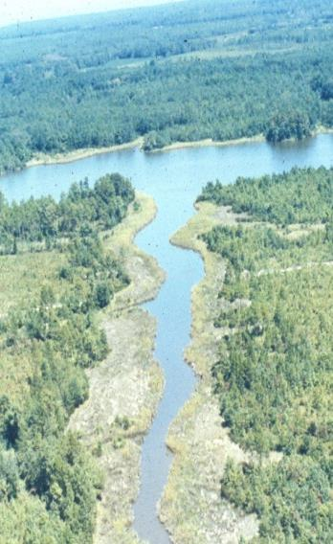
Definitions
Navigable waters
  Waters subject to the ebb and flow of the tide
  Has a connection to transportation of interstate commerce
Interstate commerce
  Defined as had been used, being used presently, or potential to be used for interstate commerce

Slide 62
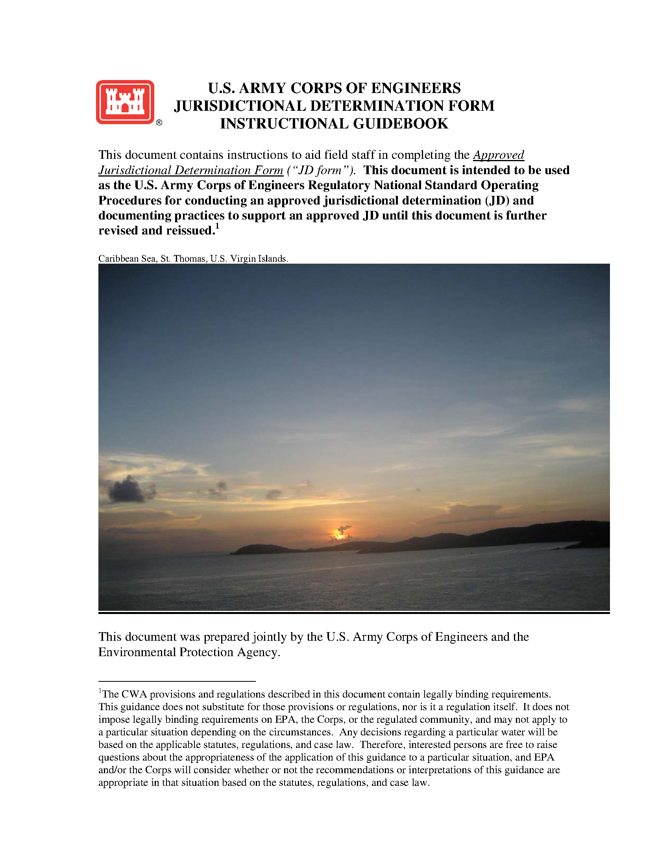
Jurisdictional Determinations

Slide 63
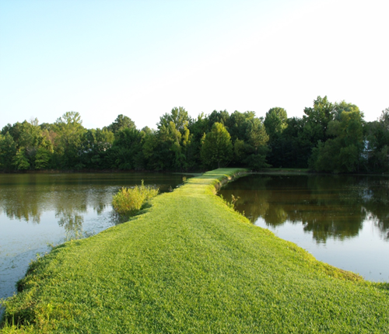
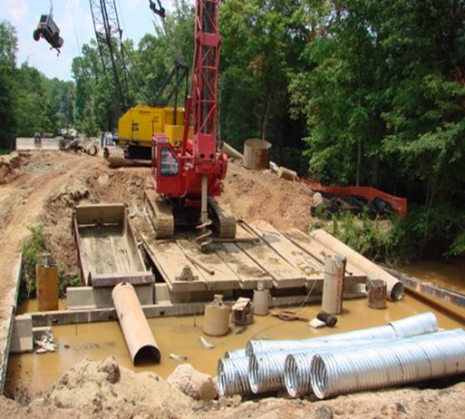
Jurisdictional Determinations
Identifies the location and type of waters of the US on your property or project site
Notes:
The GA DNR Coastal Resources Division is responsible for determining marsh jurisdictional lines relating to buffers.

Slide 64
Jurisdictional Determinations
Three types of Jurisdictional Determinations
Preliminary
JD
Approved JD

Slide 65
Jurisdictional Determinations
Preliminary JD
  Used for initial planning purposes and pre-application meeting
Approved JD
  An approved JD must include a significant nexus evaluation

Slide 66
Jurisdictional Determinations
Preliminary
Approved
  Valid for a specific project
  Only applicable to Waters of the U.S.
  Not appealable
  Coordination with other agencies is not required
  Valid for 5 years
  Applicable to Waters of the U.S. & non-waters of the U.S.
  Appealable
  In some circumstances, coordination with the EPA and USACE is required

Slide 67
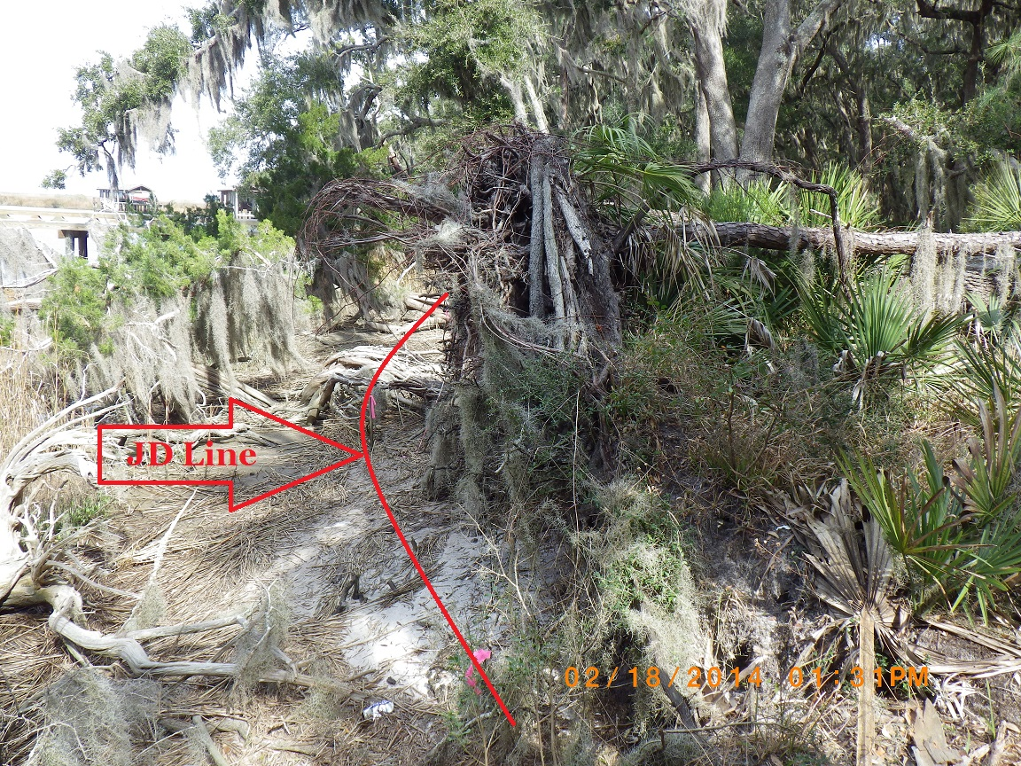
JD Line

Slide 68
Section 10 Rivers & Harbors Act
Purpose
  To protect and preserve the navigability of navigable waters
Requires that you obtain a permit from the USACE Regulatory Branch for:
  Any structure or work in, over or under a navigable water of the U.S.
The list of Section 10 waters in Georgia is maintained by the USACE

Slide 69
Section 10 Regulated Activities
Buoys
Floats
Marinas
Bulkheads
Breakwaters
Dredging
Fill
Piers
Piling
Boatlifts
Boat ramps
Marine railways
Disposal dredged material

Slide 70
Section 404 Clean Water Act
Objective
  To restore and maintain the chemical, physical, and biological integrity of the waters of the U.S.
Establishes a program to regulates the discharge of dredged or fill material into waters of the U.S., including wetlands
A permit must be obtained before any dredged or fill material may be discharged into waters of the U.S.

Slide 71
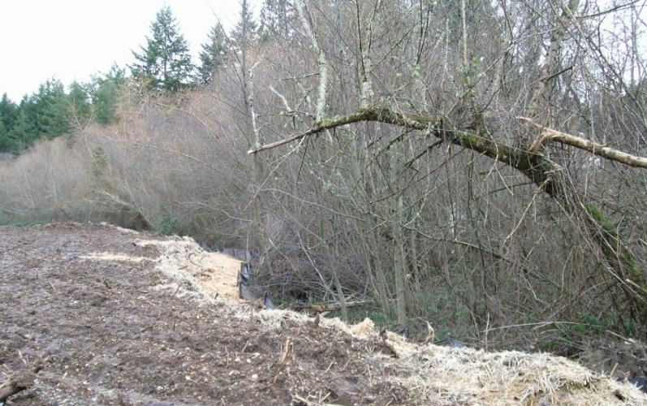
Discharge of Fill Material
Material that has the effect of:
  Replacing any portion of a water of the U.S. with dry land
  Changing the bottom elevation of any portion of a water of the U.S.
Fill Material includes:
  Rock
  Sand
  Soil
  Clay
  Plastics
  Construction debris
  Wood chips
  Overburden from excavation
wetlands
earthen fill

Slide 72
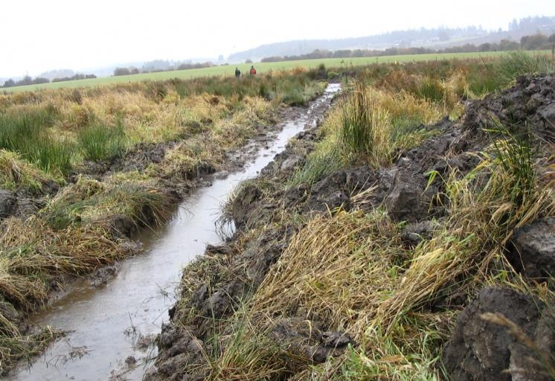
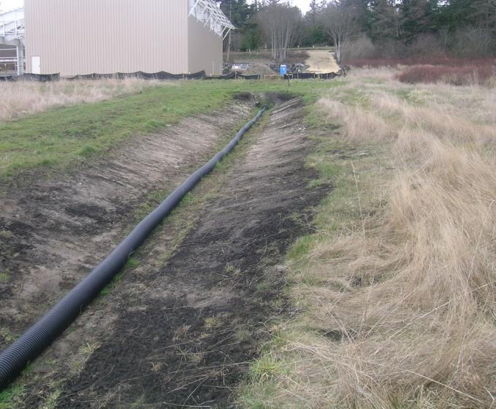
Discharge of Dredged Material
Mechanized land clearing
Grading
Excavation with associated discharge
Trenching in wetlands

Slide 73
404 Regulated Activities
Placement of fill material
Ditching activities when the excavated material is cast aside
Levee and dike construction
Mechanized land clearing
Land leveling
Most road construction
Dam construction
Slab-on-grade foundations
Grading and Landscaping
Certain pile-supported structures

Slide 74
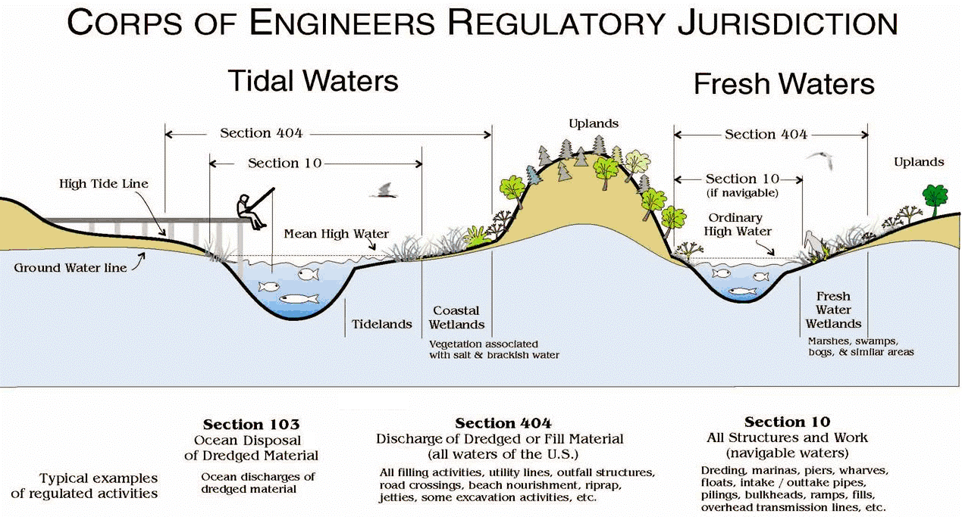
USACE Jurisdiction
Notes:
Illustration of Section 404 & 10 jurisdiction in tidal and fresh water scenarios. Shows the differences between the 2 scenarios

Slide 75
Definitions
  High Tide Line (Section 404)
  Shoreward limit of jurisdiction for all tidal waters
  Intersection of land and water at the maximum height reached by a rising tide
Mean High Water (Section 10)
  Shoreward limit of jurisdiction for all tidal waters
  Line on the shore reached by the plane of the average high water
Ordinary High Water Mark
  Shoreward limit of jurisdiction for all non-tidal waters
  Line on the shore established by the normal fluctuations in the water level

Slide 76
Wetlands
Definition
  Those areas inundated or saturated by surface or ground water at a frequency and duration to support, and that under normal circumstances do support a prevalence of vegetation adapted for life in saturated soil conditions
  Wetlands generally include marshes, swamps, bogs, and similar areas; also includes special aquatic sites such as riffle and pool complexes and submerged vegetation

Slide 77
Important Wetland Functions
Food chain production
Habitat, spawning sites, rearing and resting sites for both land and aquatic species
Protection from wave action and erosion
Storage area for storm and flood waters
Natural recharge areas
Provide natural water filtration and purification

Slide 78
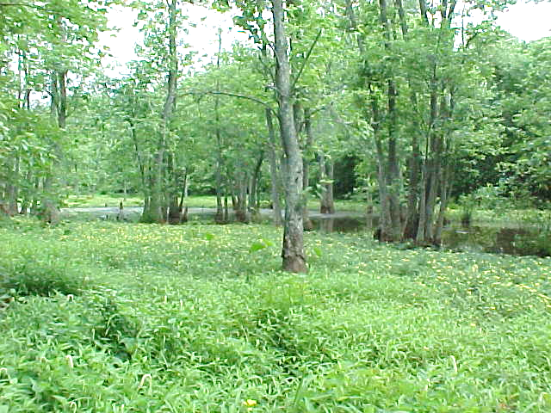
Wetlands

Slide 79
How are Wetlands Determined?
Vegetation Indicators – Hydrophytic Vegetation
  Cattails, bulrushes, cordgrass, sphagnum moss, arrowheads, willows, mangroves, sedges, rushes, and water plantains
  Also includes tree that have a shallow root systems, swollen trunks (i.e. bald cypress & tupelo gum) or roots found growing from the plant stem or trunk above the soil surface

Slide 80
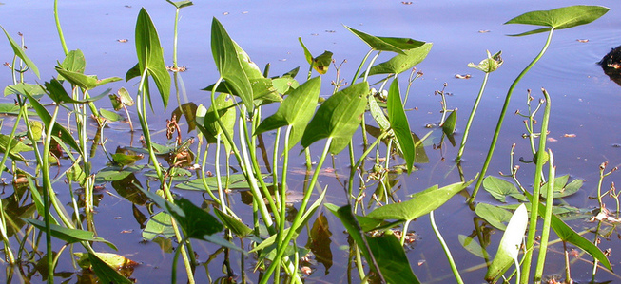
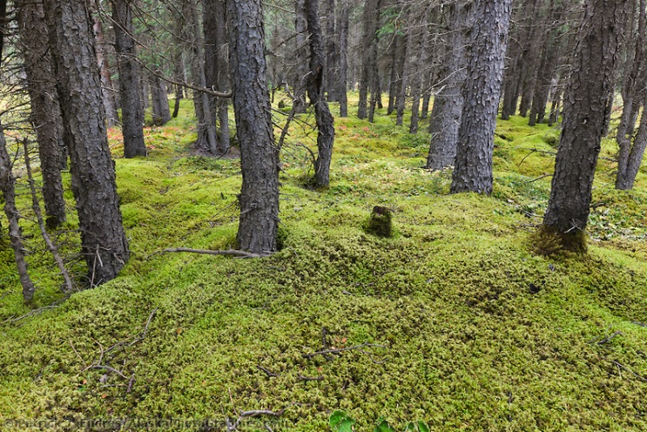
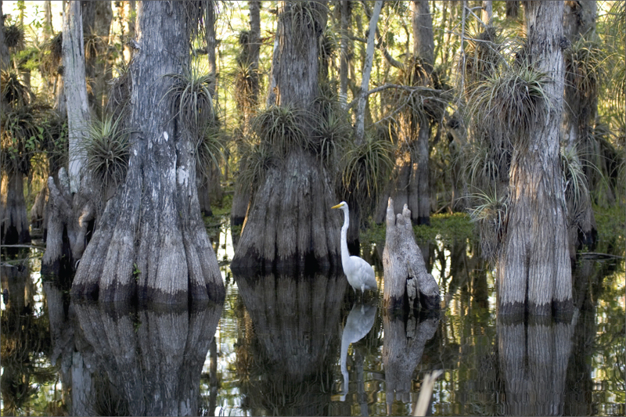
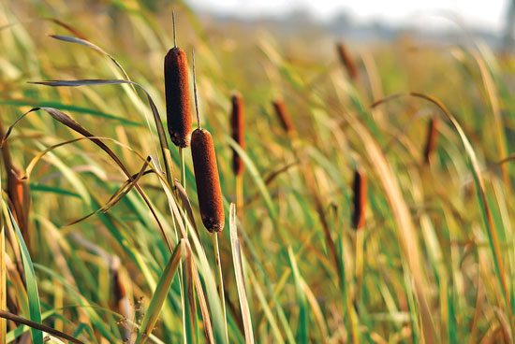
Hydrophytic Vegetation
Arrowheads
Sphagnum
Moss
Bald Cypress
Cattails

Slide 81
How are Wetlands Determined?
Soil Indicators – Hydric soils
  Soils that were developed in conditions where soil oxygen is limited by the presence of saturated soil for long periods during the growing season
  Characteristics include:
    Consists predominantly of decomposed plant material
    Thick layer of decomposing plant material on surface
    Bluish-gray or gray color below the surface
    Rotten egg odor
    Sandy soil with dark stains or dark streaks in the upper layer below the surface

Slide 82
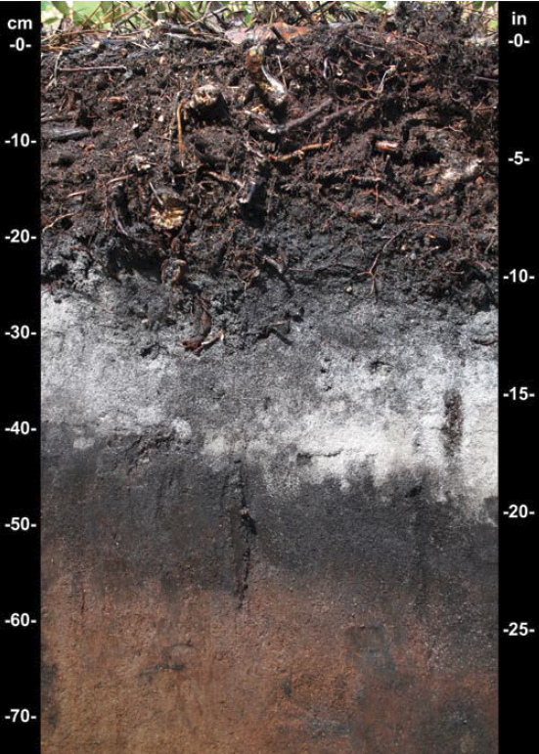
Hydric Soil
Thick layer of decomposing plant material
Gray color below the surface
Sandy soils with dark stains

Slide 83
How are Wetlands Determined?
Hydrology Indicators
  The presence of water at or above the soil surface for a sufficient period of the year to significantly influence the plant types and soils in the area
  Evidence of soil saturation
    Standing or flowing water is observed during the growing season
    Soil is waterlogged during the growing season
    Water marks present on trees
    Small piles of debris oriented in the direction of flow
    Thin layer of sediment that has been deposited on leaves

Slide 84
Wetland Hydrology
Standing water during growing
season
Water marks present with
swollen bases

Slide 85
Summary
Make no assumption when it comes to working near “State waters” or “Waters of the U.S.”
Plan Ahead
  Most buffer variances and permits take 3-4 months to be issued
Buffer variances are issued by the GA EPD
Permits for working within the flow of the water are issued by the USACE
Contact information for each Regulatory agency can be found in the “Resource Information” section

Slide 86

Questions?
GSWCC
Urban Program
4310 Lexington Road
Athens, GA 30605
(706) 552-4474

