Slide 1

BASICS OF
EROSION &
SEDIMENTATION
Level 1A: Fundamentals
Effective August 2018

Slide 2
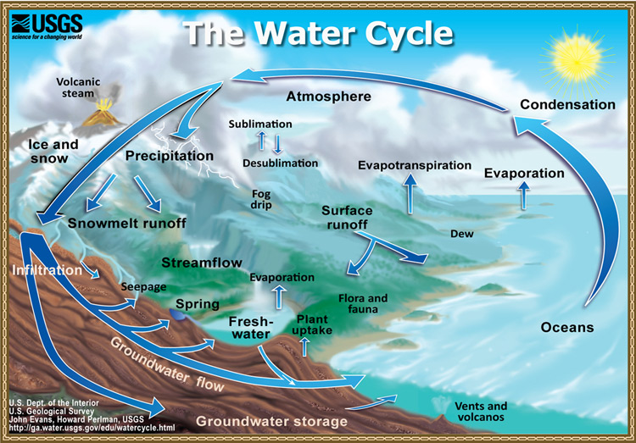
Hydrologic Cycle
Notes:
Earth's water is always in movement, and the natural water cycle, also known as the hydrologic cycle, describes the continuous movement of water on, above, and below the surface of the Earth. Water is always changing states between liquid, vapor, and ice, with these processes happening in the blink of an eye and over millions of years.

Slide 3
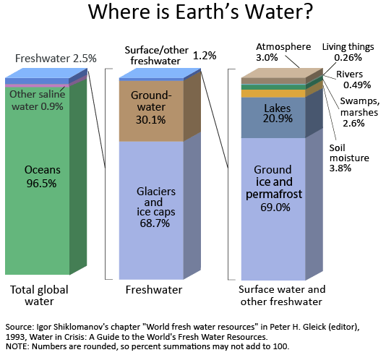
Where is Earth’s Water?
Notes:
Notice how of the world's total water supply of about 332.5 million cubic miles of water, over 96 percent is saline. And, of the total freshwater, over 68 percent is locked up in ice and glaciers. Another 30 percent of freshwater is in the ground. Fresh surface-water sources, such as rivers and lakes, only constitute about 22,300 cubic miles, which is about 1/150th of one percent of total water. Yet, rivers and lakes are the sources of most of the water people use everyday.

Slide 4
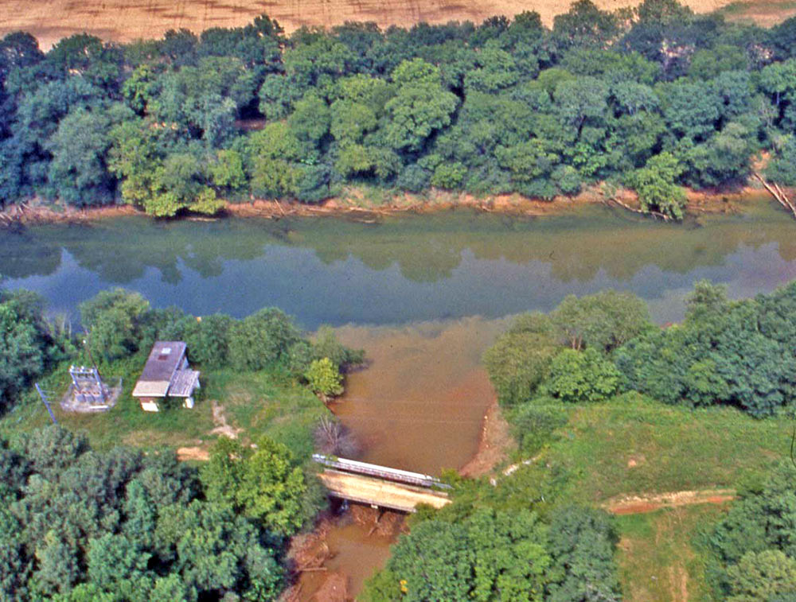
Water Quality
Sediment is the #1 non-point source pollutant
Notes:
Sediment-laden water from a construction site flows into the Chattahoochee River
Pic Credit: USGS
Credit: McDaniel College

Slide 5
EROSION
Definition
Types
Factors

Slide 6
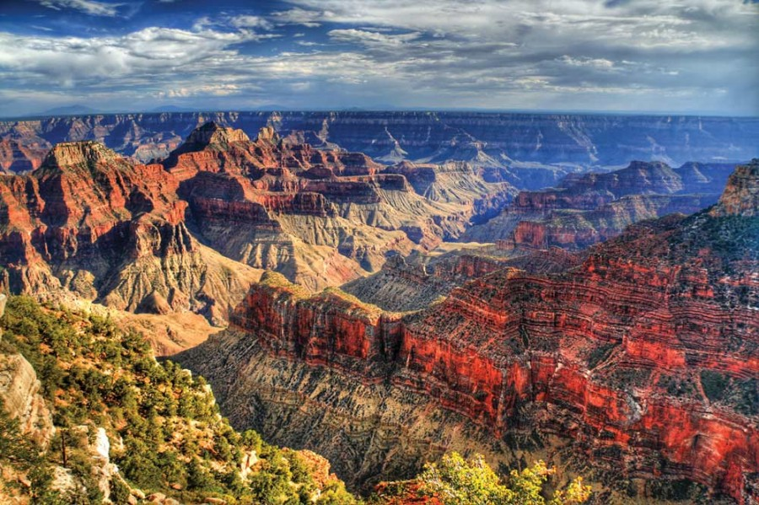
Definition
The process by which the land surface is worn away by the action of water, wind, ice and gravity

Slide 7
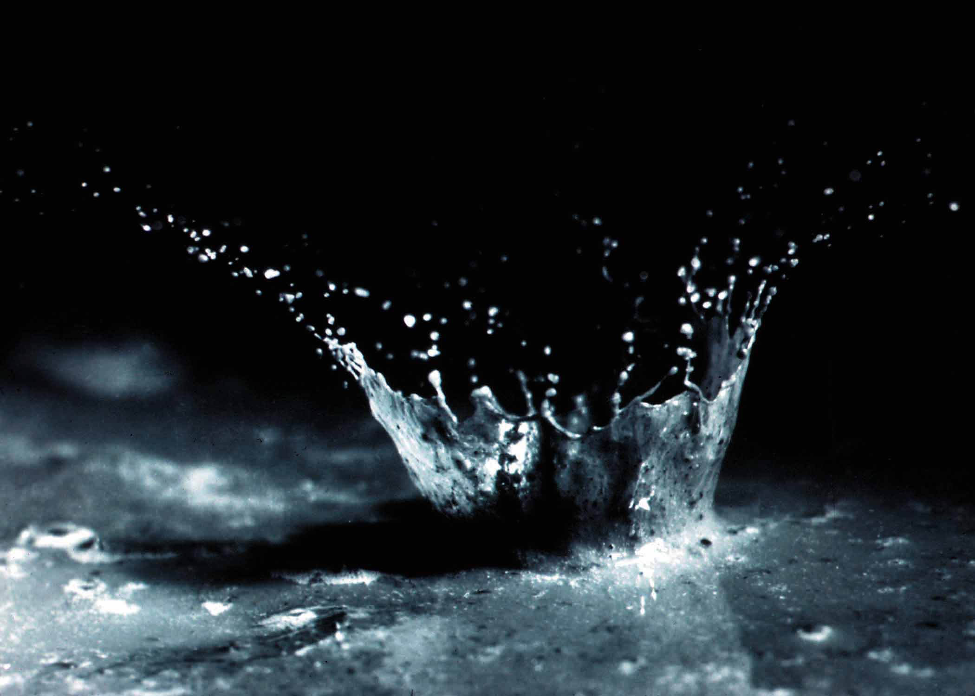
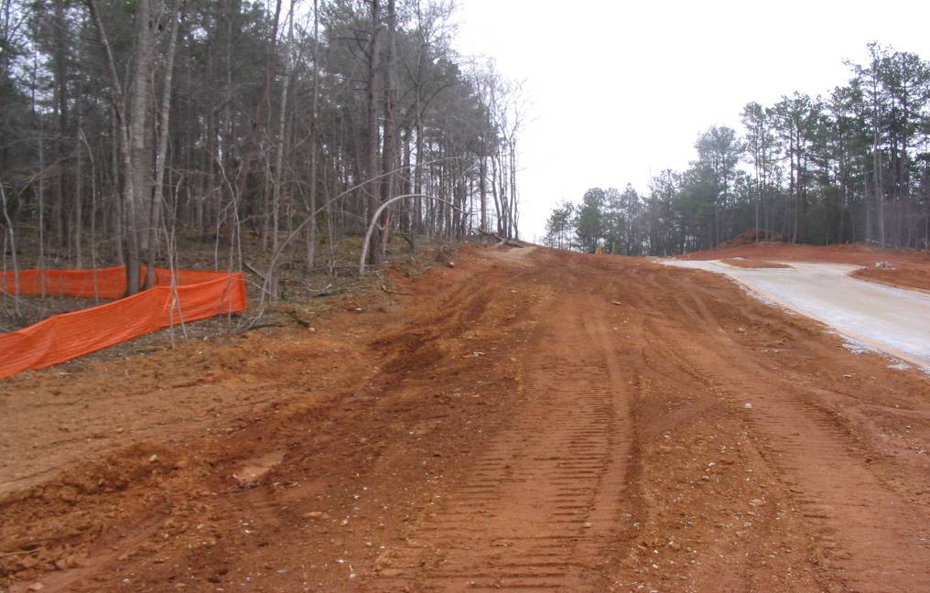
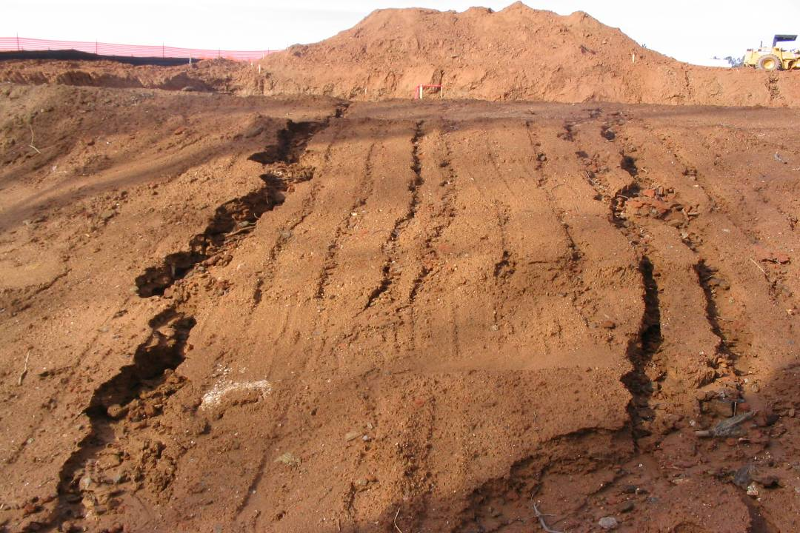
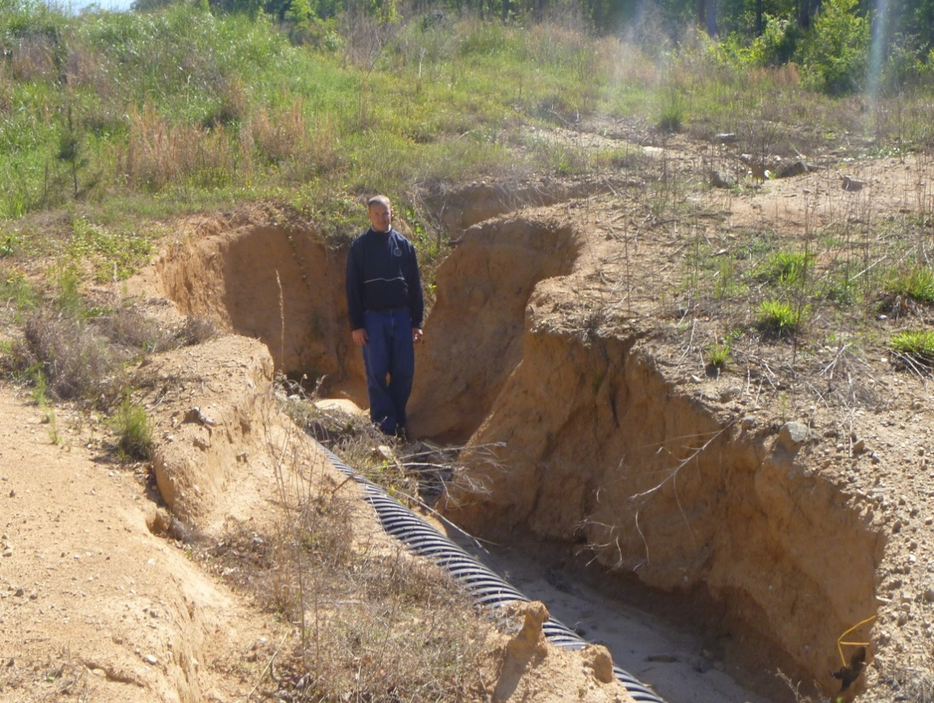
Types of Water Erosion
Splash
Sheet
Rill
Gully
Notes:
Erosion by water is a process of breaking loose and transporting soil particles. The energy of raindrops falling on denuded or exposed soils is the key element

Slide 8
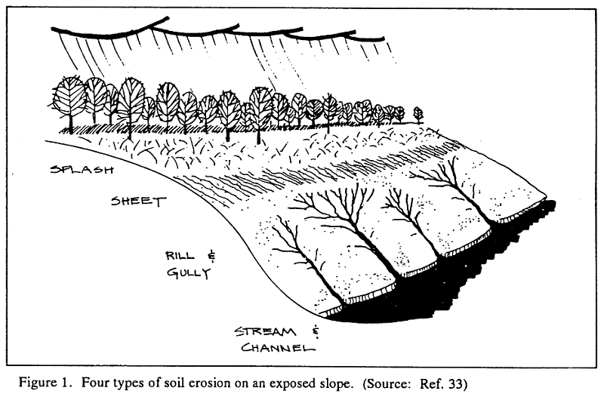
Water Erosion
Notes:
1 inch of rain falling on 1 acre is equal to about 27,154 gallons of water.

Slide 9
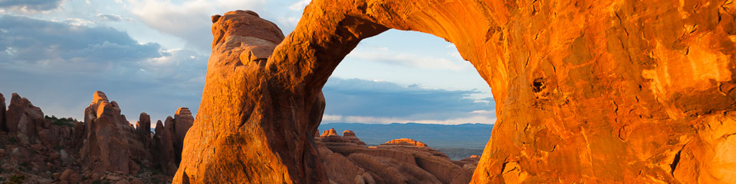
Natural (Geologic) Erosion
Definition
  Erosion without the interference of human activity that has been occurring since the earth was formed
Except in some cases of shore and stream channel erosion, the rate is very slow and uniform

Slide 10
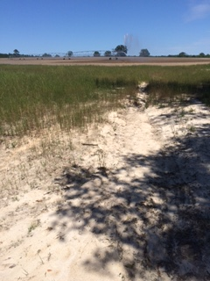
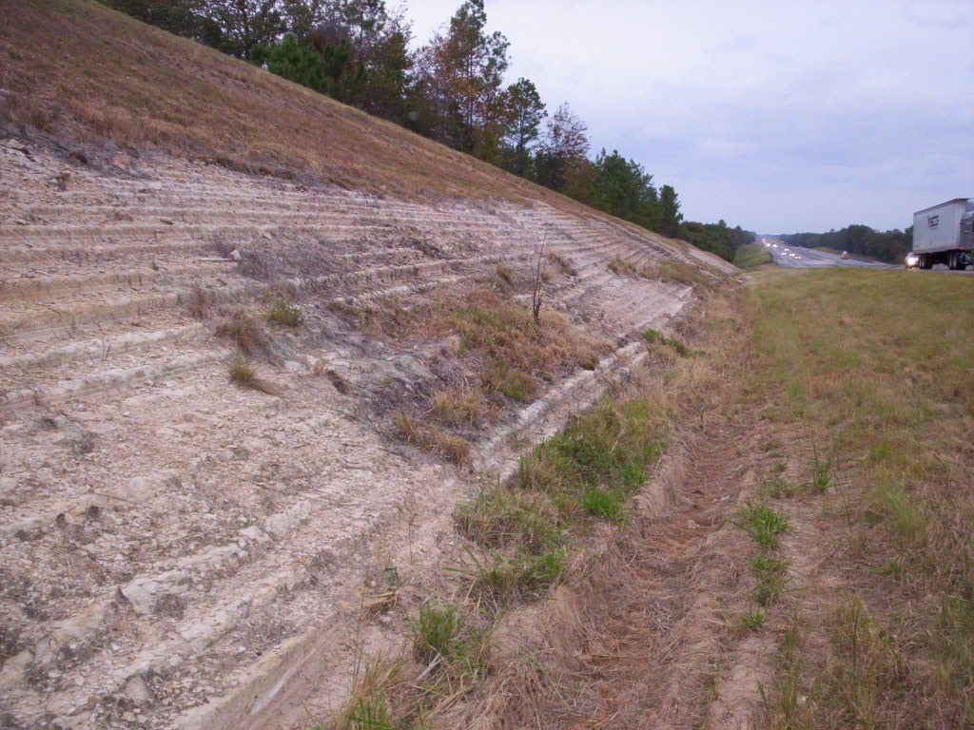
Accelerated Erosion
Definition
  Alteration of the land surface intensified by human activities (i.e. Farming & Construction)
Notes:
Pic (Left) – Erosive slopes intensified by roadway construction
Pic (Right) – Agricultural fields impacted by sediment

Slide 11
Expected Erosion Rates
Notes:
Here is an example of expected erosion rates in Georgia using the Revised Universal Soil Loss Equation. These figures are only general estimates.

Slide 12
Factors Influencing Erosion
Climate
  The frequency, intensity and duration of rainfall and temperature extremes are principle factors influencing the volume of runoff
Topography
  The size, shape, and slope characteristics of a watershed influence the amount and duration of runoff

Slide 13
30-yr Average Rainfall Data - Atlanta
www.srh.noaa.gov
Notes:
Typically, rainfall in Georgia is at its peak in mid-Summer (July)

Slide 14
Gradient
Definition
  The number of horizontal units per vertical units (i.e. 4:1 or 25%)
The greater the slope length and gradient
=
the greater the potential for runoff and erosion
4:1
1
4

Slide 15
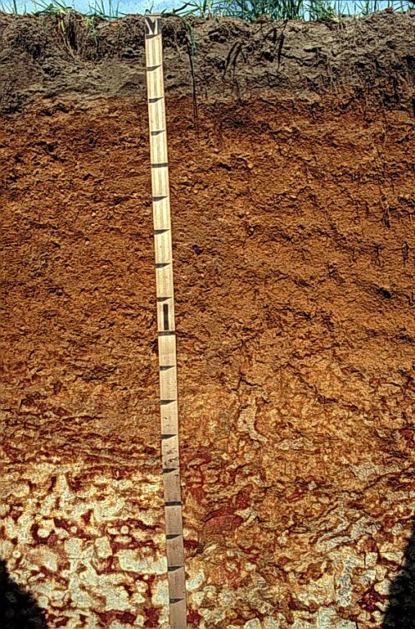
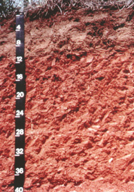
Factors Influencing Erosion
Soils
  The soil type will determine its vulnerability to erosion
Most Erodible
Least Erodible
Tifton
Cecil
Sand
Clay
Notes:
Soil containing high % of fine sands and silt are more erodible than soils containing clay and organic matter

Slide 16
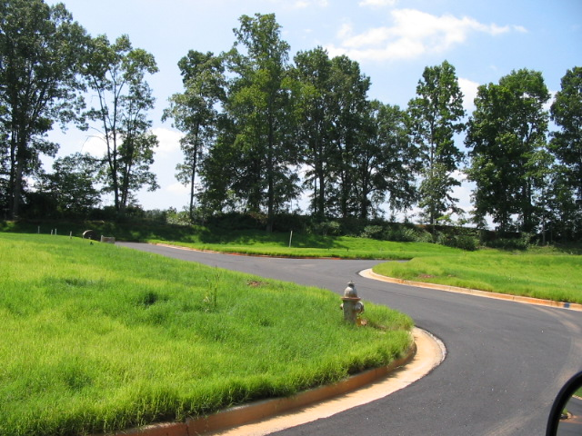
Factors Influencing Erosion
Vegetative Cover
  Extremely important factor in reducing erosion
  It will:
    Absorb energy of rain drops
    Bind soil particles
    Slow velocity of runoff
    Increase ability to absorb water
    Remove subsurface water
    between rainfalls

Slide 17
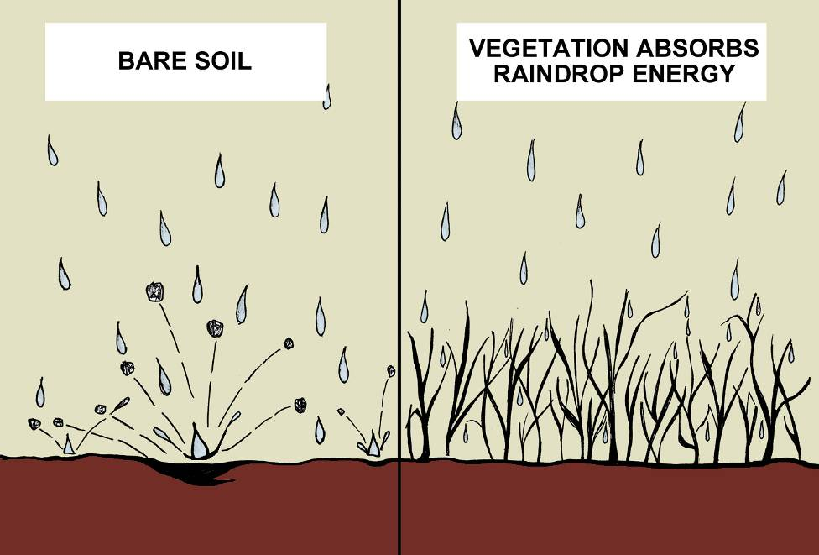
Absorb Energy of Rain Drops

Slide 18
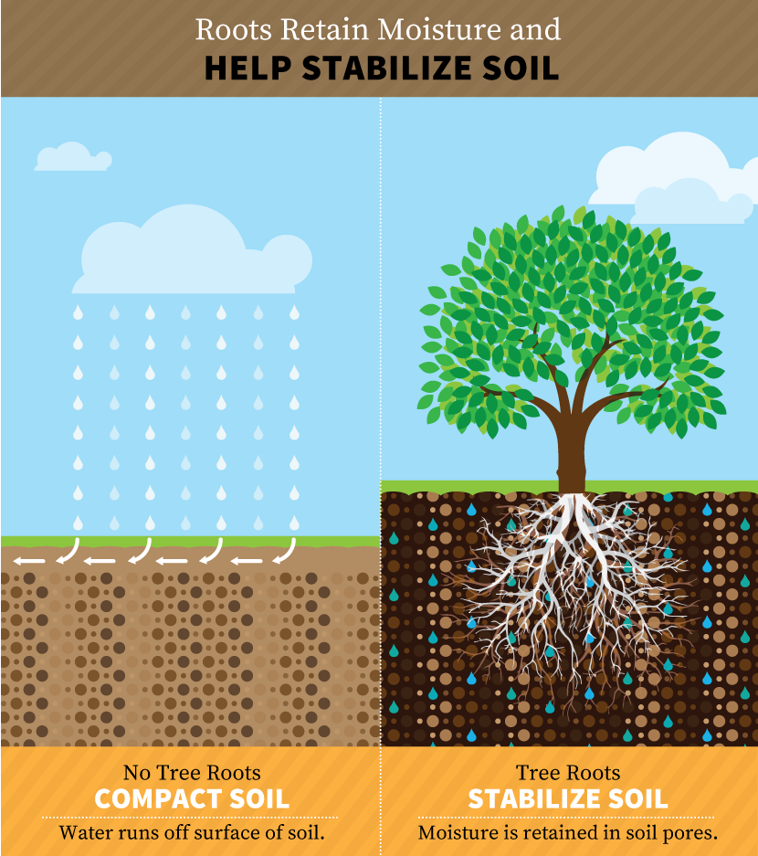
Bind Soil Particles

Slide 19
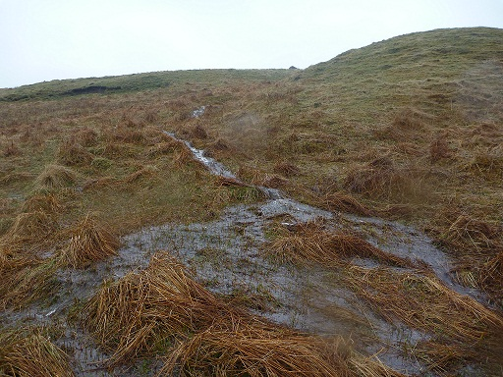
Slow Velocity of Runoff
Slows the flow of water, reducing erosion, &
trapping sediment

Slide 20
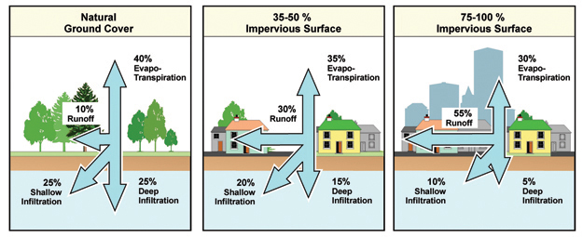
Increase Absorption
Notes:
As more and more people inhabit the Earth, and as more development and urbanization occur, more of the natural landscape is replaced by impervious surfaces, such as roads, houses, parking lots, and buildings that reduce infiltration of water into the ground and accelerate runoff to ditches and streams.

Slide 21
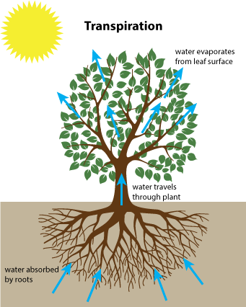
Remove Subsurface Water

Slide 22
SEDIMENTATION
Definition
Process
Everyday Impacts

Slide 23
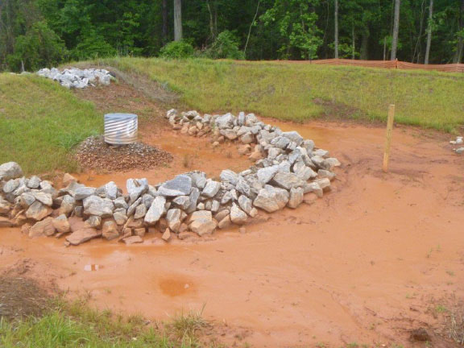
Definition
The process by which the eroded material is transported and deposited by water, wind, ice and gravity

Slide 24
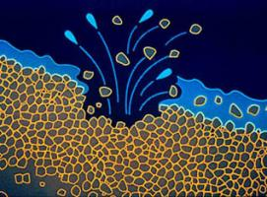
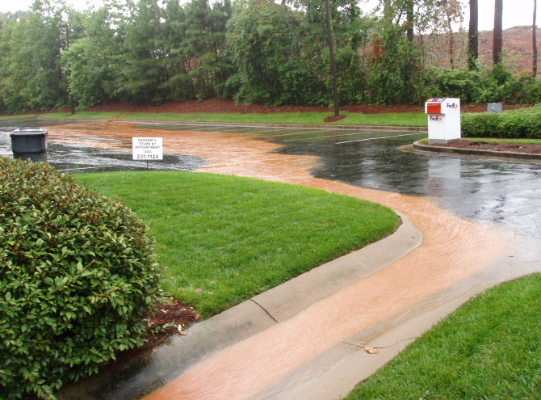
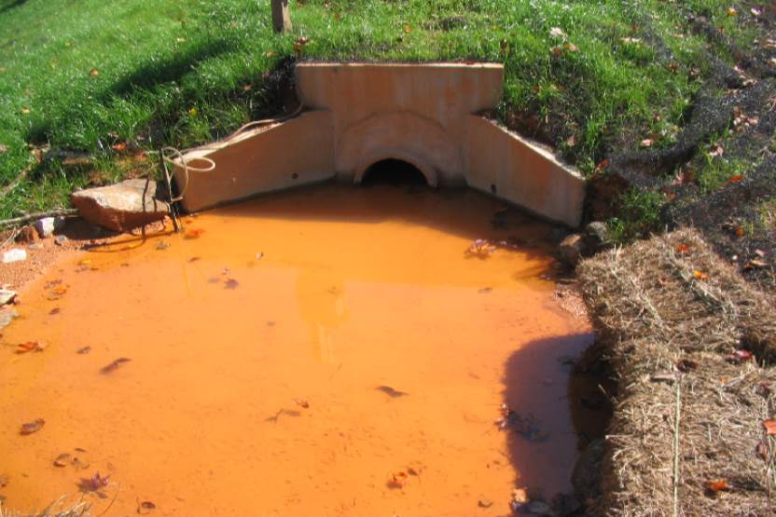
3 Step Process
Detachment
Transport
Deposition
1
2
3

Slide 25
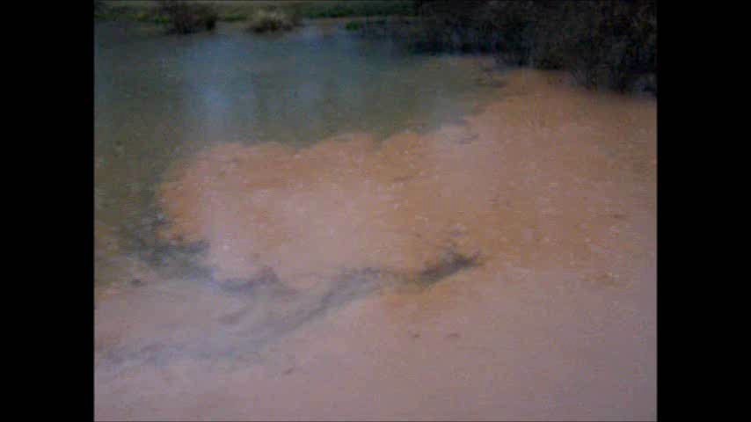
Sediment Transport
VIDEO
hover cursor over slide to
activate control bar at bottom
Notes:
VIDEO – hover cursor over slide to activate control bar at bottom

Slide 26
Everyday Impacts of Sedimentation
Increased likelihood of flooding
Loss of soil productivity
Decreased recreational value
Deterioration of water quality
Increase costs and maintenance
Impacts to wildlife and habitat

Slide 27
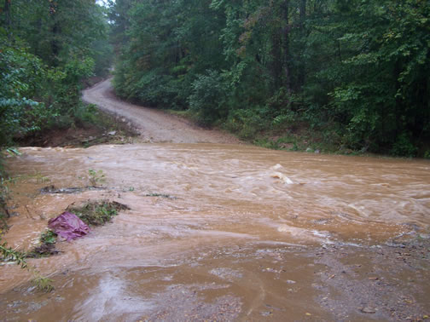
Increased Likelihood of Flooding
Notes:
Increased sedimentation causes the pipe to fill and flooding over the road

Slide 28
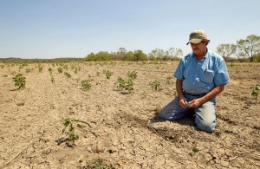
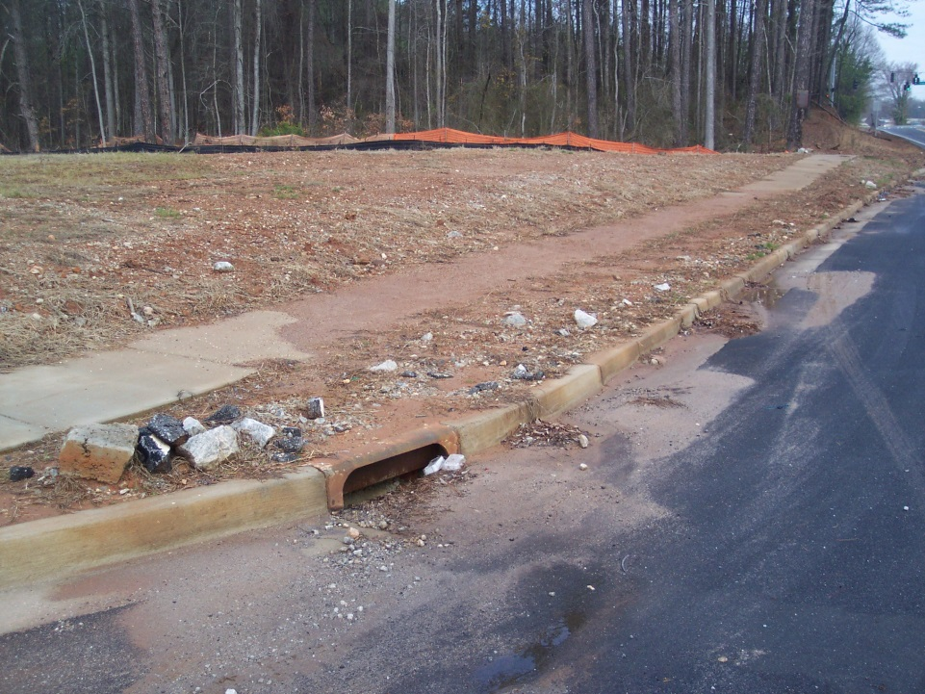
Loss of Soil Productivity
Notes:
Decline in crop production and construction site ground cover growth due to increased sedimentation

Slide 29
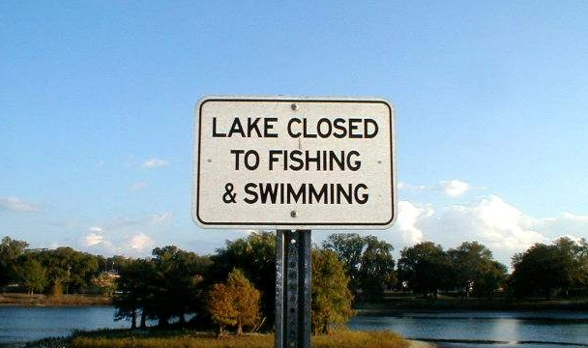
Decreased Recreational Value
Potential impacts to revenue in the State
Notes:
Recreational activities such as boating, fishing, swimming can all be impacted due to increased sedimentation

Slide 30
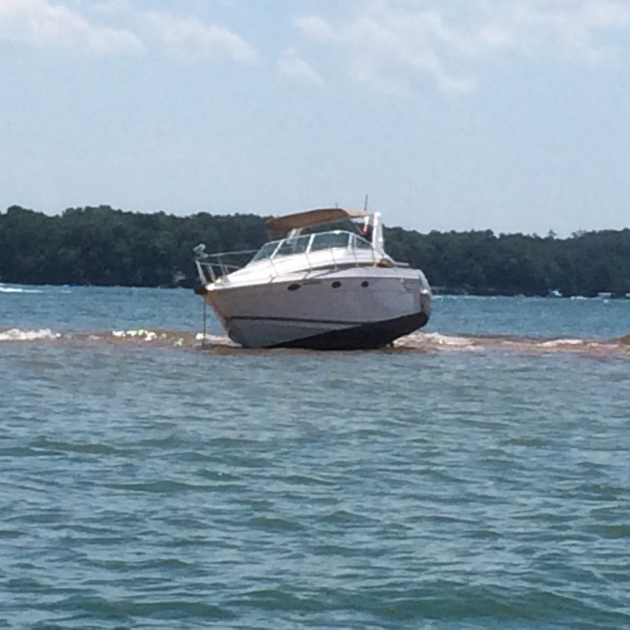
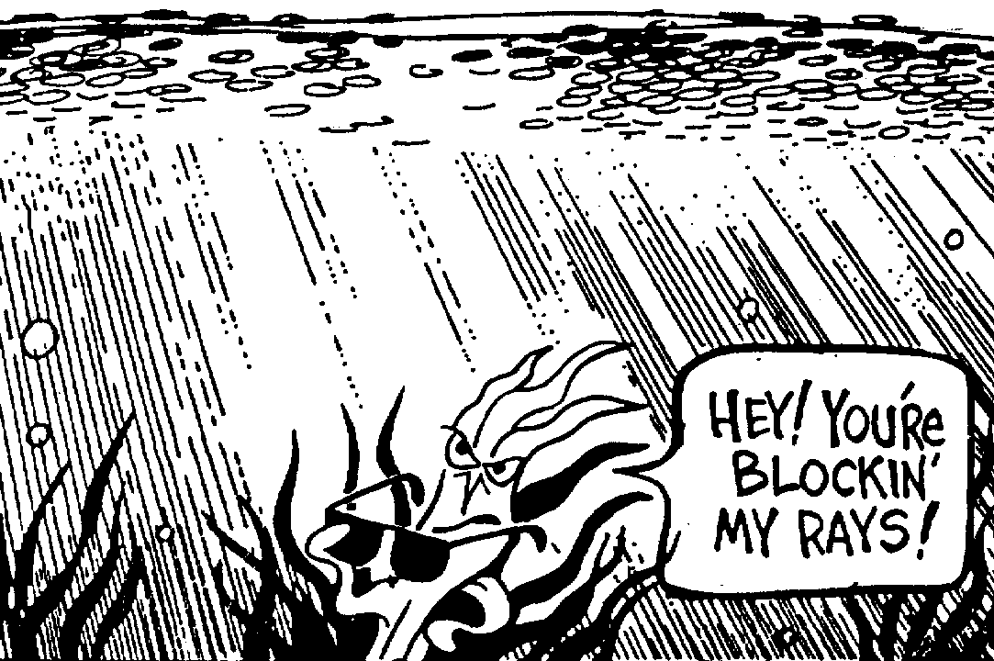
Decreased Recreational Value
Suspended sediment can block sunlight and result in a decline in plant growth
Notes:
Increased sedimentation in Lake causes boat to become beached and aquatic plants to die, therefore decreasing oxygen levels in creeks and rivers.

Slide 31
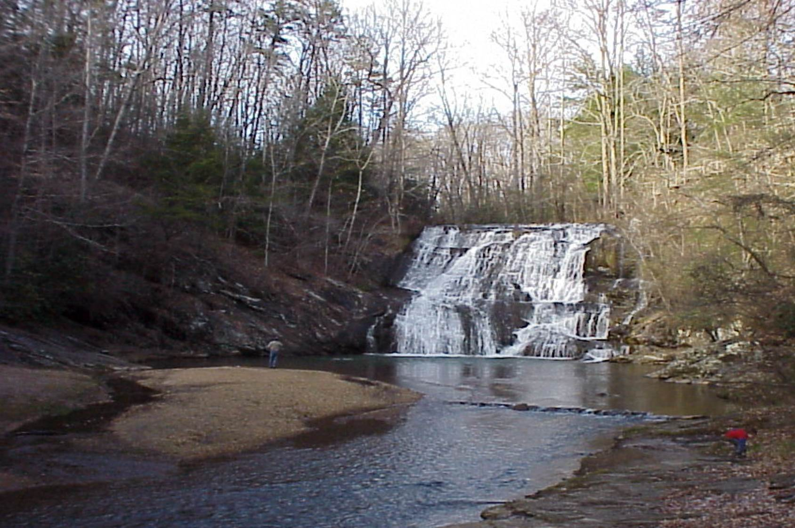
Deterioration of Water Quality
Notes:
Fall Season before construction begins

Slide 32
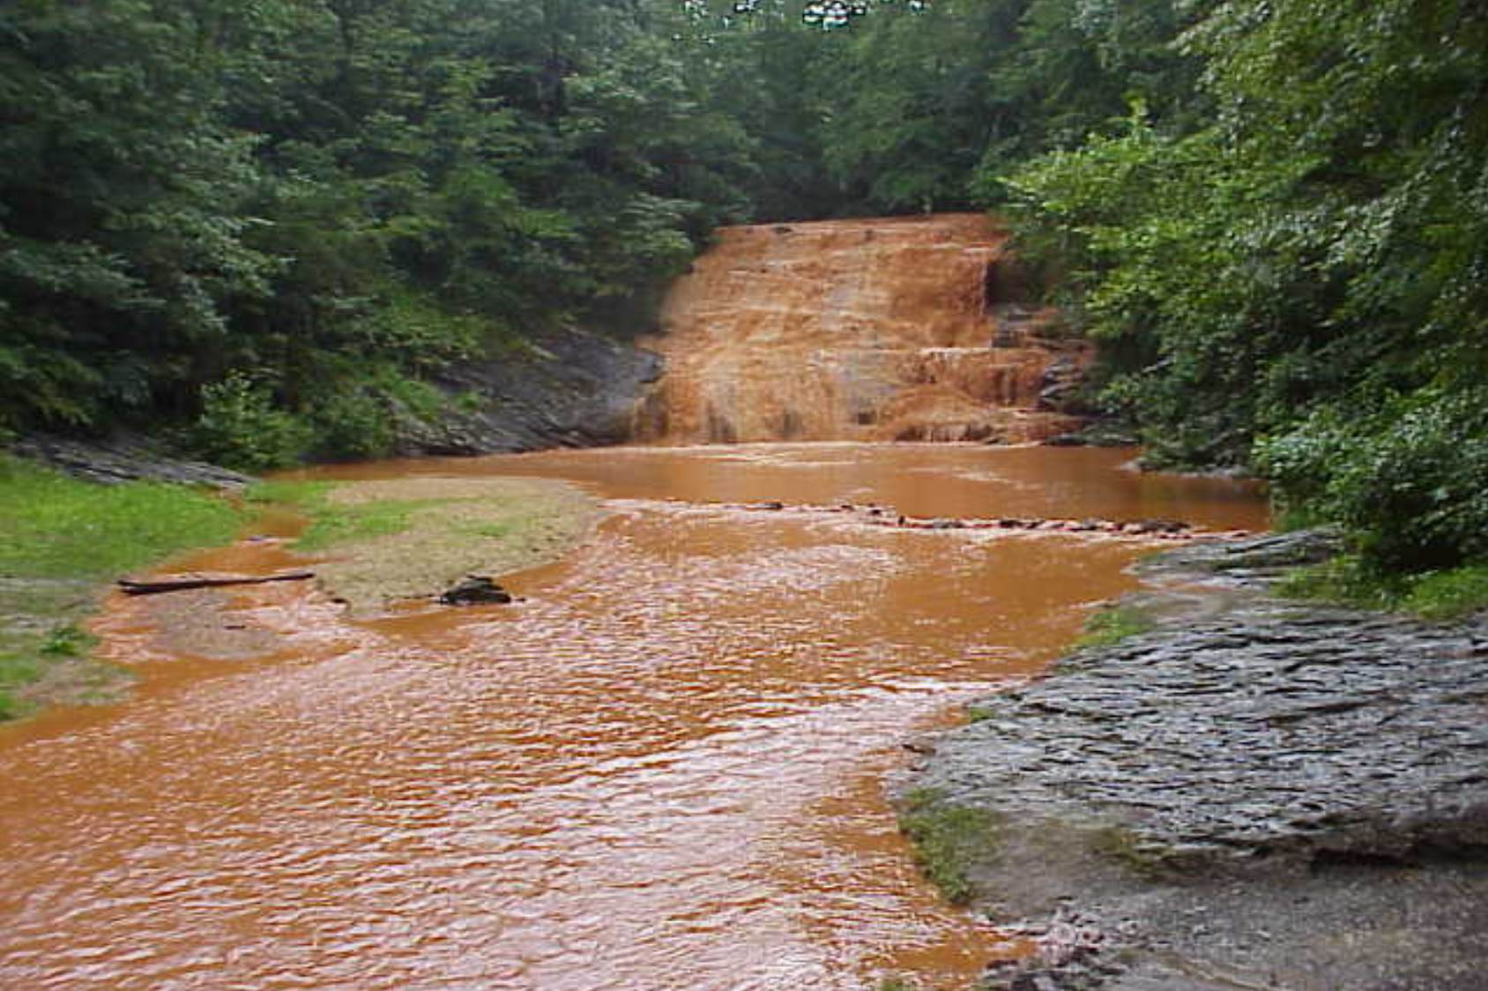
Deterioration of Water Quality
Notes:
Spring Season after construction has started

Slide 33
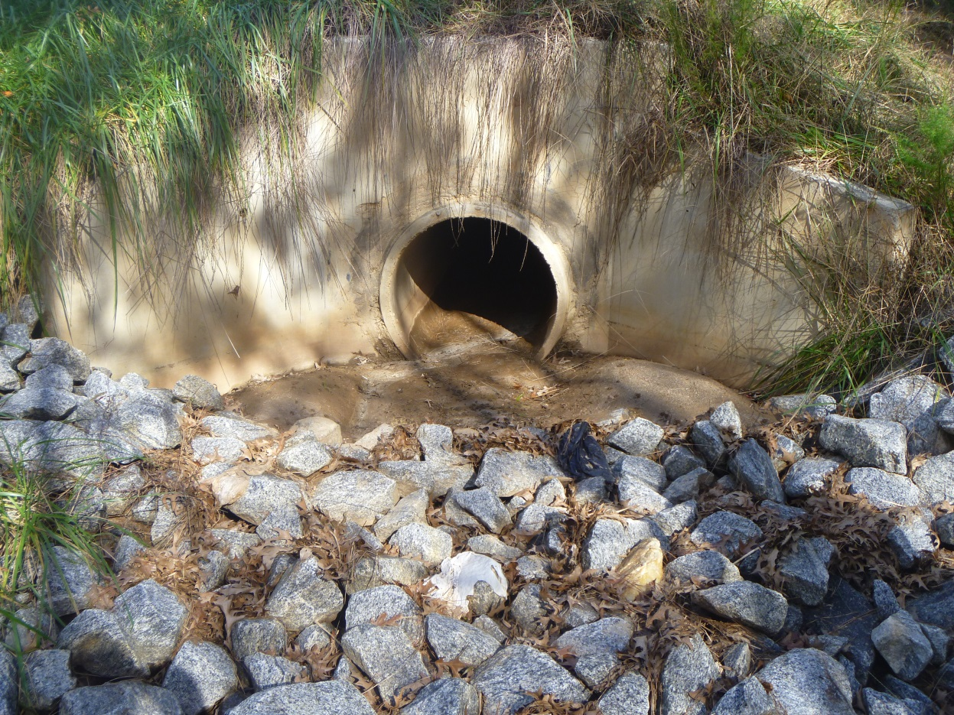
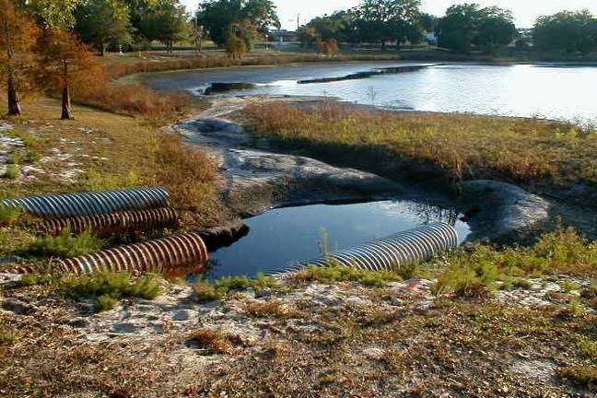
Increased Costs & Maintenance
As structures begin to fill with sediment, the flood control storage
volume decreases
Notes:
Infrastructure maintenance increases significantly when sedimentation isn't taken care of on site

Slide 34
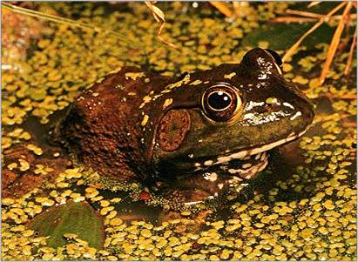
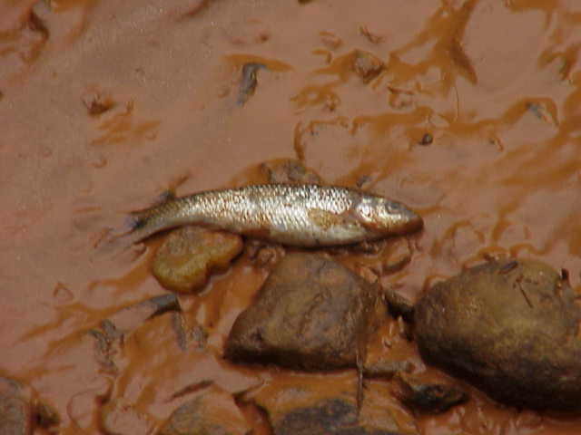
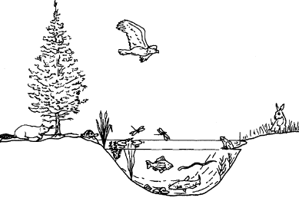
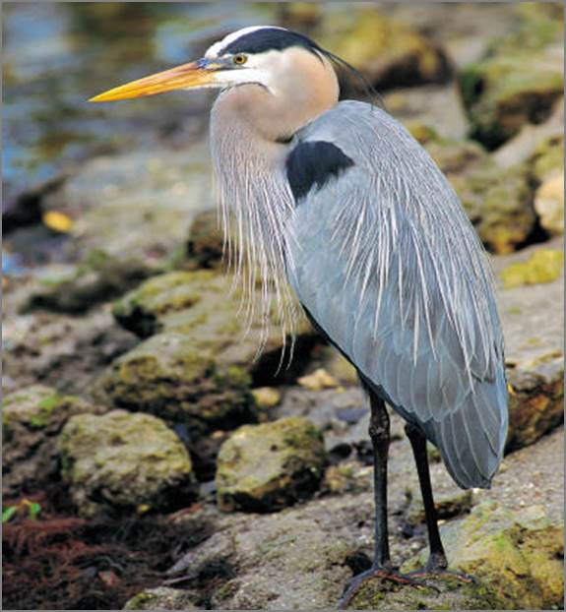
Impacts to Wildlife & Habitat
Decreased oxygen levels
Aquatic plant changes
Loss of habitat
Notes:
Fish kills due to decreased O2 levels, All aquatic organisms are affected by sedimentation in different ways which cause them to migrate to find new food sources and habitat

Slide 35
Summary
Erosion & Sedimentation are natural processes that can be accelerated by human activities
Erosion = Detachment
Sedimentation = Deposition
If accelerated erosion and sedimentation is not controlled properly on land disturbance sites, everyday resources will be impacted and costs will increase

Slide 36

Questions?
GSWCC
Urban Program
4310 Lexington Road
Athens, GA 30605
(706) 552-4474

