Slide 1
Common Issues on Site
Structural & Vegetative Measures
Level 1A Recertification
Effective August 2018

Slide 2
Maintenance
A series of properly designed, installed, and MAINTAINED BMPs shall constitute a complete defense to any regulatory enforcement
A BMP cannot function properly if it is not being properly maintained
Permittees should be inspecting BMPs on a daily, weekly, and monthly basis
All reporting to EPD is to be done electronically in GEOS

Slide 3
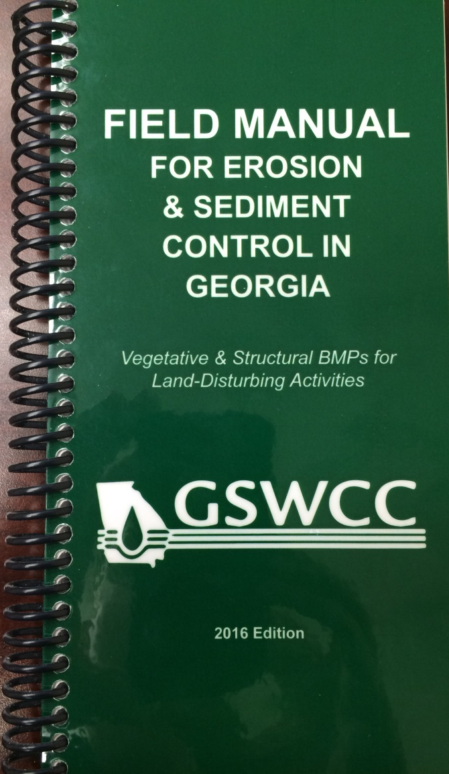
Field Manual
The current 2016 edition of the Field Manual for Erosion & Sediment Control in Georgia contains maintenance requirements for each structural and vegetative BMP
Can be found at:
www.gaswcc.georgia.gov
Notes:
As well as the Green Book & ES&PC Plan

Slide 4
Example (Sd1)

Slide 5
What to Look For
Vegetative Measures
Structural Measures
Lime requirements
Fertilizer requirements
Mulching
Re-seeding
Mowing
Inspections
Monitoring
De-mucking
Clean-out depths
Replacing materials

Slide 6
Documentation
If any BMP is in need of maintenance, it should be noted in the permittee inspection reports
Include all observations related to each individual BMP
Document on the reports the fix for each maintenance requirement
Document compliant BMPs on all inspection reports as well

Slide 7
Vegetative Measures
Common Maintenance Requirements

Slide 8
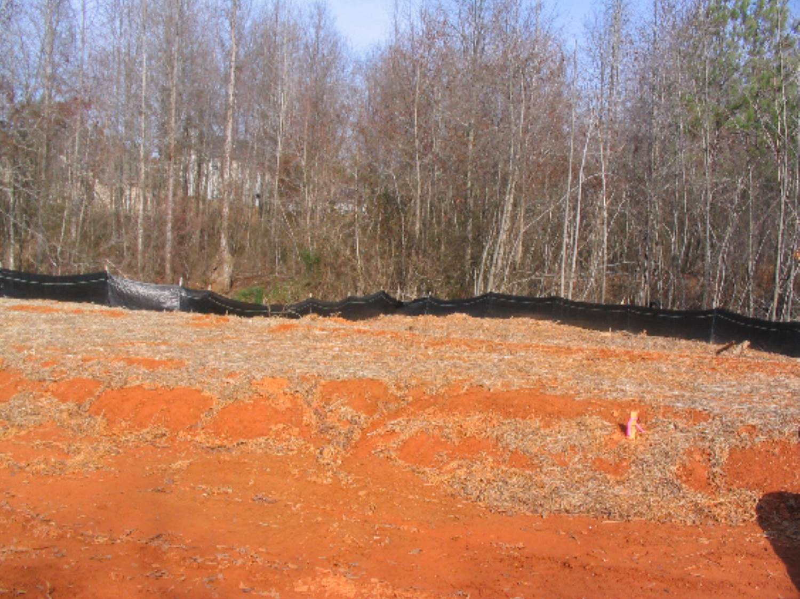
Ds1 - Mulching
90% cover is not being
maintained

Slide 9
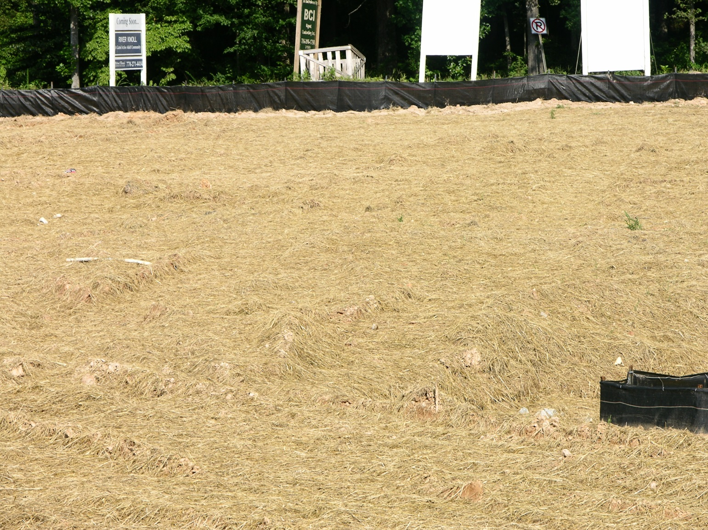
Ds1 - Mulching
Straw/hay shall be at a depth of 2”-4”
Notes:
Proper mulching depth

Slide 10
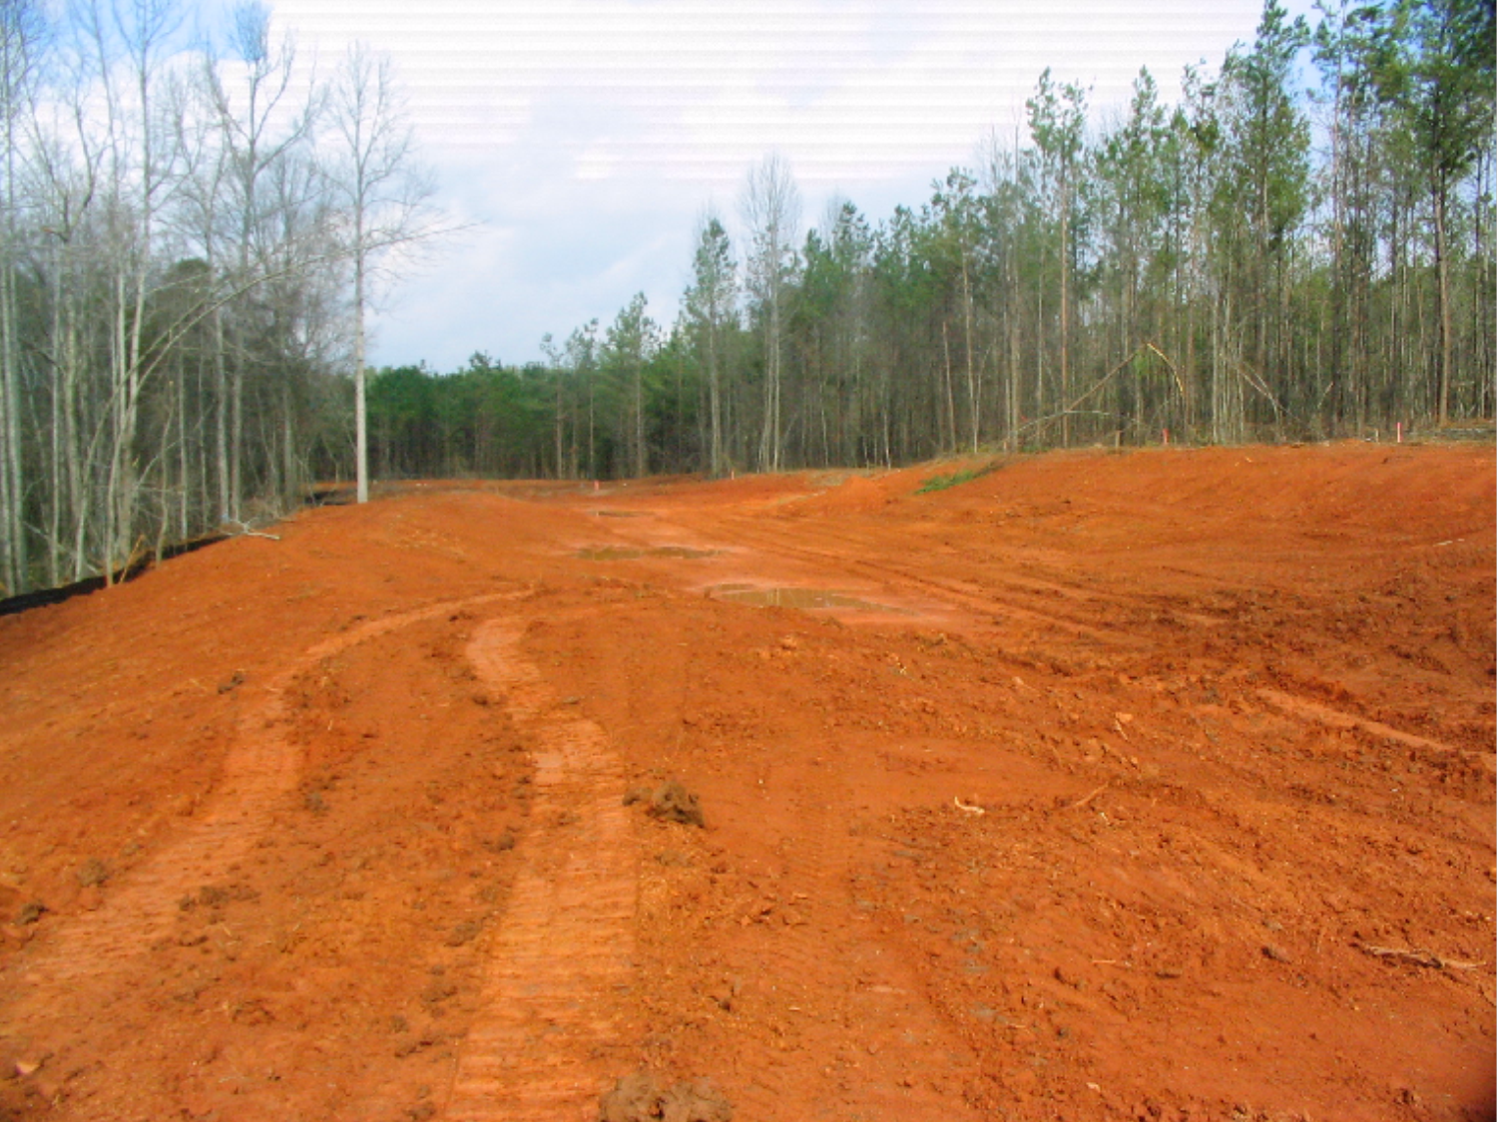
Ds2 – Temporary Vegetation
Area in need of temporary
seeding
Notes:
Even roads after 14 days of sitting idol need stabilization if left alone.

Slide 11
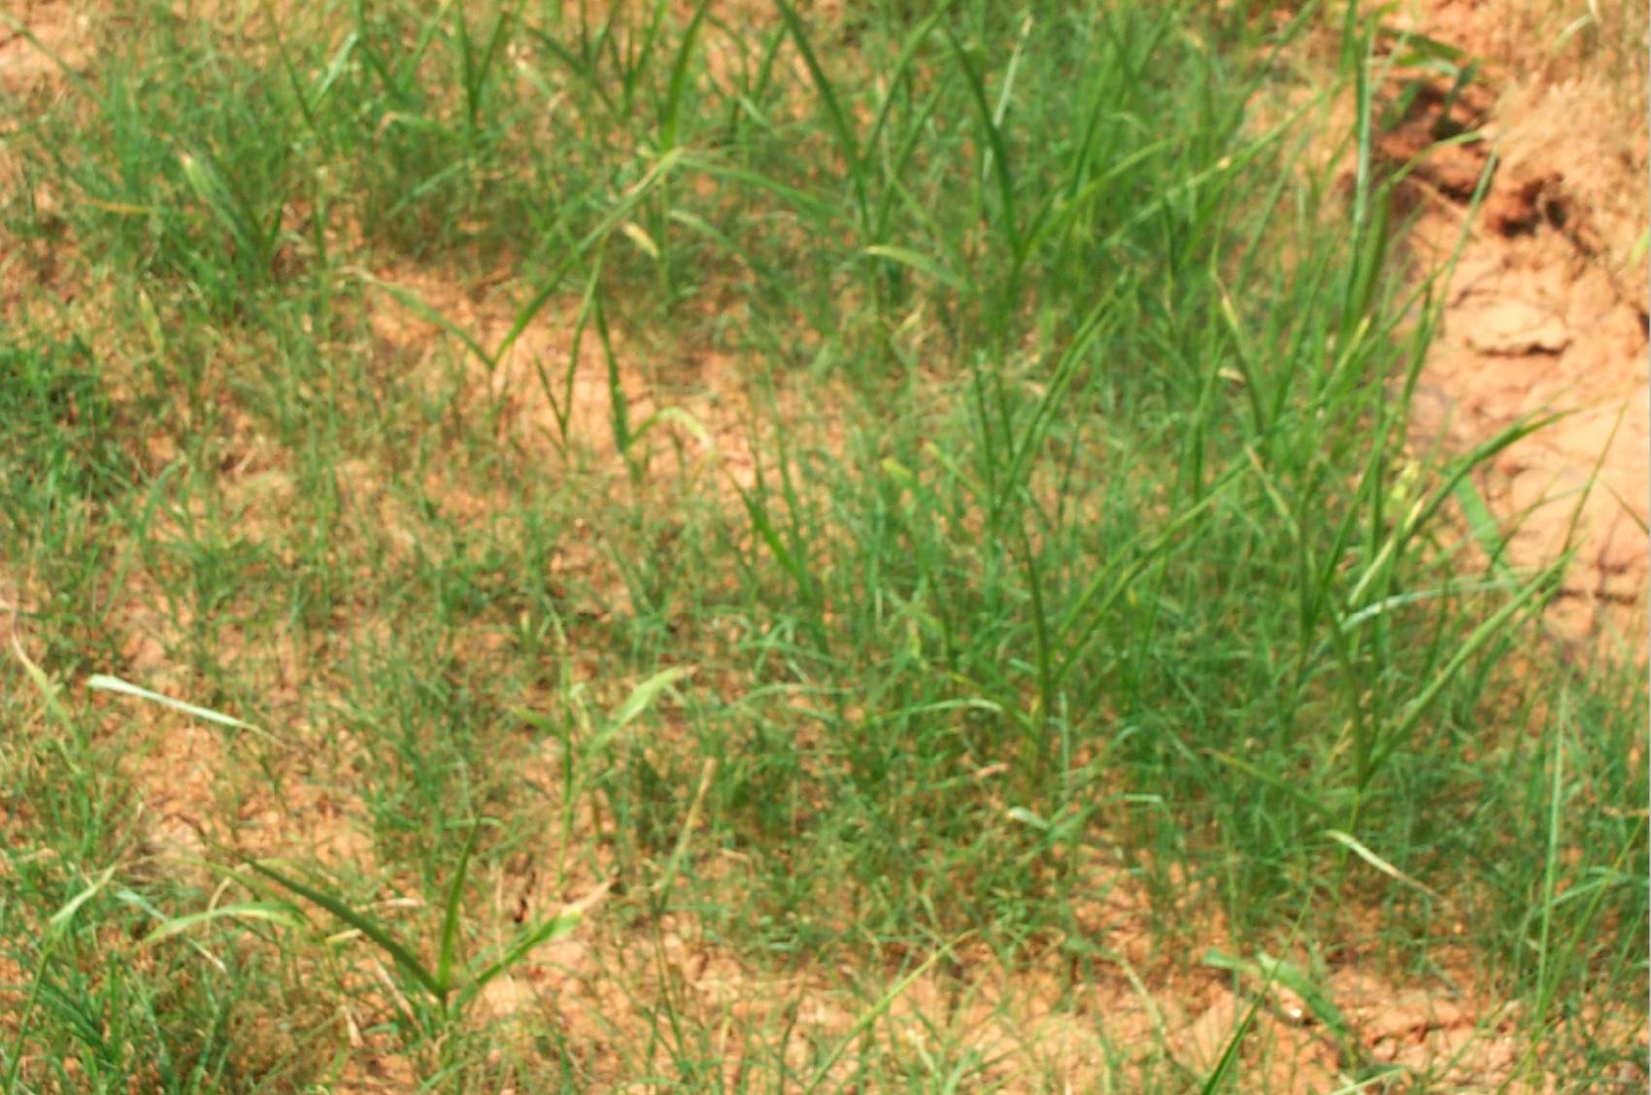
Ds2 – Temporary Vegetation
An adequate stand has failed to emerge. Re-seeding may be
needed
Sedimentation can also inhibit plant growth by screening out
sunlight

Slide 12
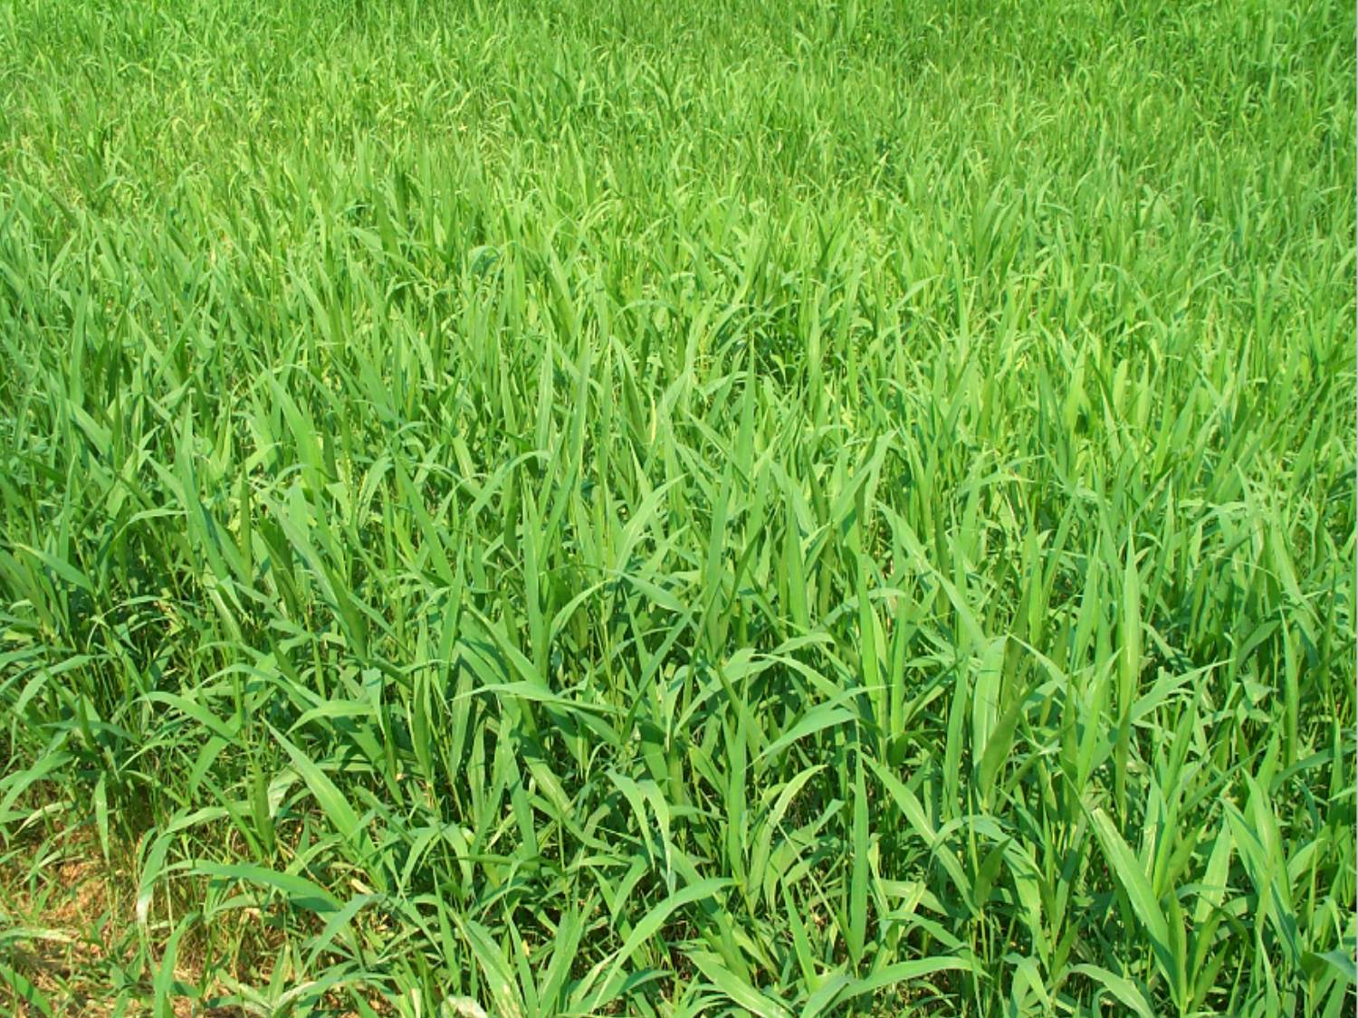
Ds2 – Temporary Vegetation
Properly stabilized stand
A top growth of 6” should be maintained at all
times
Notes:
Picture shows Brown top millet which is warm season temporary vegetation.

Slide 13
Structural Measures
Common Maintenance Requirements

Slide 14
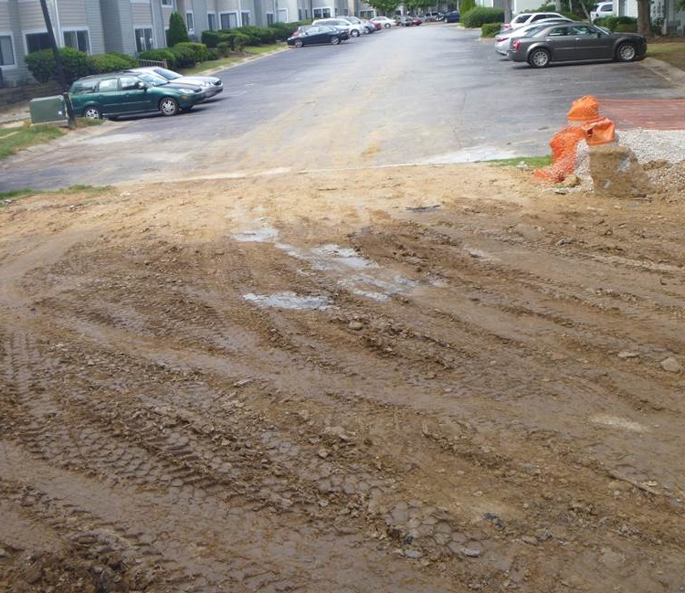
Co – Construction Exit
Co shall be maintained in a condition that will not
allow mud onto the streets
Geotextile underliner?
Mud shall be immediately removed from
roadway
Refresh stone

Slide 15
Co – Construction Exit
Proper
Construction Exit
Co should be periodically dressed with 1.5”
– 3.5” stone
Notes:
20’x50’ with 1.5-3.5 inch stone

Slide 16
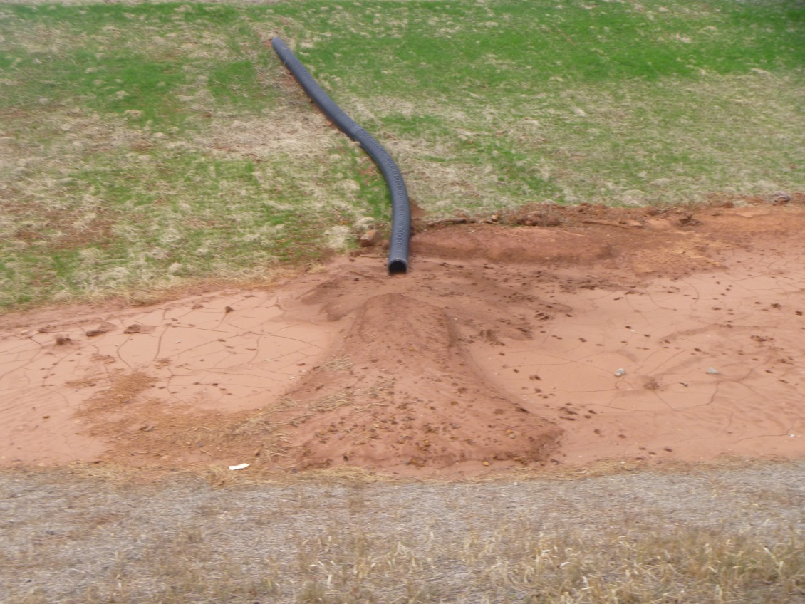
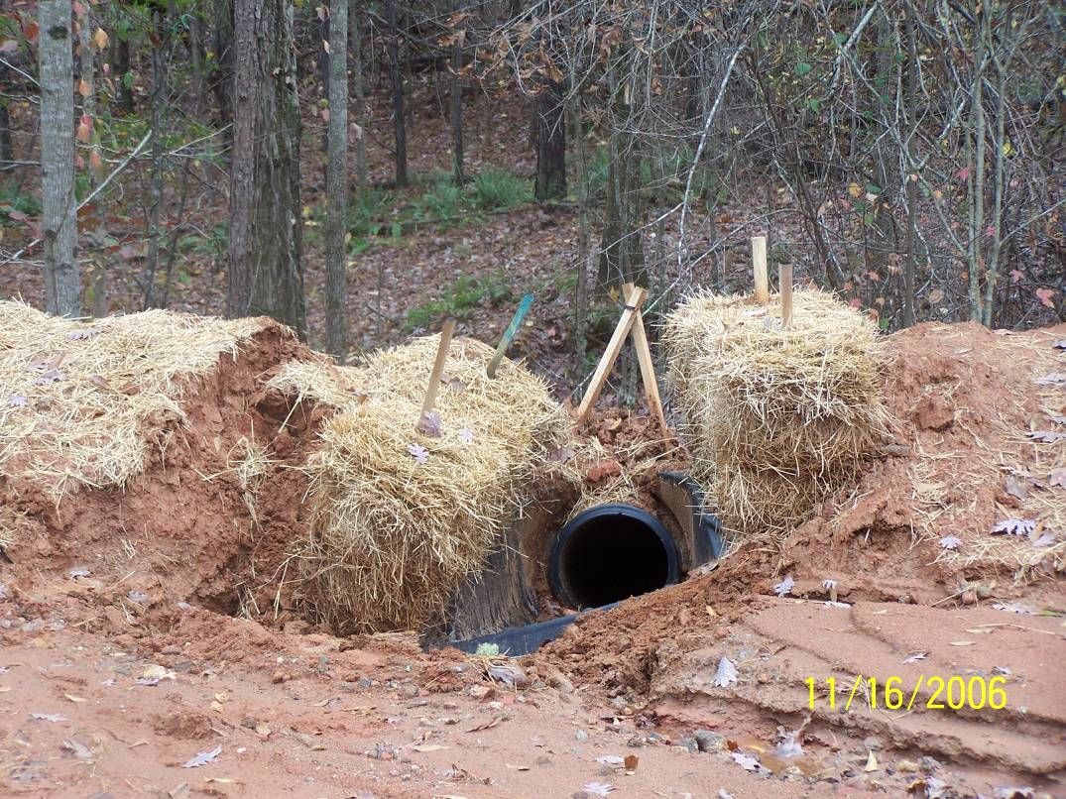
Dn1 – Temporary Downdrain
Improper installation
The dike ridge over top of the pipe was not properly
compacted
If the maximum drainage area is being exceeded for each structure, a design
change would be needed

Slide 17
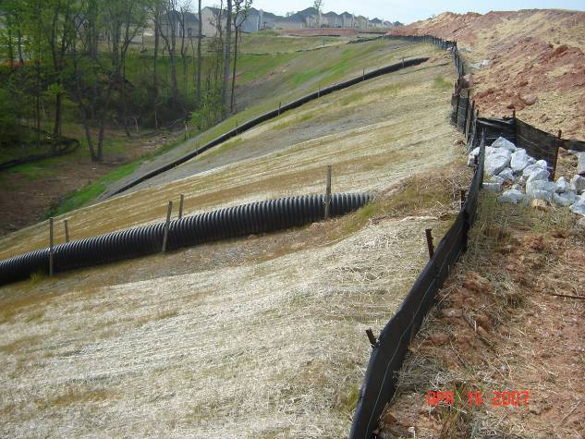
Dn1 – Temporary Downdrain
Stakes should always be used to
anchor pipe
Properly stabilized

Slide 18
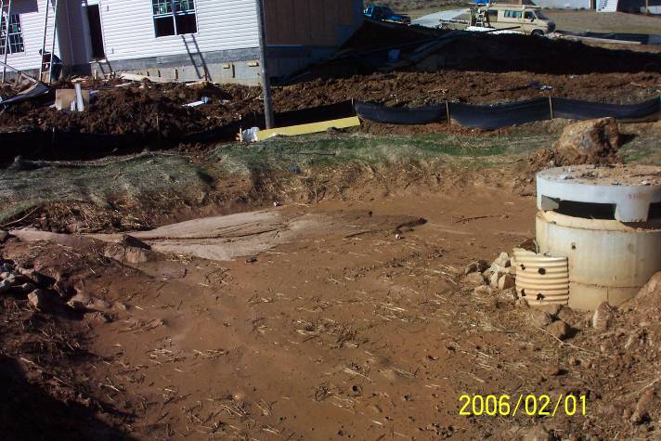
Rt - Retrofit
A Rt should have 1” holes that are 8-10”
apart
Rt shall be cleaned out at 1/3rd full
Notes:
Temporary structure that shall be removed at final stabilization

Slide 19
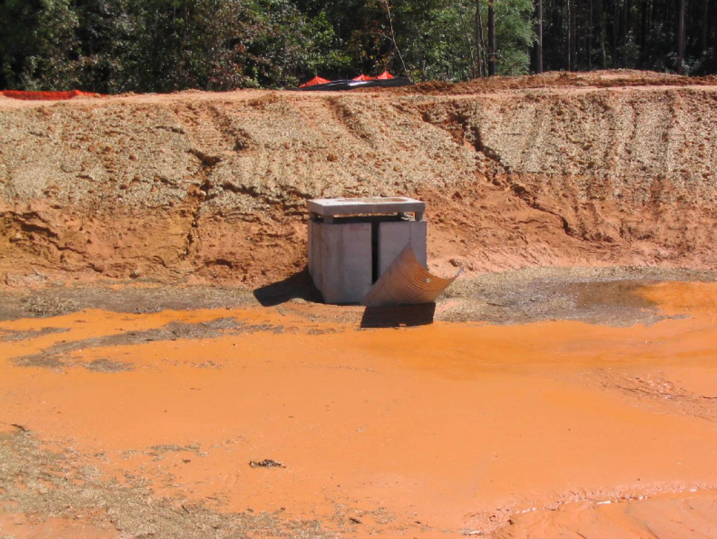
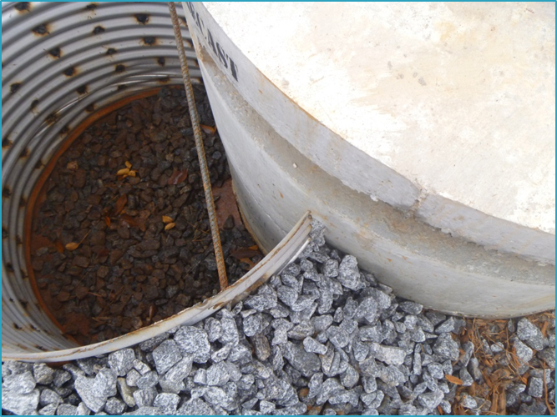
Rt - Retrofit
Rt shall be affixed to the outlet control structure

Slide 20
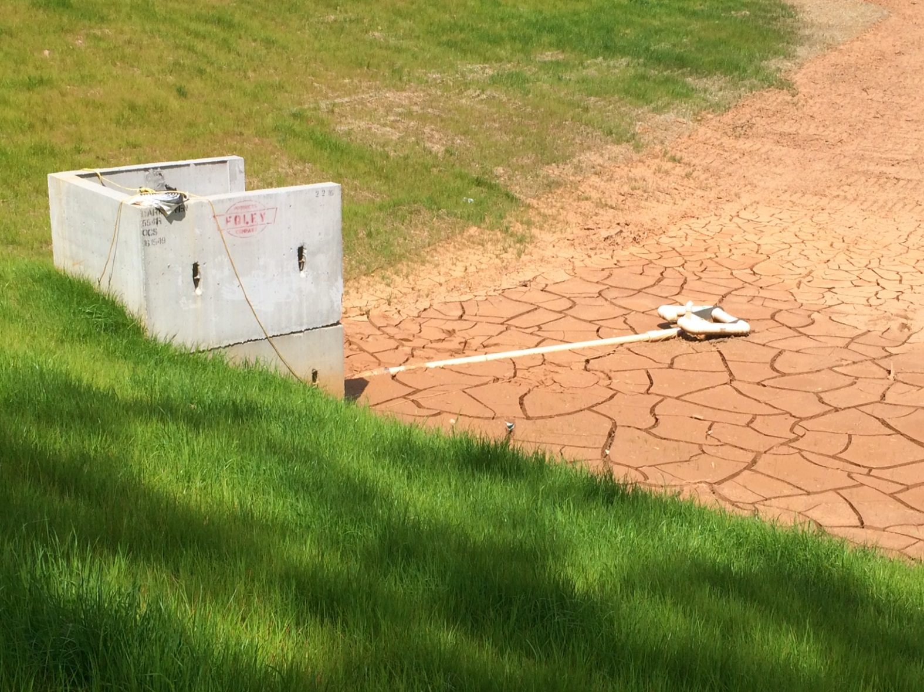
Sk – Floating Surface Skimmer
Skimmer shall be freed from the accumulated sediment to allow
normal operation

Slide 21
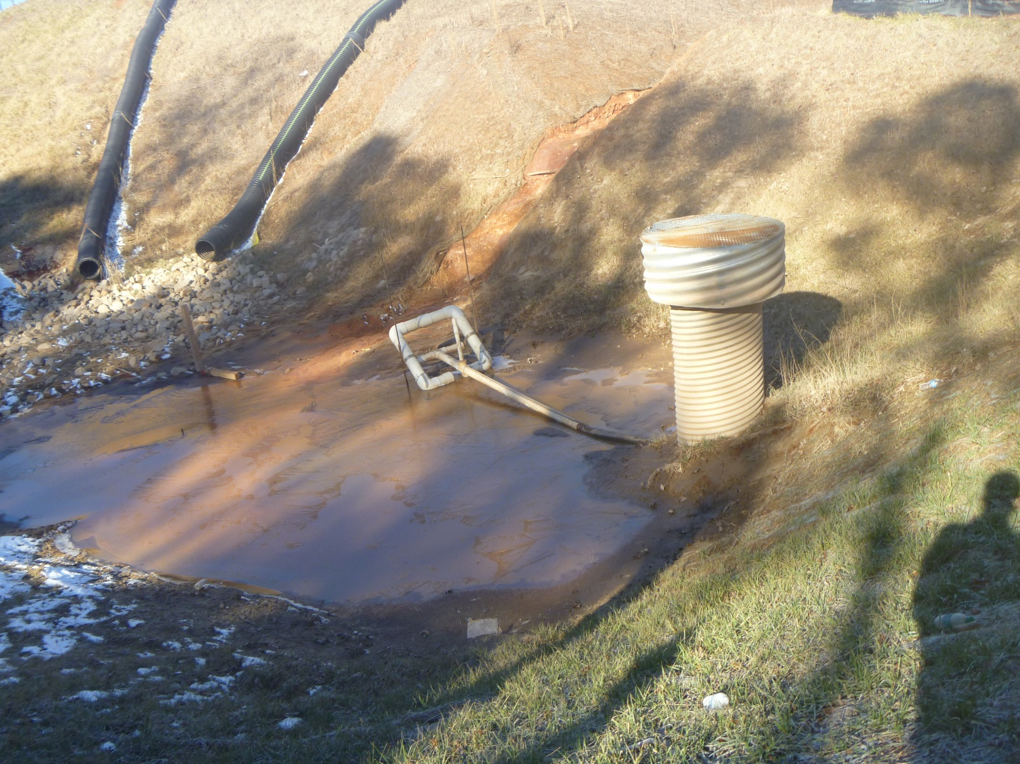
Sk – Floating Surface Skimmer
Skimmer resting on metal bar out of the accumulated
sediment

Slide 22
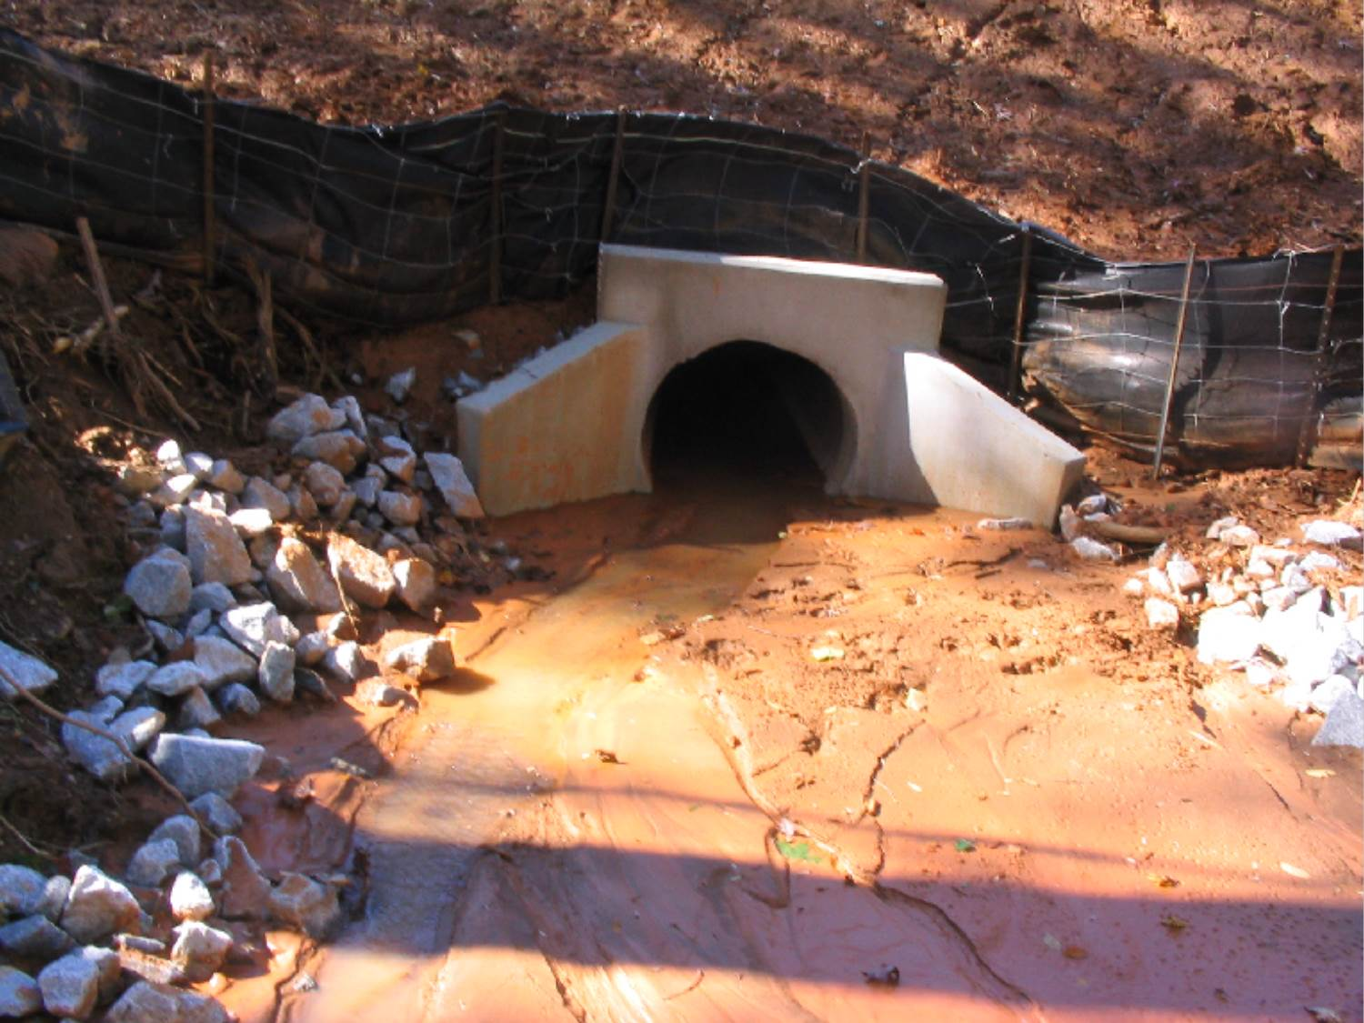
St – Storm Drain Outlet Protection
Pond should discharge clean water. This should be cleaned out and
riprap replaced
Notes:
This is likely indicative of another maintenance problem on the site such as a failure to maintain the pond and properly stabilize the site

Slide 23
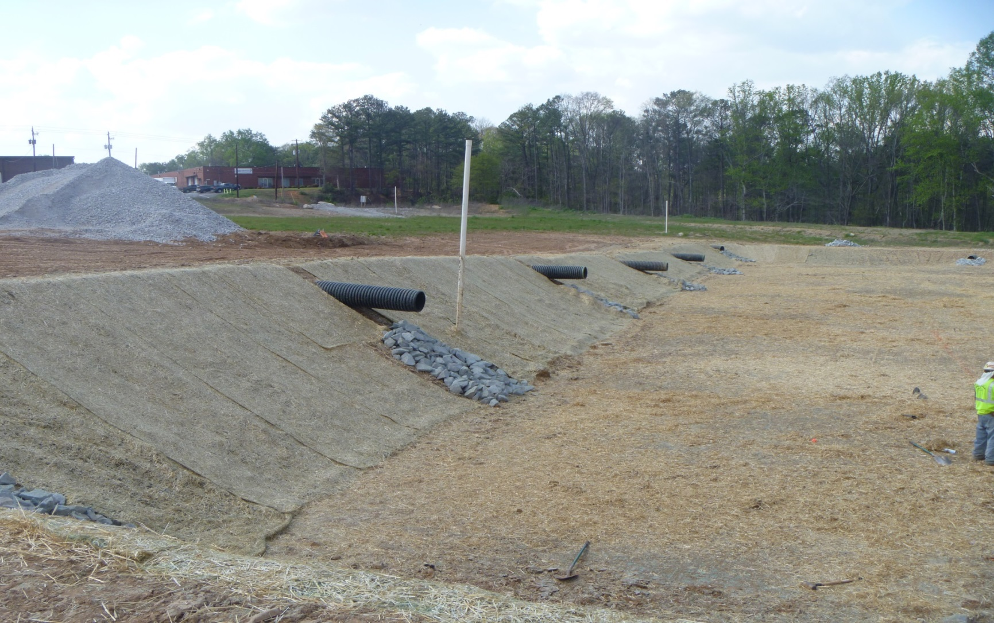
St – Storm Drain Outlet Protection
An incorrect installation can lead to additional
maintenance needs
Notes:
What is wrong with this outlet protection on some of the st’s in the picture? In the closest st the water comes out with such velocity that it misses half of the St causing more erosion in the bottom of the sediment pond

Slide 24
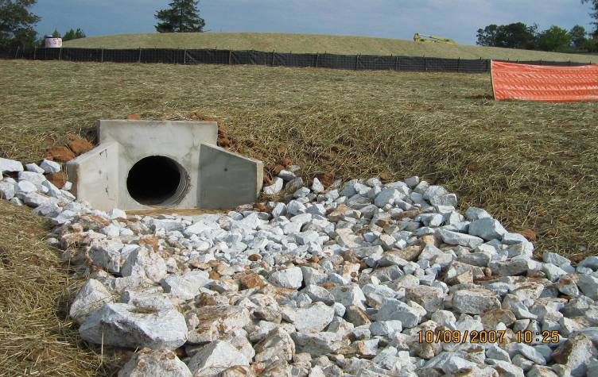
St – Storm Drain Outlet Protection
Proper Outlet Protection

Slide 25
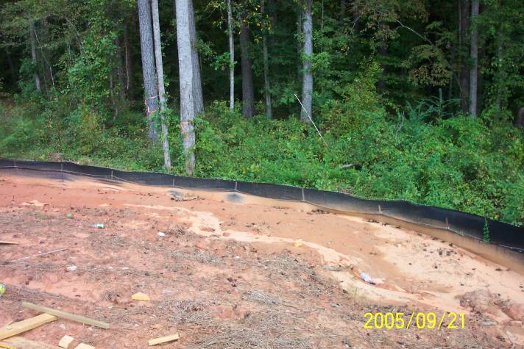
Sd1 – Sediment Barrier
The space between the rows should be at least 36”
2nd
Row
The 1st row is completely full
Sd1 shall be cleaned out at ½
full

Slide 26
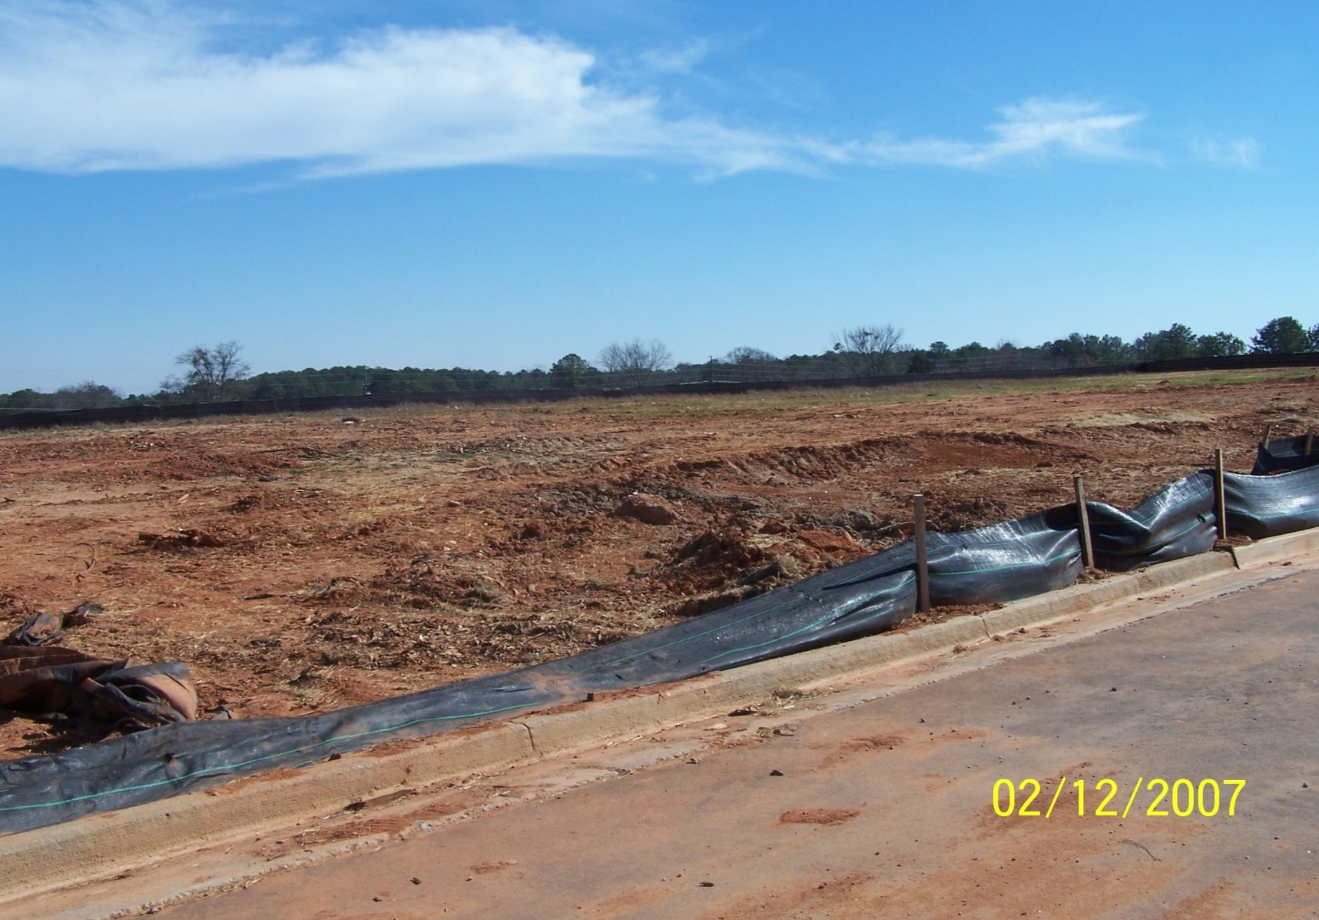
Sd1 – Sediment Barrier
Sd1 is to maintain 80% of its properly designed height

Slide 27
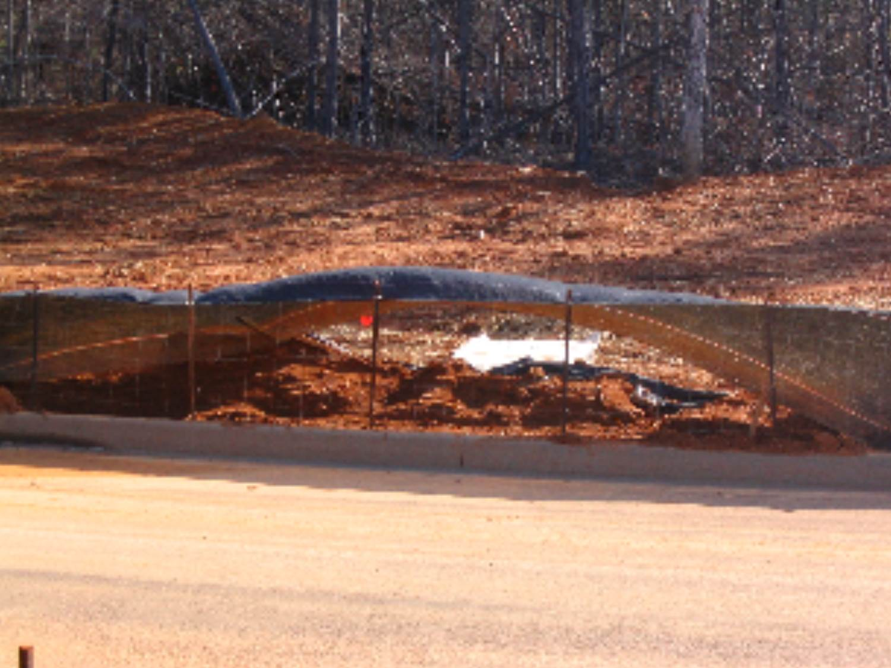
Sd1 – Sediment Barrier
Silt fence is to be trenched in a minimum of 6
inches

Slide 28
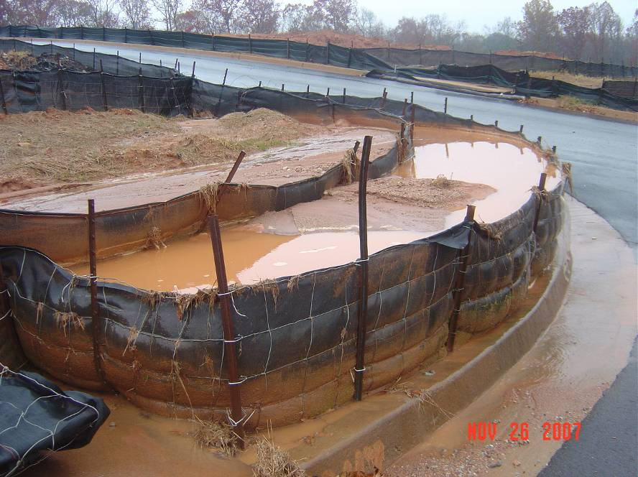
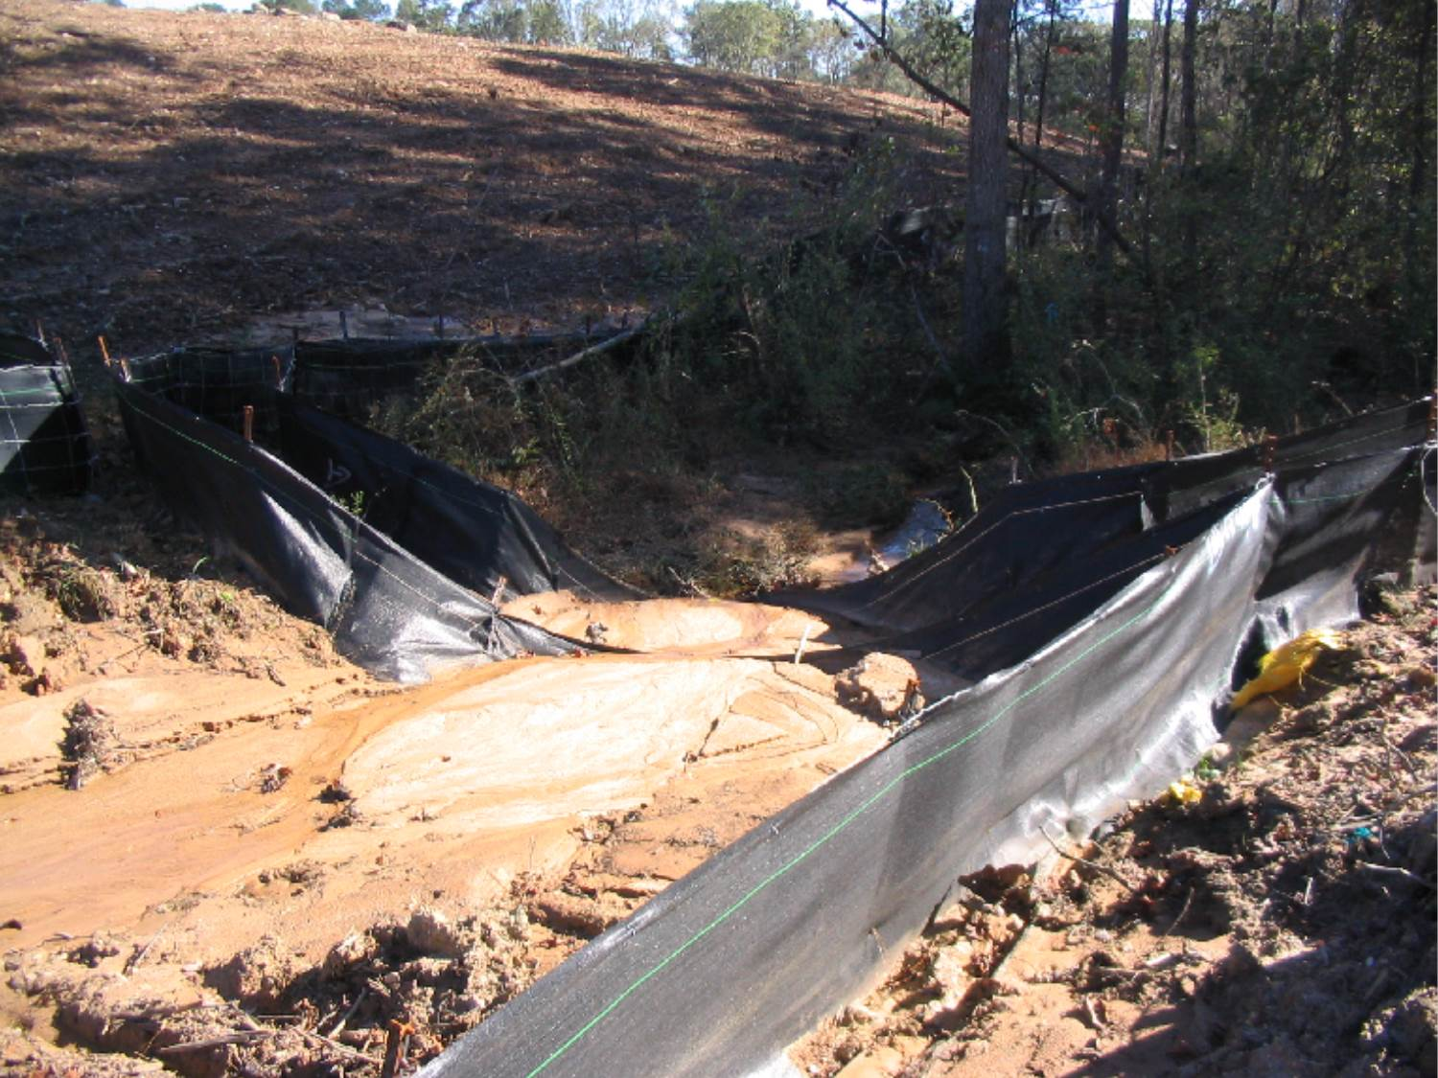
Are These the Right BMPs?
Sd1 is not designed to be placed in
concentrated flow
A sediment storage BMP would be a better choice for
this area

Slide 29
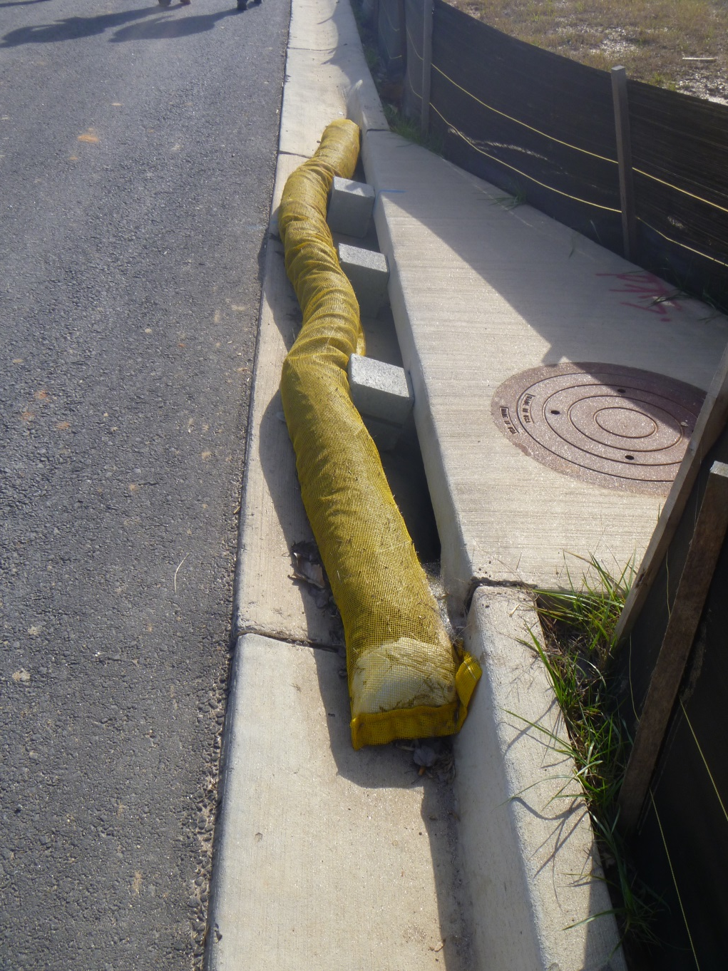
Sd2 – Curb Inlet Protection
Proper installation

Slide 30
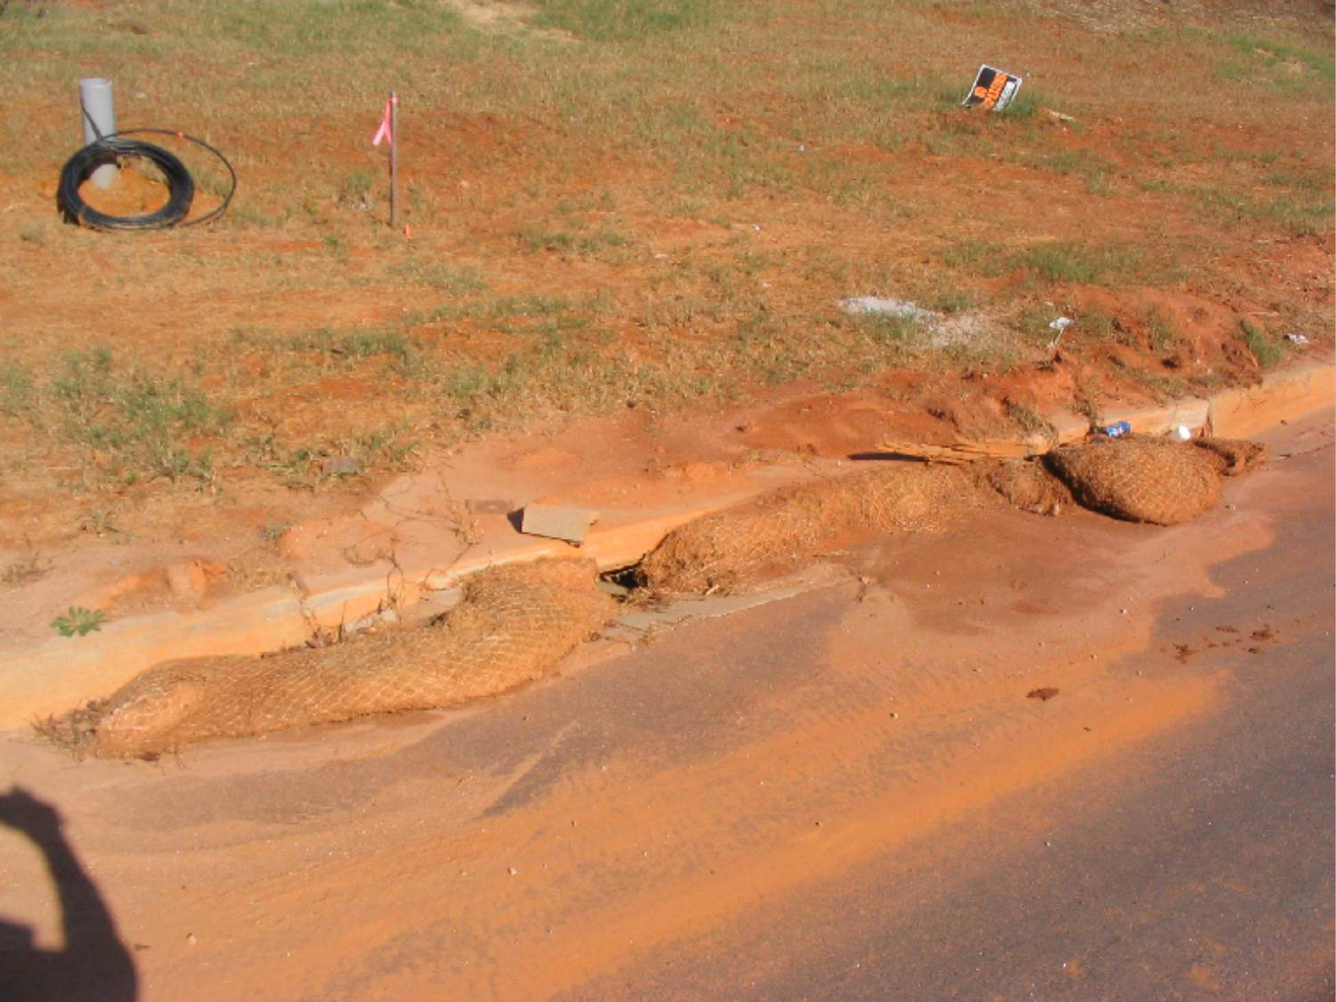
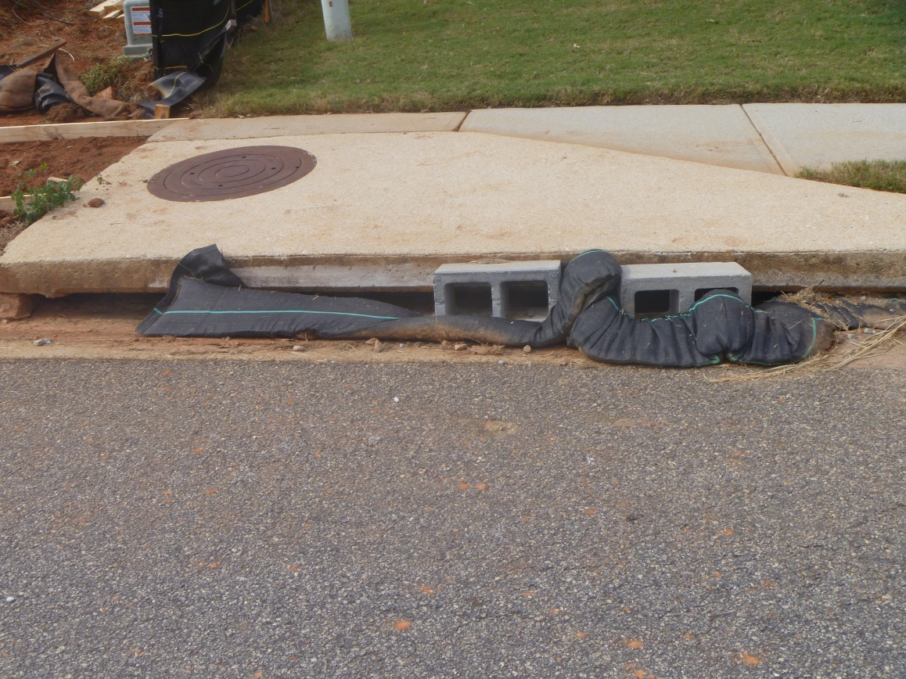
Sd2 – Curb Inlet Protection
If inlet cannot drain properly, ponding can occur
Sediment shall be removed from curb inlet protection
immediately

Slide 31
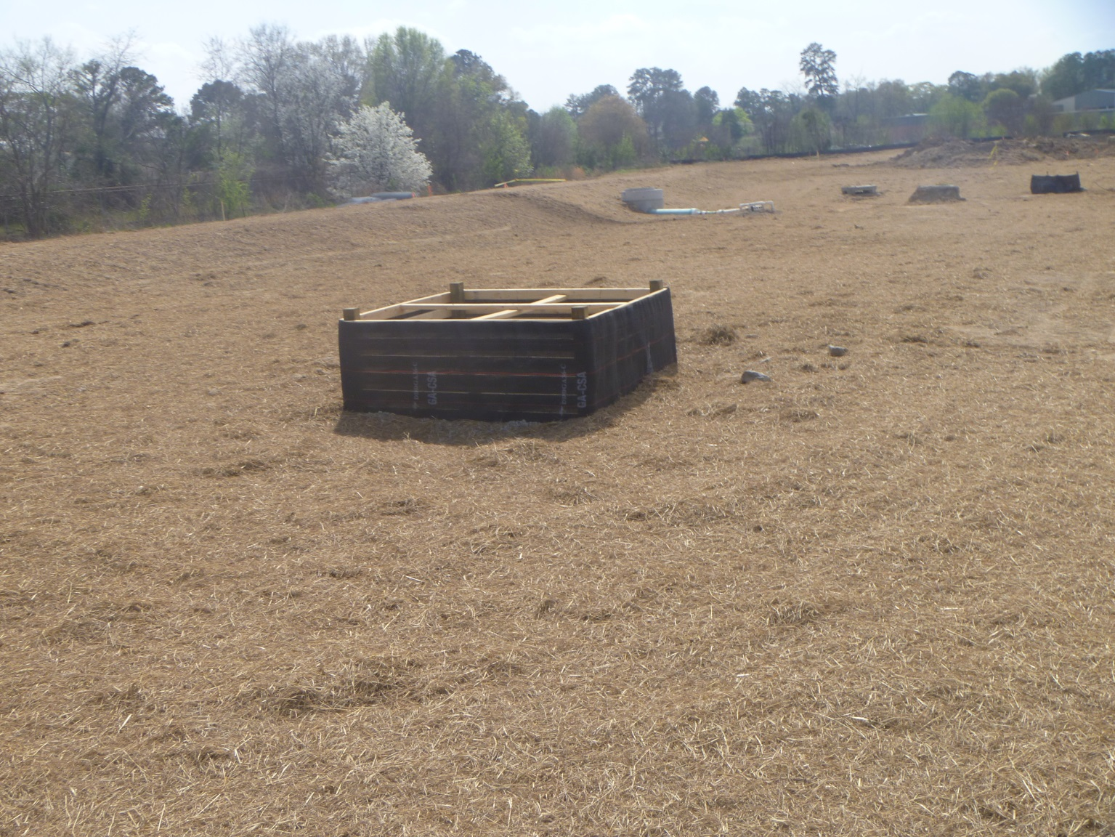
Sd2 – Inlet Protection
Sd2-BB
Proper Sd2 installation
Notes:
Sd2-BB (Baffle box)

Slide 32
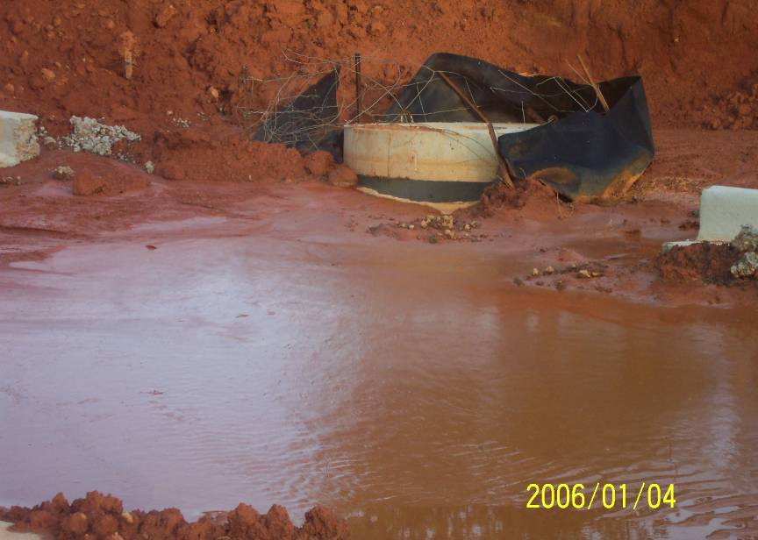
Sd2 – Excavated Inlet Protection
Sd2 shall be cleaned out at ½
full
Filter fabric and frame should be
replaced

Slide 33
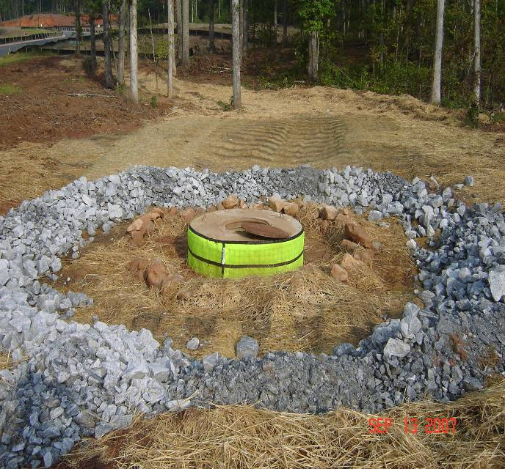
Sd2 – Excavated Inlet Protection
Properly excavated Sd2 shown in conjunction with a
Filter Ring

Slide 34
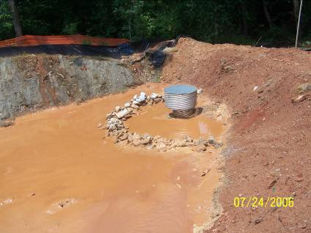
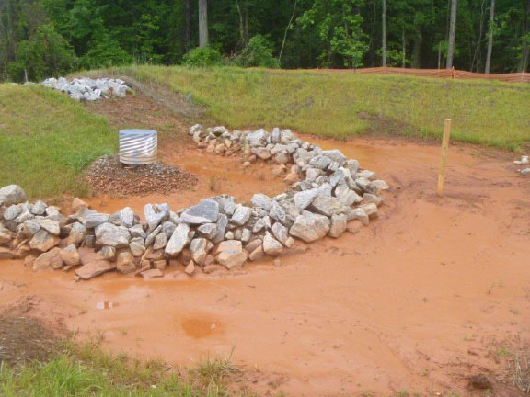
Sd3 – Temporary Sediment Basin
Sd3 shall be cleaned out at
1/3rd full

Slide 35
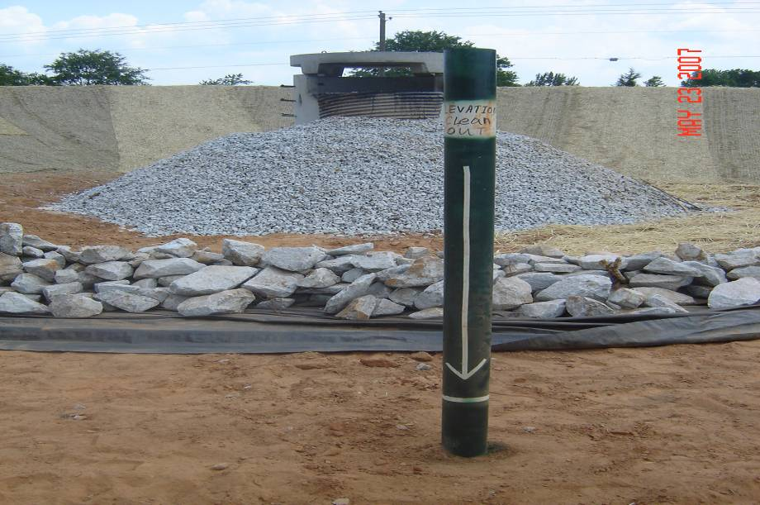
Example Clean-out Marker
Notes:
For temporary and permanent ponds

Slide 36
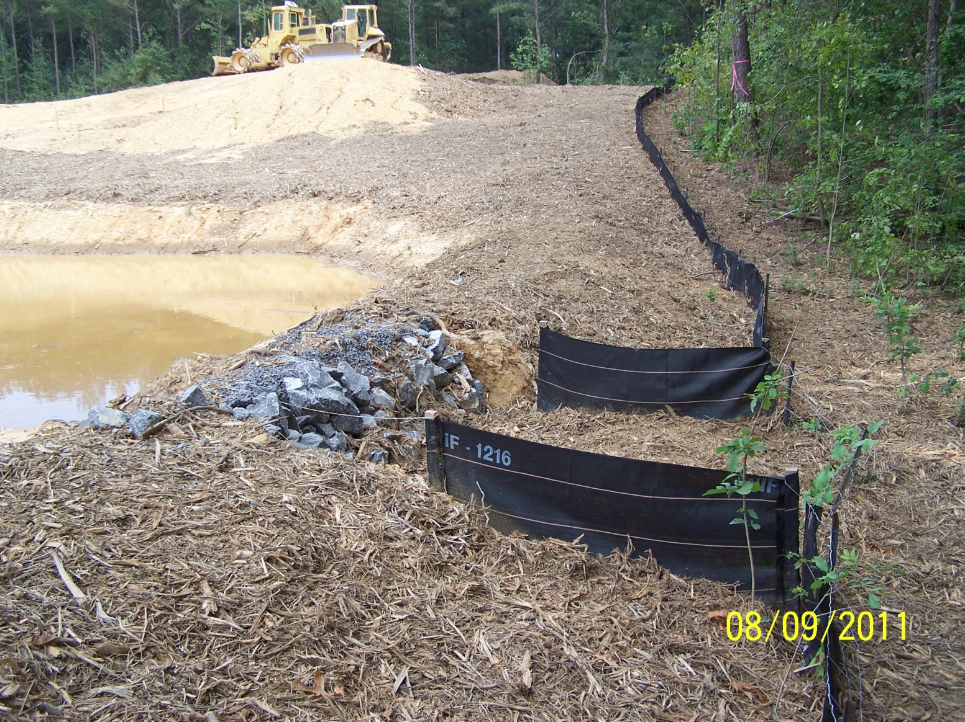
Sd4 – Temporary Sediment Trap
Sd4 shall be cleaned out at
1/3rd full

Slide 37
Tp - Topsoil
Stockpile should be stabilized with temporary vegetative
measures
Stockpile should be contained by sediment barriers

Slide 38
Summary
Remember to use the approved ES&PC Plan & Field Manual for guidance when it comes to maintenance requirements
Failure to maintain BMPs can result in possible enforcement, loss of resources (time, money, etc…), and even civil suits
Using a series of sound BMPs that are properly (1) designed, (2) installed, and (3) maintained is the only way to prevent problems from occurring on site

Slide 39
Questions?
GSWCC
Urban Program
4310 Lexington Road
Athens, GA 30605
(706) 552-4474

