Slide 1
AGENCY ROLES
Local, State, & Federal
Level 1B: Advanced Fundamentals
Effective August 2018

Slide 2
Agencies Involved
Local
Local Issuing Authorities (County/Municipality)
State
Georgia Soil & Water Conservation Commission
Soil & Water Conservation Districts
Georgia Environmental Protection Division
Federal
USDA - Natural Resources Conservation Service
U.S. Army Corps of Engineers
Environmental Protection Agency

Slide 3
Local Issuing Authorities

Slide 4
Local Issuing Authorities
Certified LIA
City or county has adopted an ordinance which is in compliance with the provisions of O.C.GA 12-7
City or county has inspection personnel, who are or will be certified inspectors (IB certified) in erosion and sediment control.

Slide 5
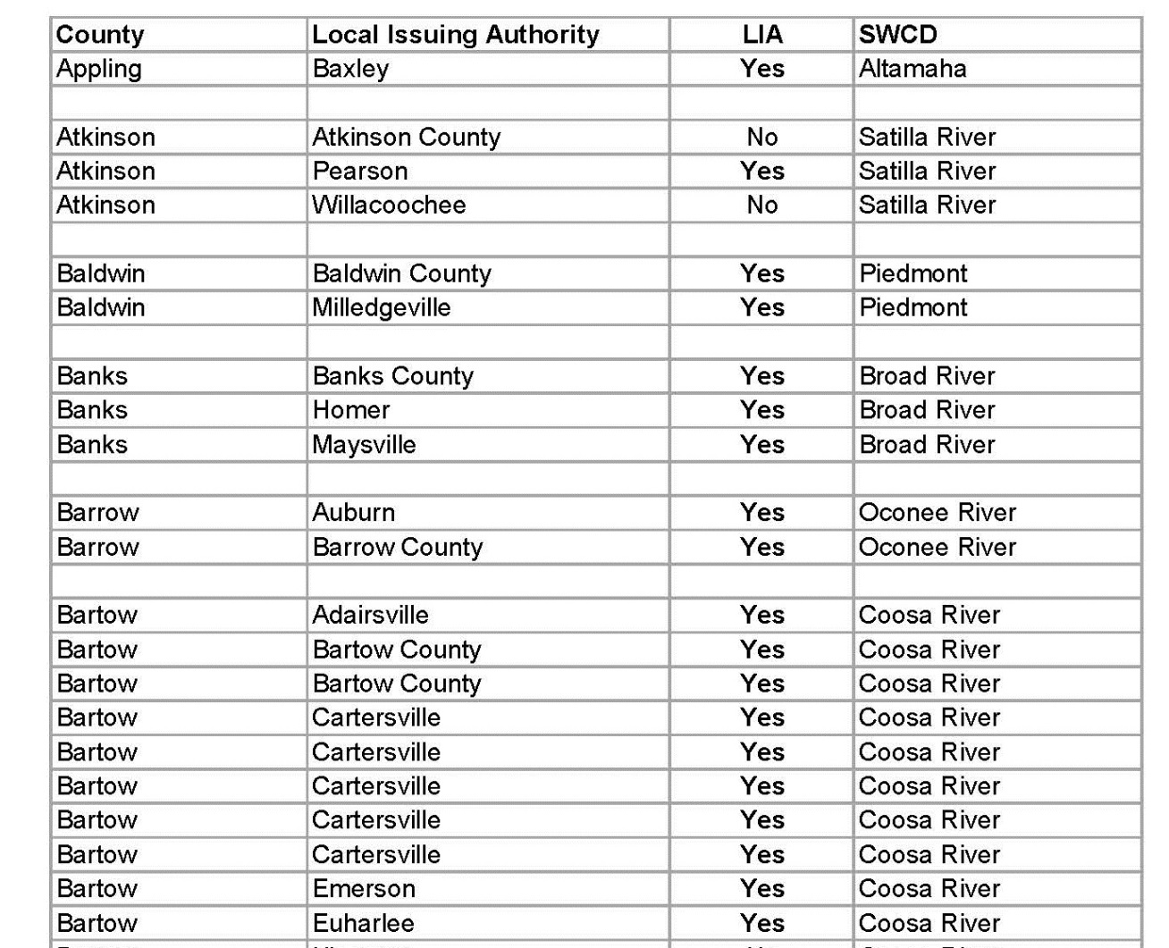
Local Issuing Authorities
Please refer to the “Resource Information” in the back of this section for a complete list of all Local Issuing Authorities in
the State of Georgia

Slide 6
LIA Role in E&SC in Georgia
Process LDA applications
Forward ES&PC plans to SWCD for review
Issue permits
Maintain list of active permits
Conduct inspections
Enforce ordinance
Collect fees
Handle E&S complaints

Slide 7
Georgia Soil & Water Conservation Commission

Slide 8
GSWCC
The Georgia Soil & Water Conservation Commission is a non-regulatory agency charged by law to provide information, education and technical assistance to Georgia citizens to better protect the state’s land and water resources

Slide 9
GSWCC
State Headquarters
4310 Lexington Road
Athens, GA 30605
(706) 552-4470
Education & Certification Program
(706) 552-4474
certification@gaswcc.ga.gov

Slide 10
GSWCC Role in E&SC in Georgia
Urban Water Resource Program
Certification Program
Course design and development w/ SAB
Administration of certification program
Offer training opportunities around the State
Audit approved trainers
Technical Program
Publication of Design and Field Manuals
Development and implementation of Plan Review Checklists
Provides technical assistance to SWCDs, other government agencies, various stakeholders
Technical review ES&PC Plans
Participant in Complaint Resolution Process

Slide 11
GSWCC role in E&SC in Georgia
Rural Water Resources Program
Contact concerning any agricultural type E&SC complaints

Slide 12
Soil & Water Conservation Districts

Slide 13
SWCD
Created in 1937 by GA legislature
There are 40 Soil & Water Conservation Districts in Georgia with 370 Supervisor positions
Each county has at least two supervisors
Supervisors are elected and appointed
Unpaid public servants

Slide 14
SWCD Role in E&SC in Georgia
Approve/deny ES&PC Plans
Participate in District Assessment Teams (DAT) and overview Local Issuing Authority programs
Memorandums of Agreement with Local Issuing Authorities
Participant in Conservation partnership

Slide 15
Georgia Environmental Protection Division

Slide 16
GA EPD
The Environmental Protection Division of the Georgia Department of Natural Resources is a state agency charged with protecting Georgia's air, land, and water resources through the authority of state and federal environmental statutes.

Slide 17
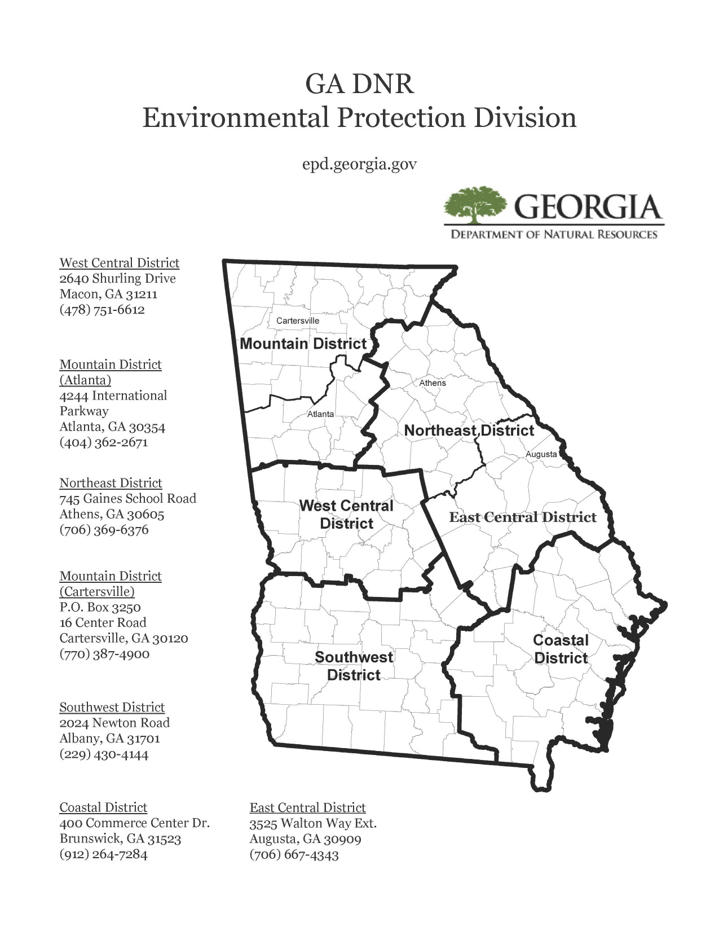

Slide 18
EPD Role in E&SC in Georgia
Selective enforcement
Certification/De-certification of Local Issuing Authorities
Complaint Resolution
State Waters determinations
Notes:
Selective enforcement – EPD enforces the NPDES permit where there is no local issuing authority and also provides selective enforcement in all jurisdictions. When a city or county can not resolve compliance problems, the problem must be referred to EPD for resolution

Slide 19
USDA-Natural Resources Conservation Service

Slide 20
USDA-NRCS
The Natural Resources Conservation Service of the United States Department of Agriculture provides technical expertise and conservation planning for farmers, ranchers and forest landowners wanting to make conservation improvements to their land.

Slide 21
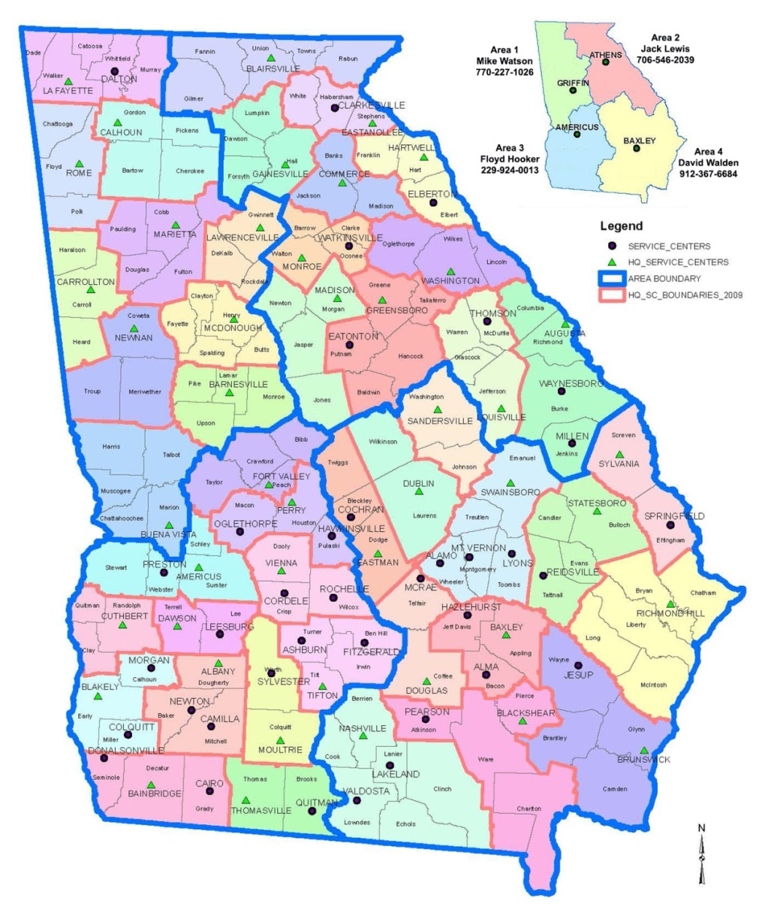
USDA-NRCS
Area 1 Griffin
201 W Solomon St
Griffin, GA 30223
Area 2 Athens
355 E Hancock Ave
Athens, GA 30601
Area 3 Americus
295 Morris Dr
Americus, GA 31719
Area 4 Baxley
239 NE Park Ave
Baxley, GA 31513
State Office
355 E Hancock Ave
Athens, GA 30601
NRCS also operates Service Centers across Georgia to meet the needs of each of Georgia’s 159 counties.

Slide 22
NRCS Role in E&SC in Georgia
Technical review of ES&PC plans
Technical guidance and support as requested
Participant in Conservation Partnership

Slide 23
U.S. Army Corps of Engineers

Slide 24
USACE
The Regulatory Program of the United States Army Corps of Engineers is committed to protecting the Nation's aquatic resources and navigation capacity, while allowing reasonable development through fair and balanced decisions.

Slide 25
USACE
Savannah District
Regulatory Division U.S. Army Corps of Engineers ATTN: CESAS-RD 100 West Oglethorpe Avenue Savannah, Georgia 31401-3604
Piedmont Branch U.S Army Corps of Engineers 1590 Adamson Parkway The Plaza, Suite 200 Morrow, GA 30260-1777
Coastal Branch U.S. Army Corps of Engineers ATTN: CESAS-RD-C 100 West Oglethorpe Avenue Savannah, Georgia 31401-3604

Slide 26
USACE Role in E&SC in Georgia
Evaluate permit applications for construction activities that occur in the Nation’s waters
Jurisdiction
Section 10 – Rivers and Harbors Act of 1899
Regulates structures, or work in or affecting, navigable waters of the United States
Section 404 – Clean Water Act of 1972
Regulates discharges of dredged or fill material into wetlands and other waters of the United States

Slide 27
Environmental Protection Agency

Slide 28
EPA
The Environmental Protection Agency leads the nation's environmental science, research, education and assessment efforts and protects Americans from significant risks to human health and the environment where they live, learn, and work

Slide 29
EPA
EPA Region 4 Office
61 Forsyth Street SW
Atlanta, GA 30303
(800) 241-1754
Notes:
Georgia is in EPA Region 4

Slide 30
EPA Role in E&SC in Georgia
Develops and enforces environmental regulations
Offers financial assistance in the form of grants
Performs environmental research
Sponsors voluntary projects and programs
Furthers environmental education
Provides technical information

Slide 31
Additional Agencies
Georgia Forestry Commission
Purpose is to minimize erosion and stream sedimentation from forestry practices
Accept E&SC complaints relating to logging/silviculture
GA DNR Coastal Resources Division
Primary responsibility is managing Georgia's marshes, beaches, and marine fishery resources
Responsible for determining marsh jurisdictional lines relating to buffers

Slide 32
Summary
Local, State and Federal agencies are involved in erosion and sediment control regulation, enforcement and technical guidance
Contact information for participating agencies available in “Resource Information” section of course notebook

Slide 33
Questions?
GSWCC
Urban Program
4310 Lexington Road
Athens, GA 30605
(706) 552-4474

