Slide 1


Role of the Inspector
Enforcement
Level 1B: Advanced Fundamentals
Effective August 2018

Slide 2
Purpose of the Inspector
The inspector is the key person in determining if the approved plan has been implemented properly
The inspector is the person who ensures the responsible party keeps the site in compliance
The inspector should be effective at communicating the issues present on site
The inspector should ensure that all sites are being evaluated fairly and consistently

Slide 3
Role of the Inspector
Duties that can be expected of an inspector
  Official Representative
  Fact Finder
  Provider of enforcement presence
  Enforcement case developer
  Technical educator
  Technical authority
Notes:
Personification of agency, city or county, Quality of work reflection on credibility of agency, Intermediary between public and regulated community
Gathers information through site inspections and determines compliance
A calm demeanor is always best
Collects and preserves evidence of non-compliance, Generates documentation
Inspector serves as a source of regulatory information and may provide technical assistance to individuals on-site
Interpret regulatory requirements, assess the adequacy of control measures on site, interpret technical data, assess impacts

Slide 4
Characteristics of an Exceptional Inspector
Inquisitive
Determined
Professional appearance
Integrity and impartiality
Avoids conflicts of interest
Maintains standards of conduct
Consistently applies ordinance to all individuals

Slide 5
Certified Local Issuing Authorities
Per O.C.G.A. 12-7-7, one of the responsibilities of a certified LIA is to conduct inspections of all Land Disturbing Projects within its jurisdiction
Inspectors should be visiting sites at least once a week and after every rainfall to ensure the sites remain in compliance
All inspectors should be familiar with their Local Ordinance & the State Law

Slide 6
The Site Inspection
Do’s & Don’ts
Sequence
What should be on site?
Documentation

Slide 7
Before an Inspection
Review the approved ES&PC Plan
  Check contours, critical areas, delineated state waters
Have a copy of the Plan with you or on site at all times
Bring any inspection files or forms that will be needed
Secure any additional equipment you may need, such as cameras, hardhats, safety vests, etc…
Review all phases of the approved plan to understand the scope of the construction activity
Notes:
Before leaving the office, ensure you have everything you need to conduct a proper inspection

Slide 8
Equipment
Field Inspection Equipment may include
  Cameras
  Logbook & Pen
  Tablet
  Tape measure
    Crucial for checking proper installation and maintenance of BMPs
  GPS
  Sampling Equipment
  Turbidity Meter
  GSWCC Field Manual

Slide 9
1st Visit
Present your credentials and provide contact info
Walk the perimeter of the site
Start from the lowest point of the site and work your way up
Ensure that the initial sediment storage and perimeter control BMPs have been installed properly
Document any observations along the way
  Note date, time, and weather conditions
Notes:
If this is the first site visit – walking the site will give you a clear idea of the terrain and will alert you to any potential problems that are occurring from off site water and sedimentation

Slide 10
The ES&PC Plan
During every site inspection
  You should ask to see the approved ES&PC Plan
  Observe how the site has changed since the last inspection
  Confirm the site conditions match the plan
  Determine that all practices have been installed and are being maintained
  If any deficiencies are found, appropriate action must be taken to obtain compliance

Slide 11
What to Inspect
Construction exits
Inspect discharge points & downstream areas for impact
Walk the perimeter of the site
Inspect active areas
Inspect disturbed areas that are not currently being worked
Inspect areas that have undergone final stabilization
Take into account the entire site, phase of the Plan, and ensure that the project is reflective of the Plan
Notes:
Each time the site is visited

Slide 12
What Should Be On Site?
Approved ES&PC Plan
  These should be updated on site if there is ever a revision to the plan
At a minimum, one certified person shall be on site at all times when land disturbing activities are being conducted
The following slide lists all of the documents that must be kept on site or readily available at a designated alternative location until a NOT is submitted

Slide 13
What Should Be On Site?
LDA Permit
All NOIs submitted to the GA EPD
Design Professional 7-day letter
Daily, weekly, and monthly inspection reports
Daily rainfall data
Any buffer variances or permits
Violation summaries and reports
All sampling and monitoring information, results, and reports

Slide 14
Documentation
A complete and factual record should be documented for the entire inspection
  Current activities at the site
  Any observations related to BMPs
  Any observations related to sediment leaving the site
  Any outcomes
These records support potential enforcement action
A way to communicate your findings to other
  Provides a “site history” for another inspector
Notes:
After an inspection is performed some type of report must be completed. This may simply mean completing the inspection form, making comments and signing off on the form. In the case of sites that are severely out of compliance and facing enforcement action, a more detailed written report may be needed.

Slide 15
Structural BMPs
What to look for?

Slide 16
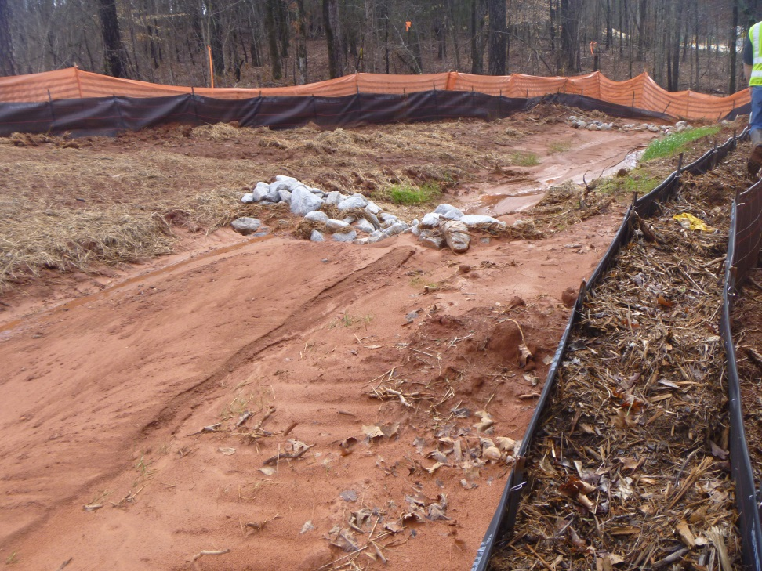
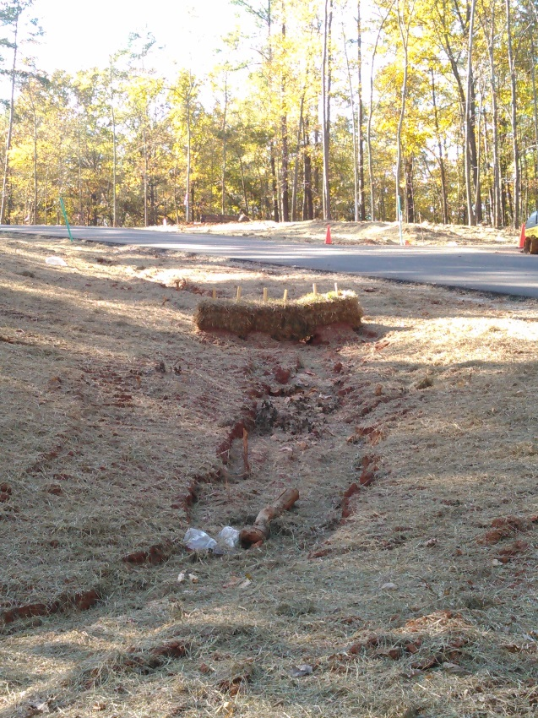
Cd - Check Dam
What to look for:
  Is the center of the check dam lower than the outer edges?
  Is the toe of the upstream dam at the same elevation as the top of the downstream dam?
  Does the channel flow exceed 2 cfs? If yes, then other BMPs are needed
  If Cd-Hb, has a splash pad been installed?
Sediment overtopping
Undermining
No splash pad

Slide 17
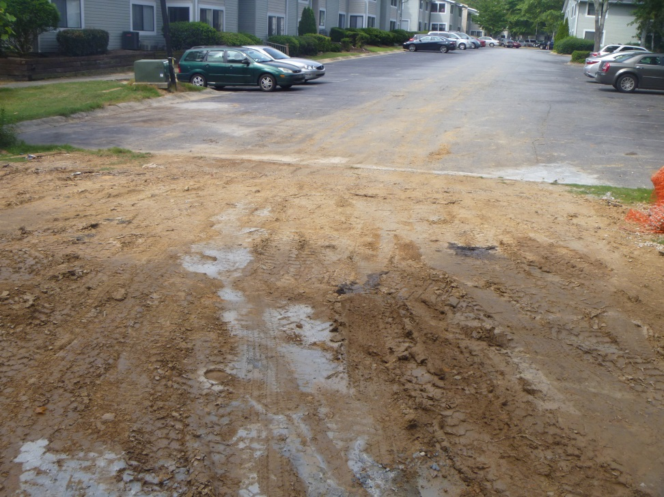
Co – Construction Exit
What to look for:
  Is the exit the appropriate length and width?
  Has the correct size rock been used?
  Has the geotextile been placed under the rock?
  Is sediment tracked onto the roadway?
No rock
No geotextile
Sediment tracked on road

Slide 18
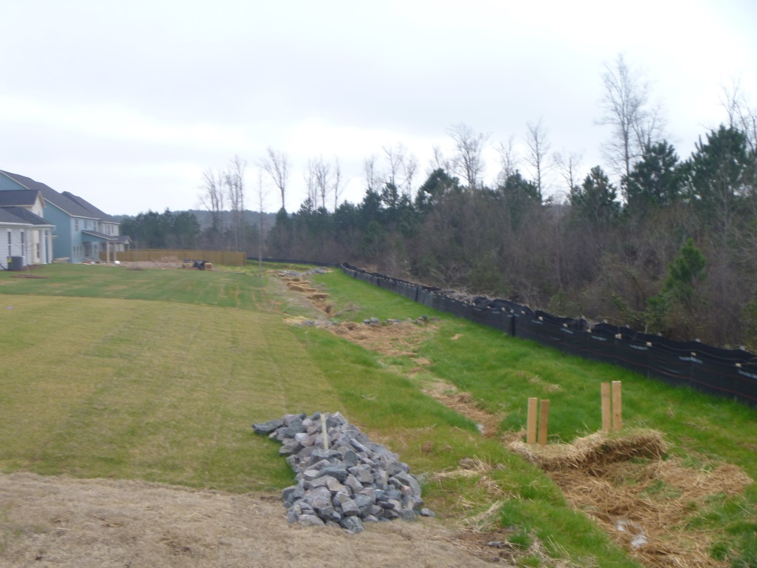
Di - Diversion
What to look for:
  Does the diversion have a ridge?
  Does the ridge have a minimum width of 4 feet?
  Does the diversion have an adequate outlet?

Slide 19
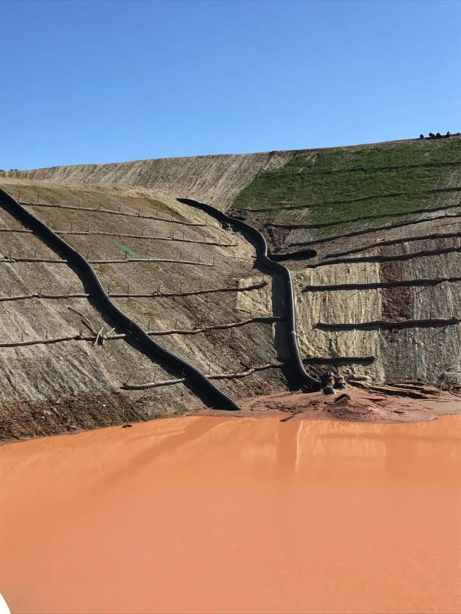
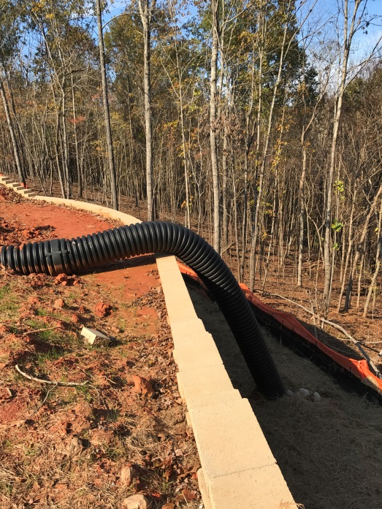
Dn – Downdrain Structure
What to look for:
  Is the structure properly staked?
  If the slope is steeper than 2:1, are the drains placed diagonally across the slope?
  Has outlet protection been installed?
  Is the pipe diameter appropriate for the drainage area?
Improper installation

Slide 20
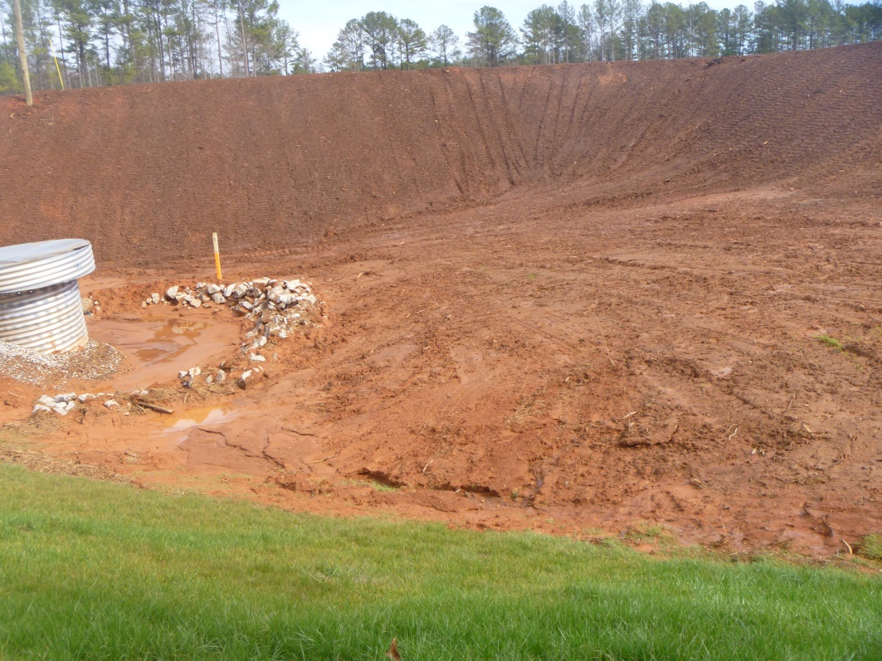
Fr – Filter Ring
What to look for:
  Is the filter ring constructed with the proper stone size?
  Are other BMP control measures being used?
  Is it a minimum of 2 feet tall?
  Is the filter ring kept clear of trash & debris?
Sediment overtopping
Maintenance

Slide 21
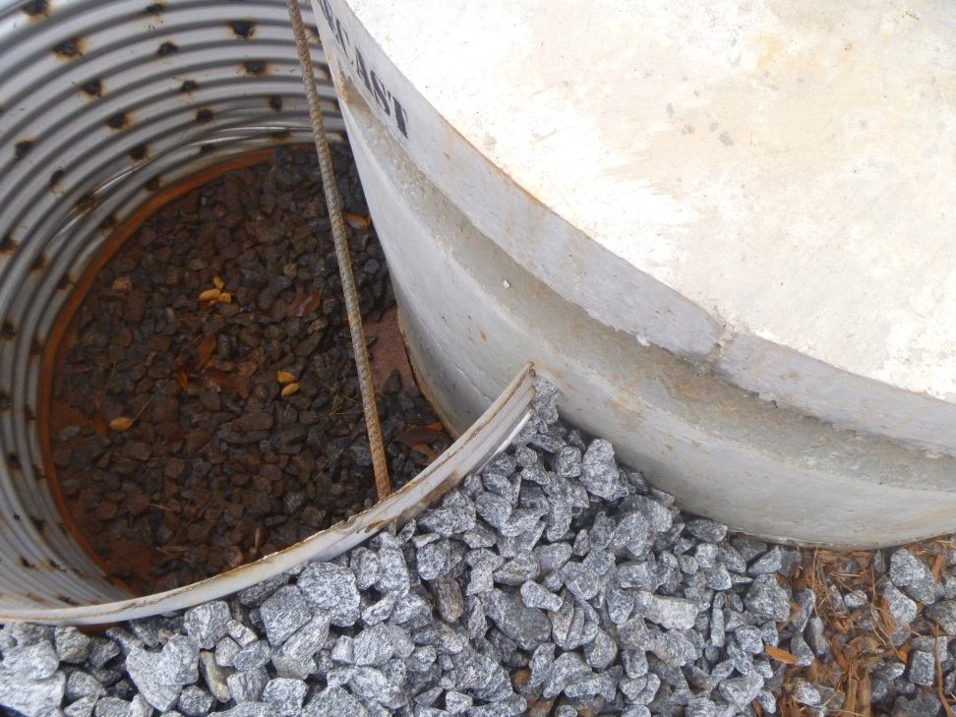
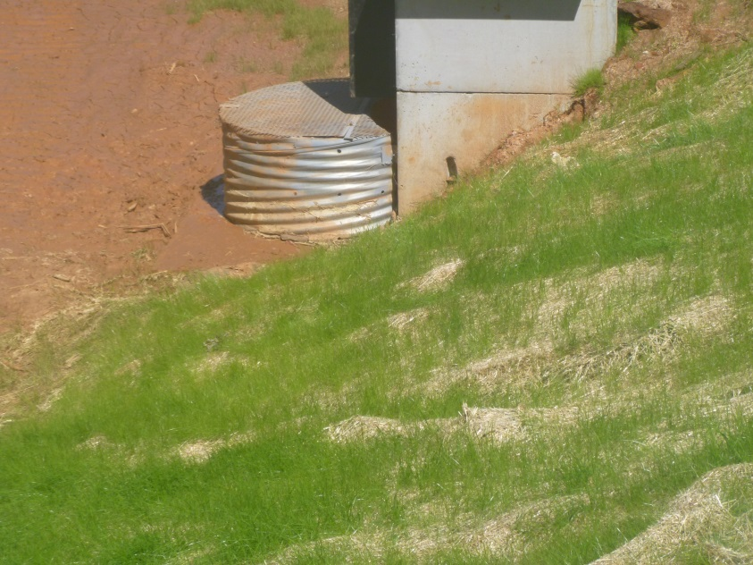
Rt - Retrofit
What to look for:
  Has the half-round been affixed to the structure?
  Has the correct size rock been used?
  Is the structure being cleaned out at 1/3rd full?
Not securely attached to structure
Improper hole size & spacing

Slide 22
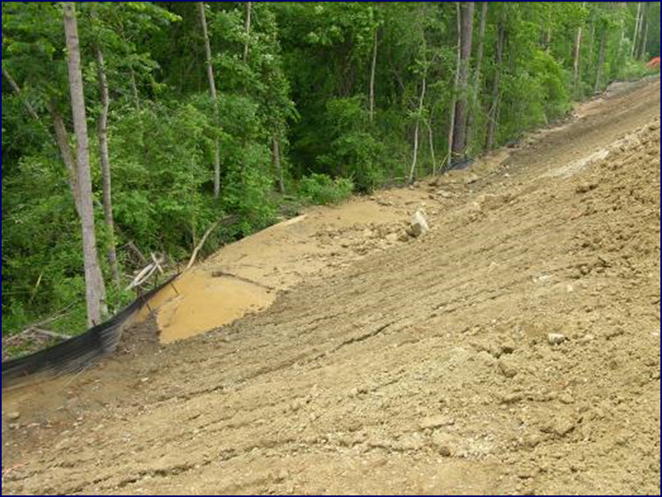
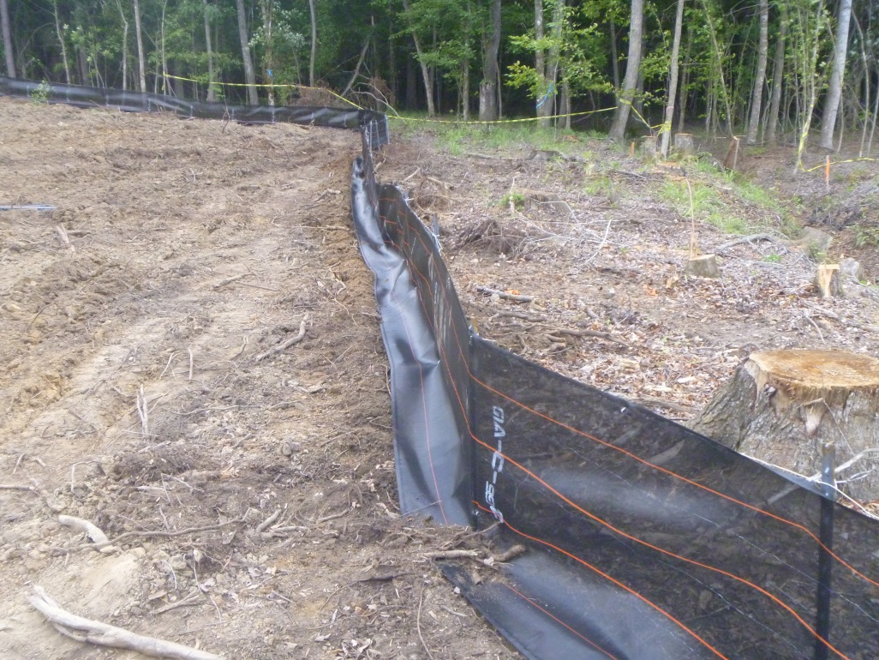
Sd1 – Sediment Barrier
What to look for:
  Has the appropriate type been installed?
  Is the silt fence trenched in?
  Is the barrier being cleaned out at ½ full?
  Has the barrier been installed in an area of concentrated flow?
  Is the barrier being maintained at 80% of its original height?
Maintenance
Not trenched in

Slide 23
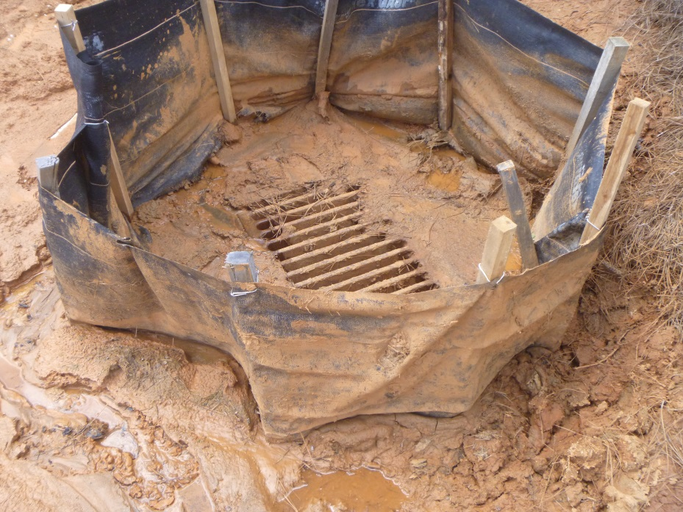
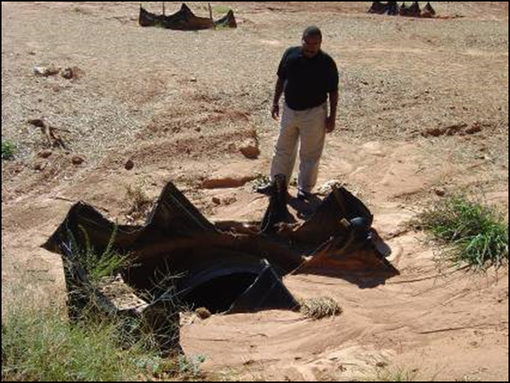
Sd2 – Inlet Sediment Trap
What to look for:
  Is the trap self draining?
  Does the installed practice match the need?
  Is the trap being cleaned out at ½ the height?
Maintenance
Installation

Slide 24
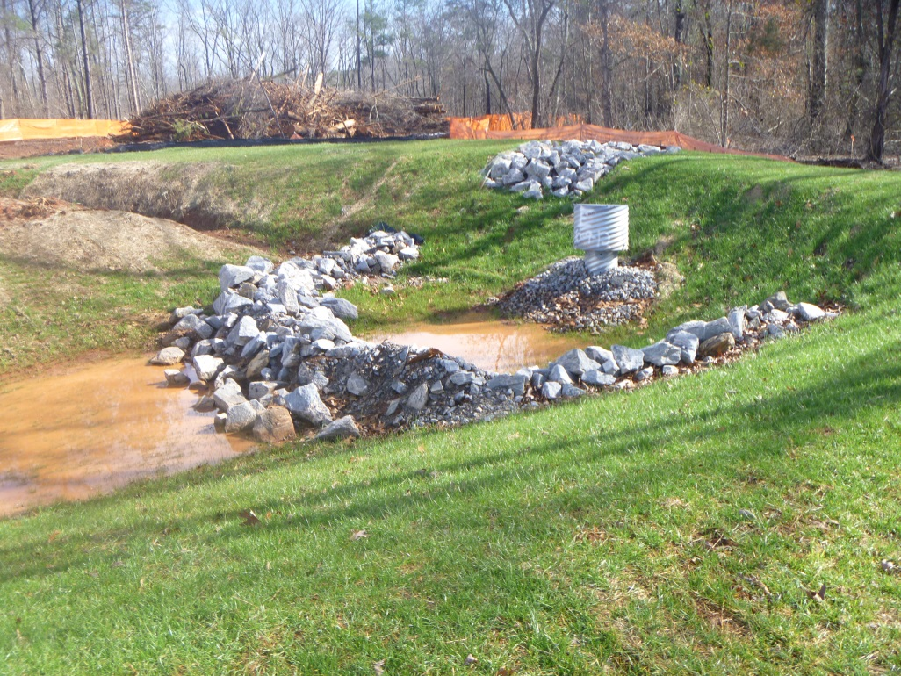
Sd3 – Temporary Sediment Basin
What to look for:
  Has emergency spillway been installed?
  Has the basin been properly stabilized?
  Is there a clean out marker?
  Does the riser have the correct size holes and stone placed around?
  Is a trash rack in place?
Proper construction

Slide 25
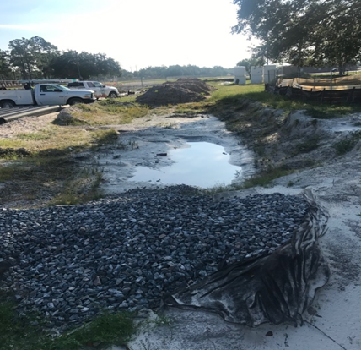
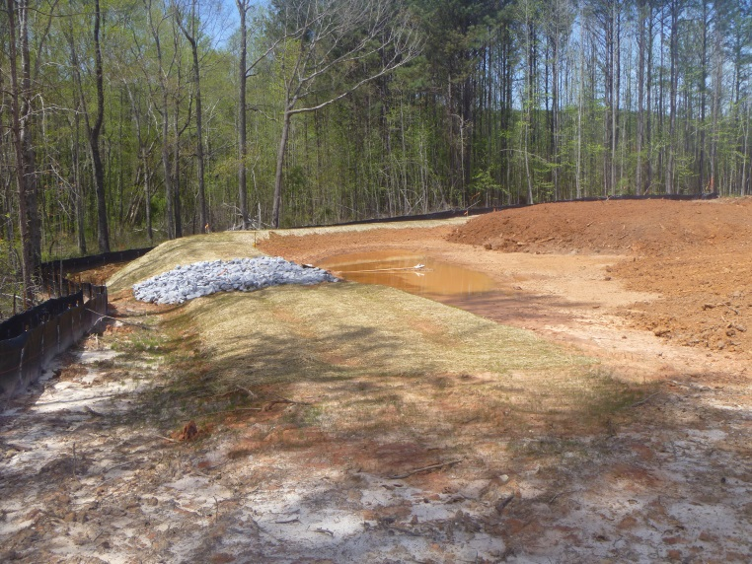
Sd4 – Temporary Sediment Trap
What to look for:
  Has the appropriate sediment trap been constructed? (A, B, or C)
  Is the length:width ratio greater than 2:1?
  Is the trap being maintained at 1/3 full?
No outlet
Proper installation

Slide 26
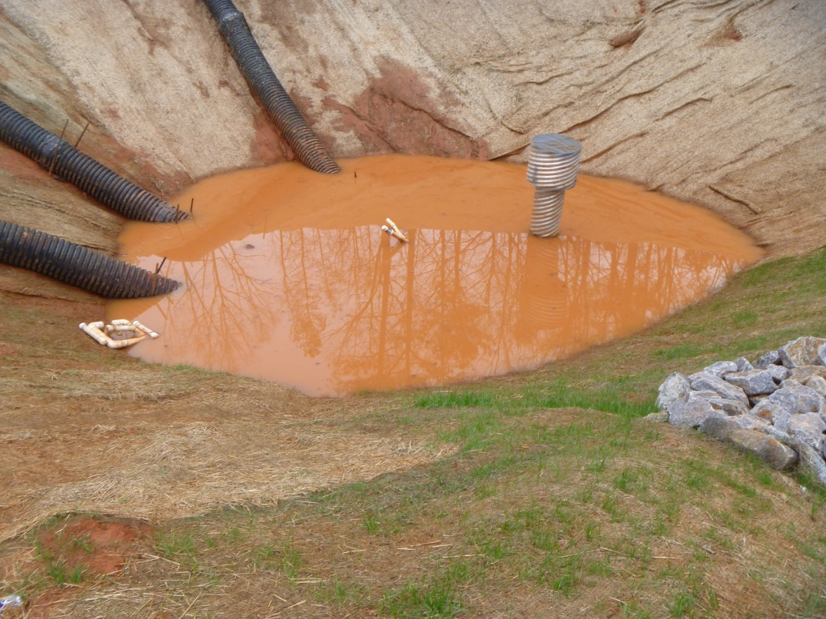
Sk – Floating Surface Skimmer
What to look for:
  Is the skimmer stuck in the mud?
  Has the device been damaged or clogged?
  Is the skimmer properly attached to the outlet structure?
  Is a portion of the skimmer visible at all times?
Damaged – needs repair

Slide 27
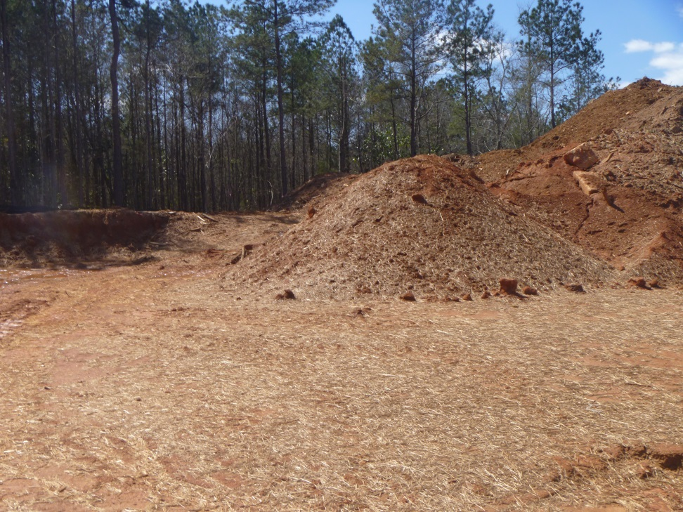
Tp - Topsoiling
What to look for:
  Has the stockpile been stabilized properly?
  Is it contained by a sediment barrier?
  Is a uniform application of 5” unsettled being used when applying topsoil?
No sediment barrier
Not stabilized

Slide 28
Vegetative Practices
What to look for?

Slide 29
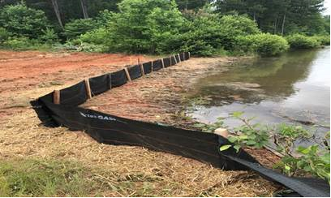
Bf – Buffer Zone
What to look for:
  Is a buffer delineated on the Plan?
  Is there a buffer encroachment?
  In sensitive areas, have 2 rows Sd1-S been installed?
Cleared entire buffer
Not two rows Sd1-S

Slide 30
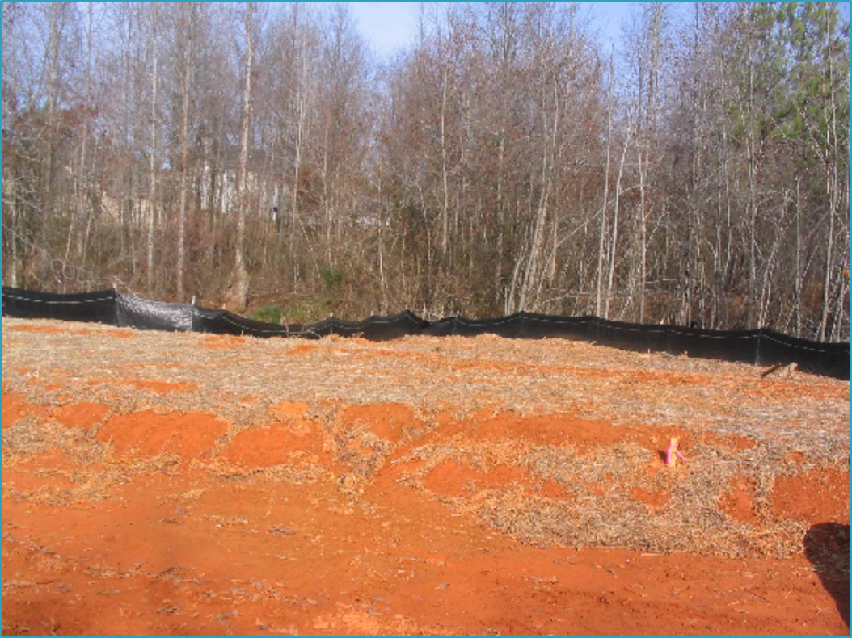
Ds1 - Mulching
What to look for:
  Has mulch been applied to all disturbed areas within 14 days?
  Has it been applied to an appropriate depth?
  Has it been anchored?
  Is it older than 6 months?
Not applied at proper depth
Coverage not maintained

Slide 31
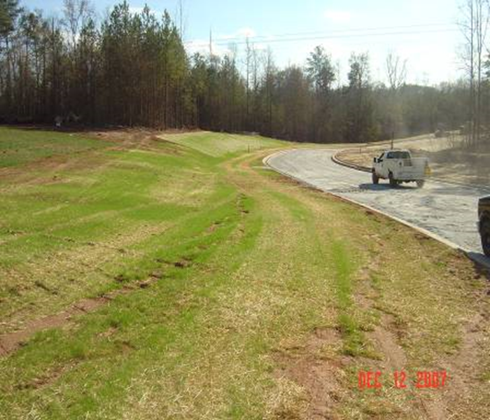
Ds2 – Temporary Seeding
What to look for:
  Has the right species been selected for the time of year?
  Has an adequate stand emerged?
  Will this species be in place for less than 6 months?
Adequate stand present

Slide 32
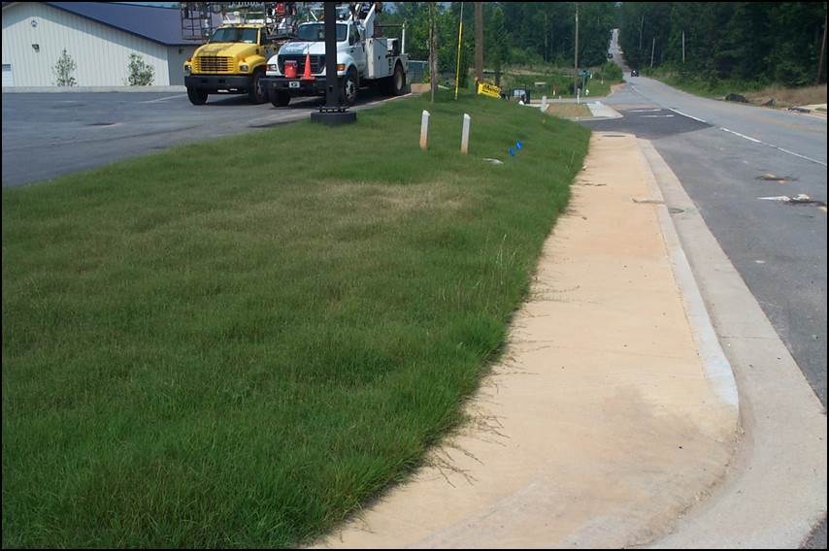
Ds3 – Permanent Seeding
What to look for:
  Has the right species been selected for the time of year?
  Is 100% of soil surface uniformly covered with a 70% density or greater?
  Is a 6” top growth being maintained?
Uniformly covered

Slide 33
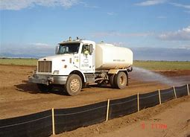
Du – Dust Control
What to look for:
  Is there evidence of dust on site?
  What control method is being used?
  If using the spray method, has traffic flow been prohibited?

Slide 34
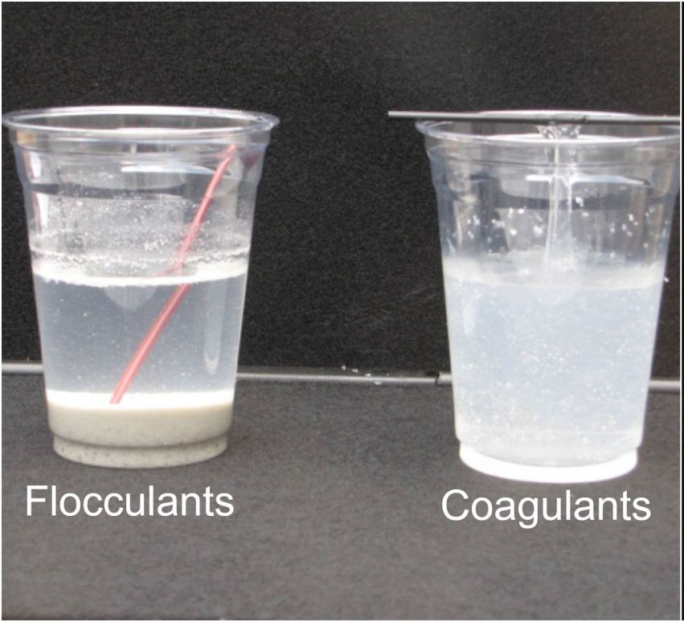
Fl-Co – Flocculants & Coagulants
What to look for:
  Have only anionic forms been used?
  Has it been applied to surface waters of the state?
  Has it been applied in the appropriate storm water ditches or storage basins?

Slide 35
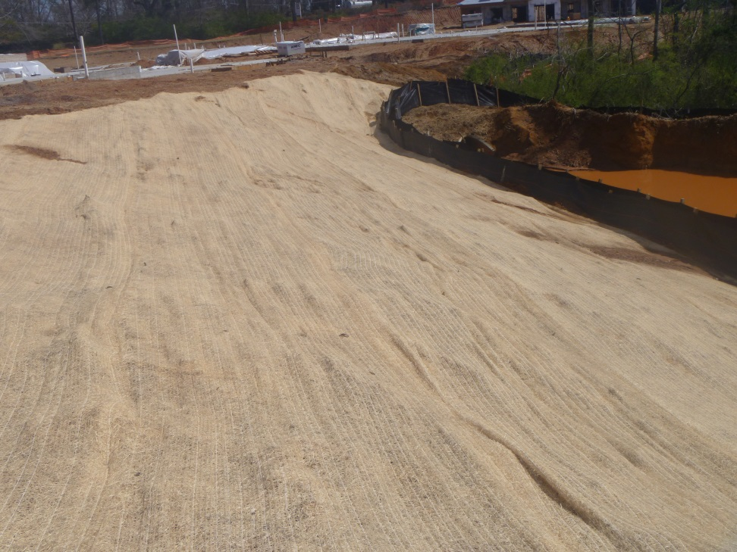
Ss – Slope Stabilization
What to look for:
  Have the blankets been rolled & anchored properly?
  Does the Plan specify RECP or HECP?
  Are there any failures, washouts, or dislocations?
  Has HECP been applied per manufacturer’s directions?
RECP
Incorrect installation

Slide 36
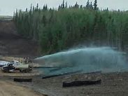

Tac - Tackifiers
What to look for:
  What type of tackifier is being used?
  Are only anionic forms being used?
  Are tackified areas checked after rain events?
  Have soil infiltration rates been reduced?

Slide 37
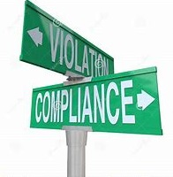
Enforcement
Violations
Interactions

Slide 38
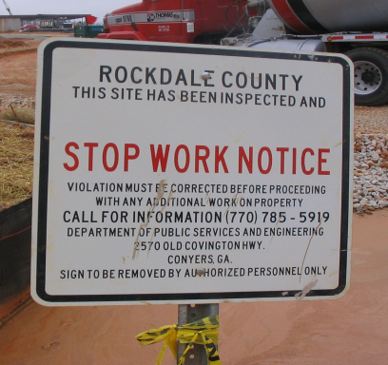
Notice of Violation
First & Second Violation
  A written warning is issued to the permittee
  The permittee shall have five (5) days to correct the violation
  If the violation is not corrected within five (5) days, an immediate stop work shall be issued
Third Violation
  An immediate stop work order shall be issued
GESA: OCGA 12-7-12(c)

Slide 39
Handling Violations
The inspection records written by an inspector are the basis for enforcement and civil penalties
Remember
  Write a report for each inspection conducted at the site
  Take a substantial amount of pictures
  Always write the report at the site so that you don’t forget anything
For consultants, this is your client’s best defense against a violation

Slide 40
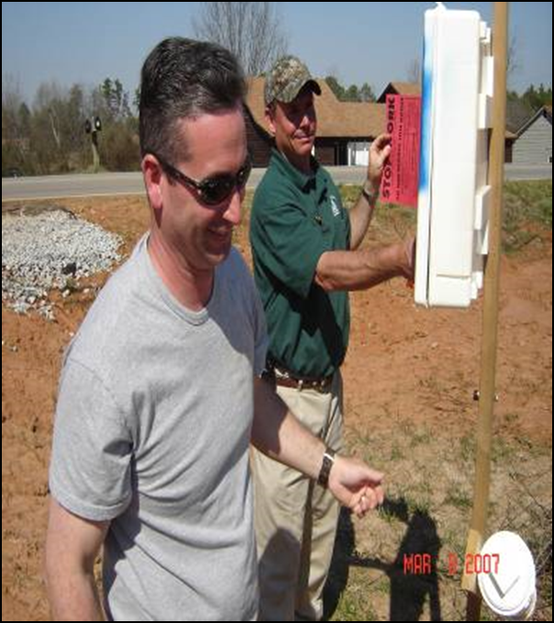
Interactions at the Site
As an inspector you will be dealing with a wide range of people.
To be effective, you must follow the law and be fair and consistent when enforcing it.
You must conduct yourself in a professional manner

Slide 41
Dealing with Difficult People
An inspector will often have to handle heated situations
Often times you will not have time to prepare a response and you must resolve the situation immediately.
The following are a list of steps that can be used to resolve a heated situation

Slide 42
Key Steps
Maintain a friendly and professional attitude
  Don’t argue with the person
  Show that you have interest in their problem
  State that you would like to help them solve it
  Don’t let their anger get to you
  Don’t take what they say personally

Slide 43
Key Steps
Acknowledge that a difficult situation exists
  Show that you take the complaint seriously
  Choose your words carefully
  Use a tone that demonstrates understanding
  Respond to what the person is saying
  If you owe an apology, apologize only for the specific incident

Slide 44
Key Steps
Calm the individual by questioning and verifying
  Demonstrate that you are willing to work with them
  Don’t assume anything, ask specific questions
  Respond to show that you understand the problem
  Be sure that you and the person are on the same page

Slide 45
Key Steps
Involve the person in solving the problem
  Ask the person to help you solve the problem
  Request suggestions and offer your assistance to correct the situation
  Explain the law and regulations and the reasoning behind them
  Continue to ask questions to keep their focus on the problem

Slide 46
Key Steps
Handle the problem
  Be positive
  Focus on the most feasible solution
  Decide on a follow-up action to ensure the problem has been resolved

Slide 47
References
Manual for Erosion and Sediment Control in Georgia
  2016 Edition - GSWCC
NPDES Permits GAR100001,100002,100003
Conducting Environmental Compliance Inspections: Inspector’s Field Manual, International Edition
  Office of Enforcement and Compliance Assurance - Environmental Protection Agency
Florida Erosion and Sediment Control Inspector’s Manual
  Florida Department of Environmental Protection

Slide 48
Summary
Inspectors must be professional, fair and consistent
Inspectors must be technical authorities
Proper inspection procedures must be observed
Properly applied enforcement action promotes broader compliance
Knowing how to deal with people can go a long way

Slide 49

Questions?
GSWCC
Urban Program
4310 Lexington Road
Athens, GA 30605
(706) 552-4474

